Slide 3
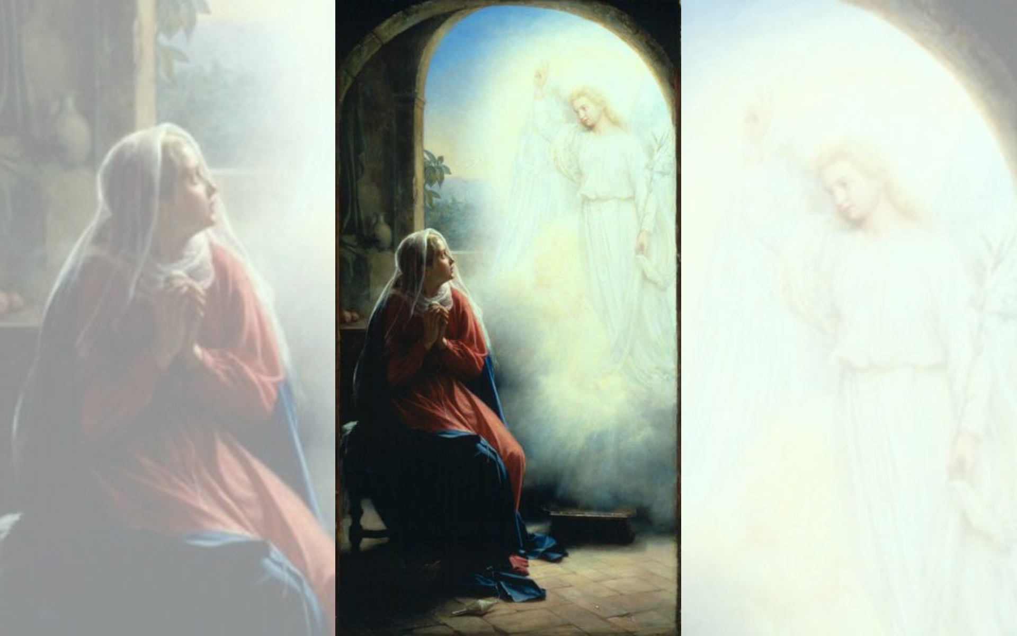
Title: The Annunciation
Artist: Carl Heinrich Bloch
Date unknown

Slide 4
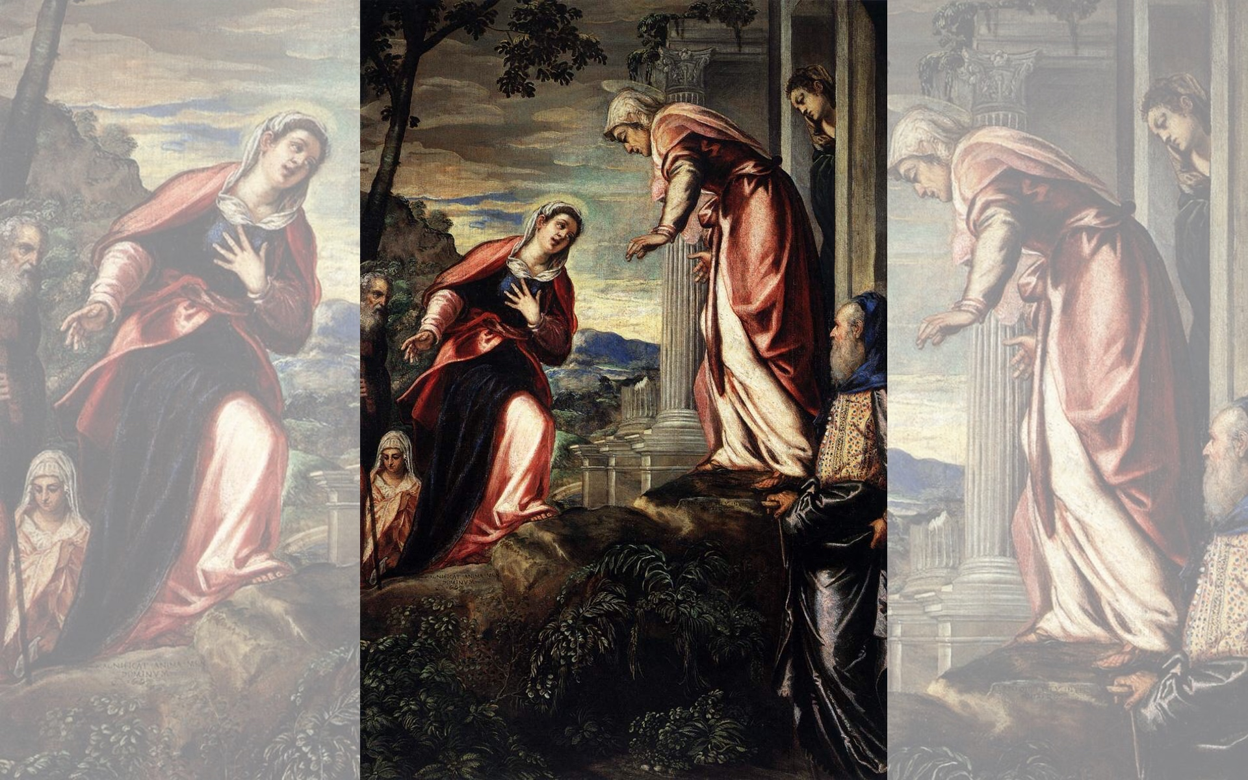
Title: The Visitation
Artist: Tintoretto
Year: 1549

Slide 5
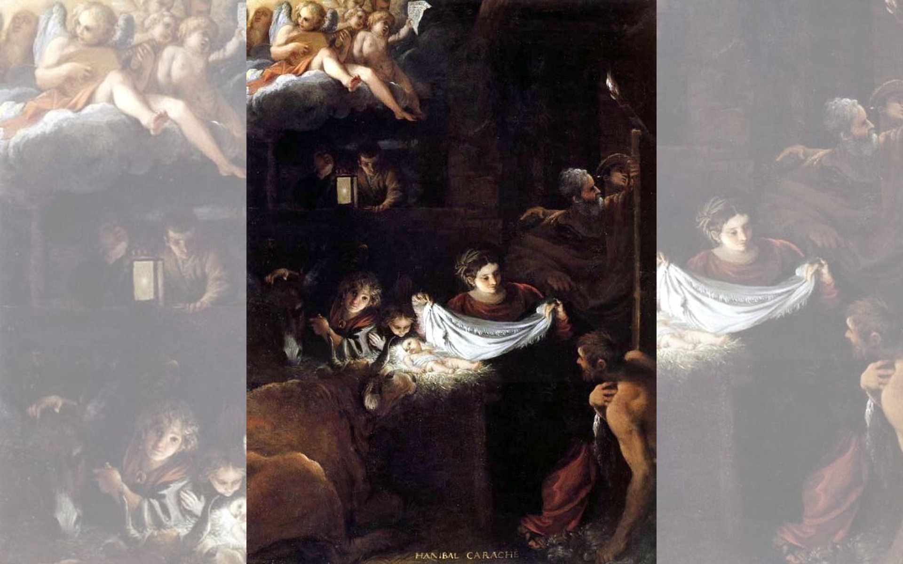
Title: Nativity
Artist: Francesco Albani
Year: c. 1600

Slide 6
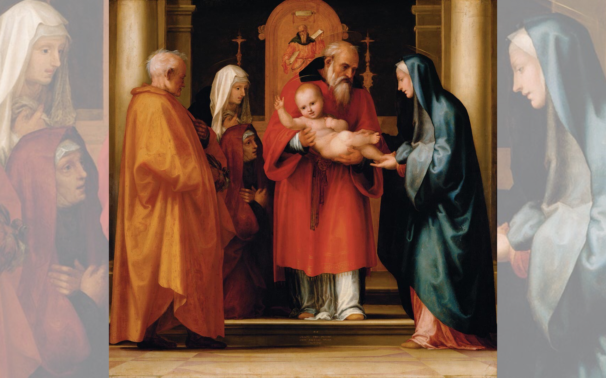
Title: The Presentation of Christ in the Temple
Artist: Fra Bartolomeo
Year: 1516

Slide 7
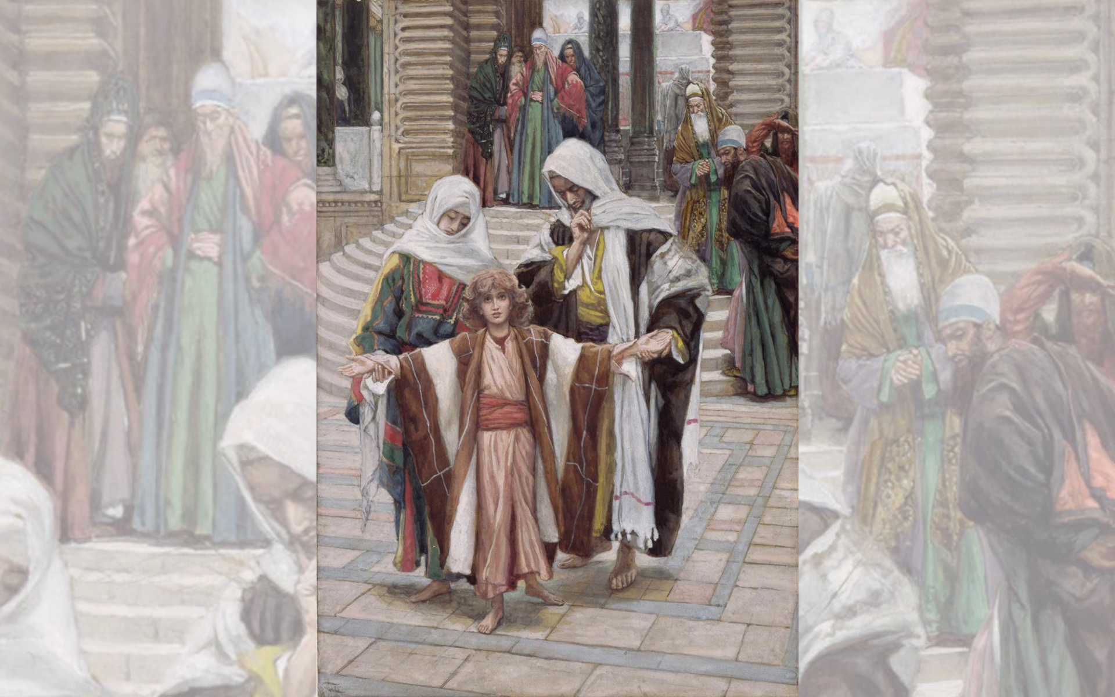
Title: Jesus Found in the Temple
Artist: James Tissot
Year: 1886-1894

Slide 9
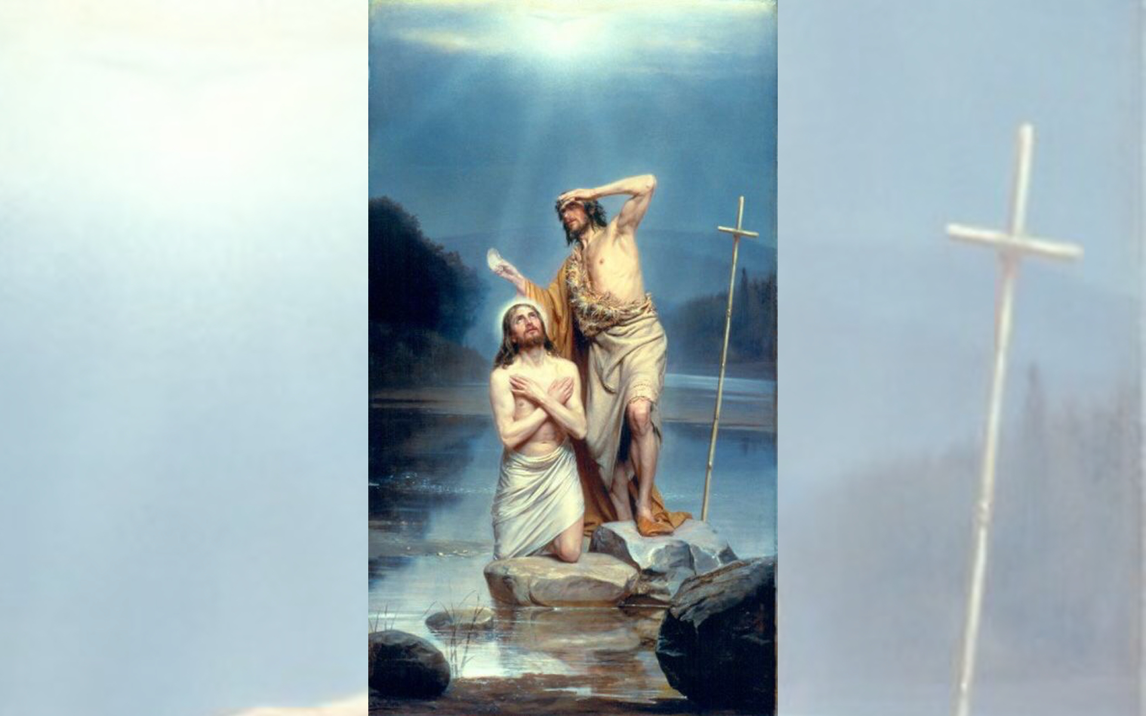
Title: The Baptism of Christ
Artist: Carl Heinrich Block
Date Unknown

Slide 10
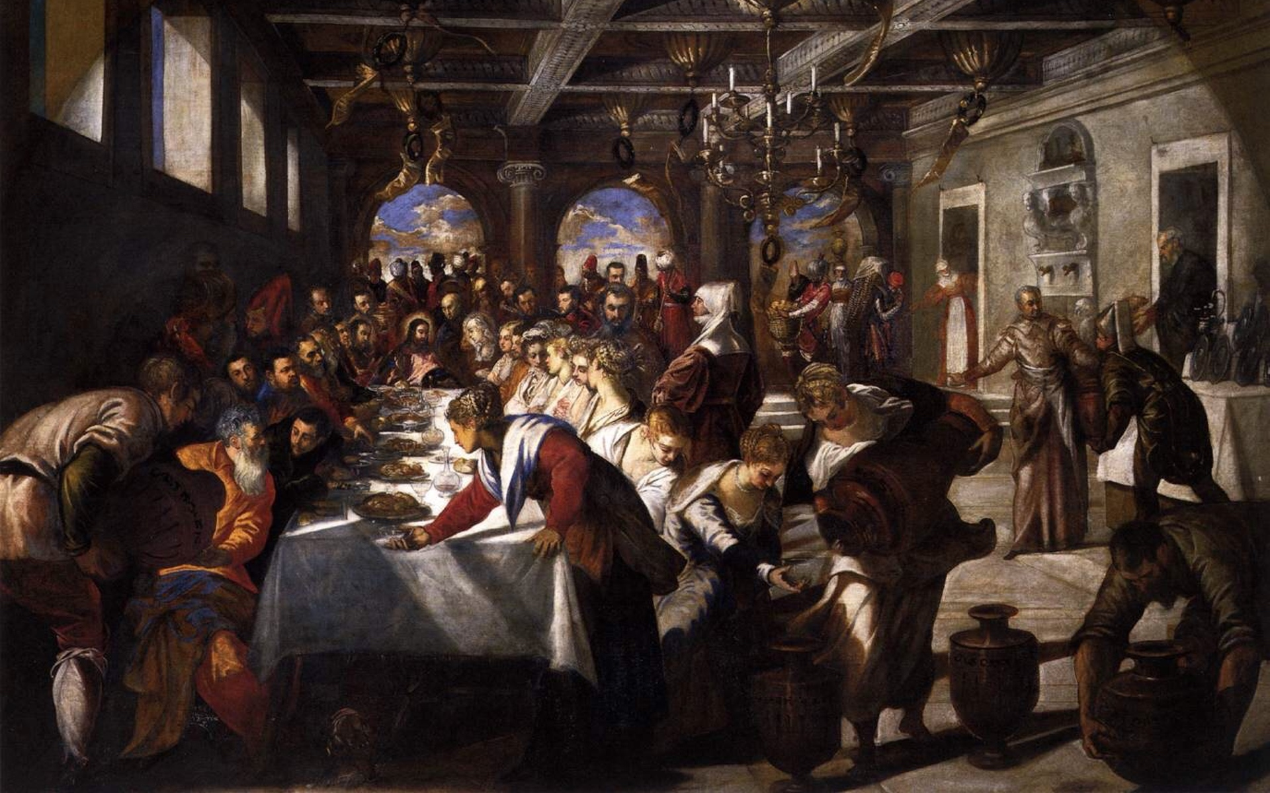
Title: Marriage at Cana, Artist: Tintoretto, Year: 1561

Slide 11
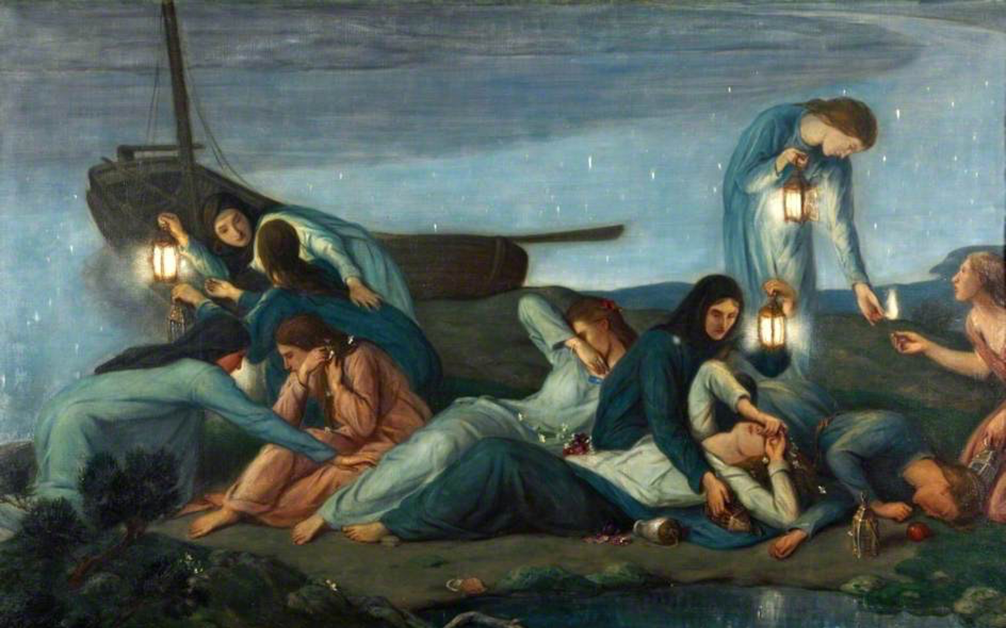
Title: The Wise and Foolish Virgins, Artist: Charles Haslewood Shannon, Year: 1920

Slide 12
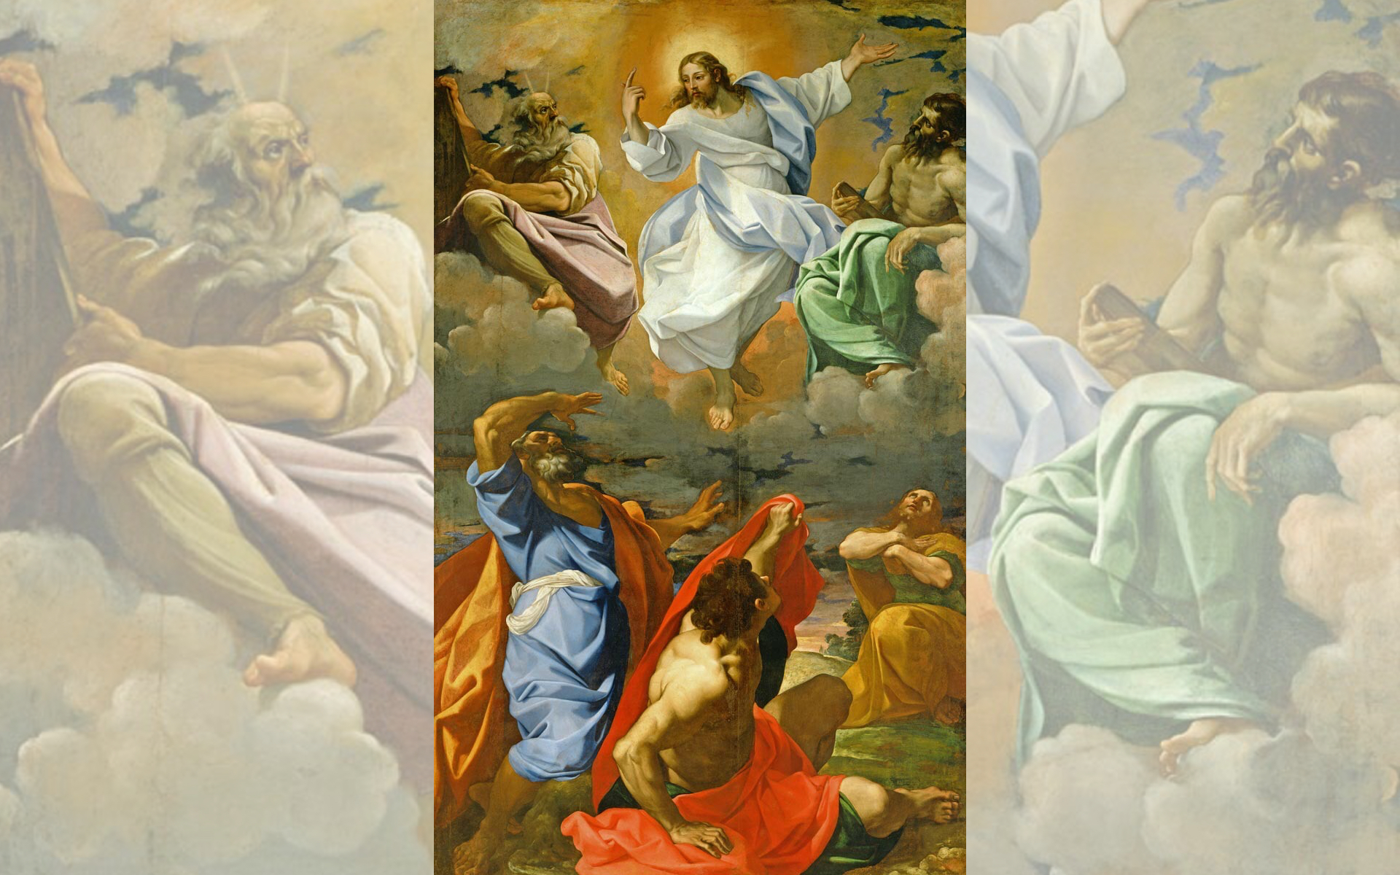
Title: The Transfiguration
Artist: Lodovico Carracci
Year: 1594-1595

Slide 13
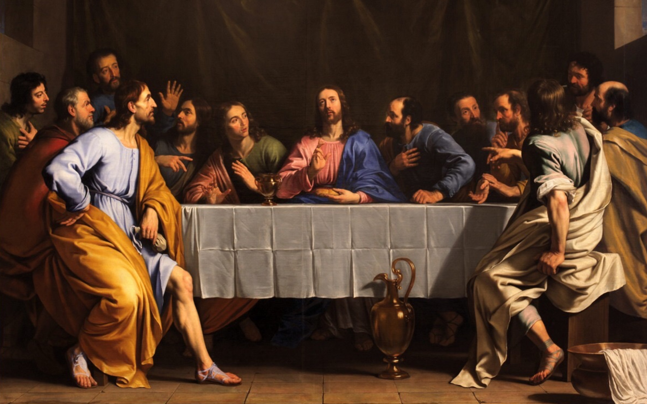
Title: The Last Supper, Artist: Philippe de Champaigne, Year: 1652

Slide 15
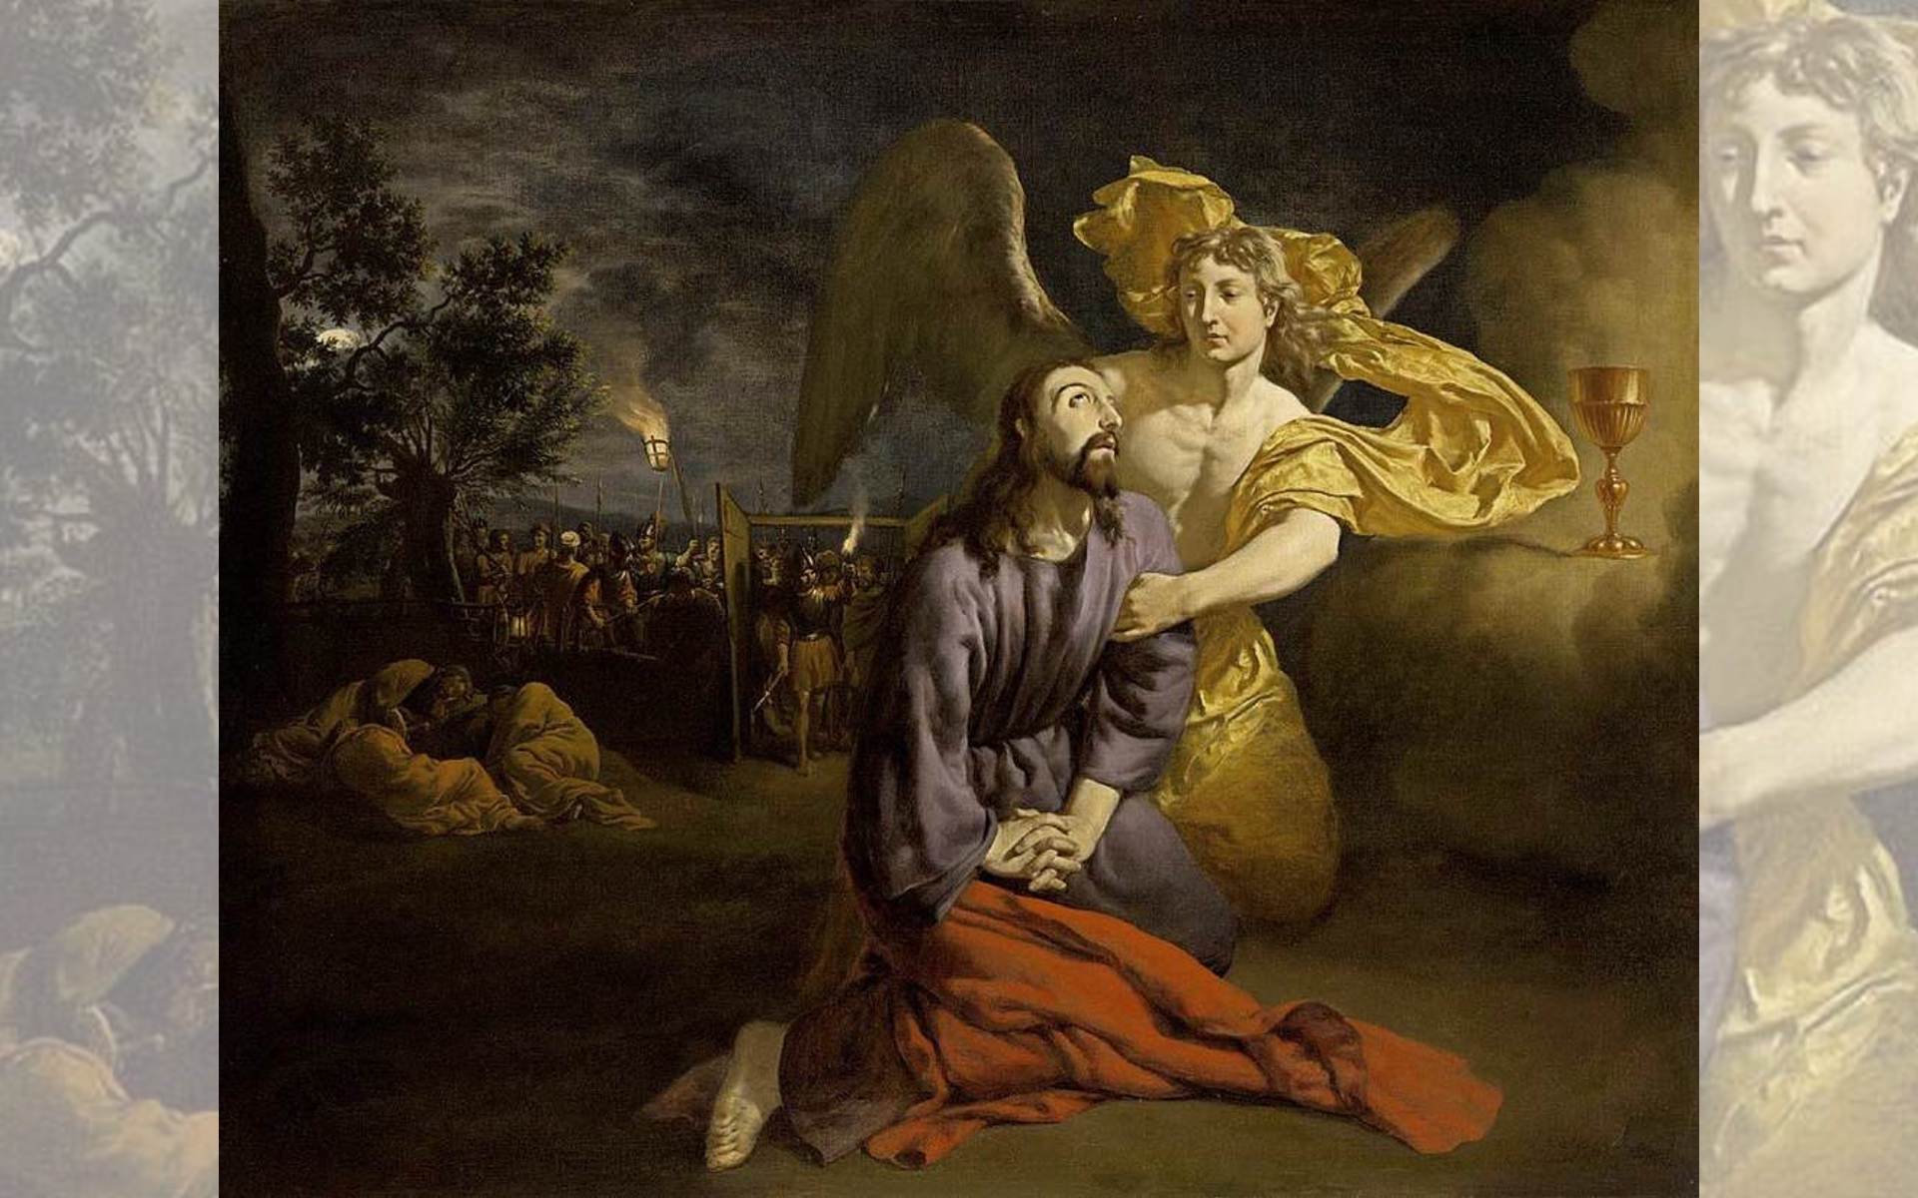
Title: Agony in the Garden, Artist: Adriaen van de Velde, Year: 1665

Slide 16
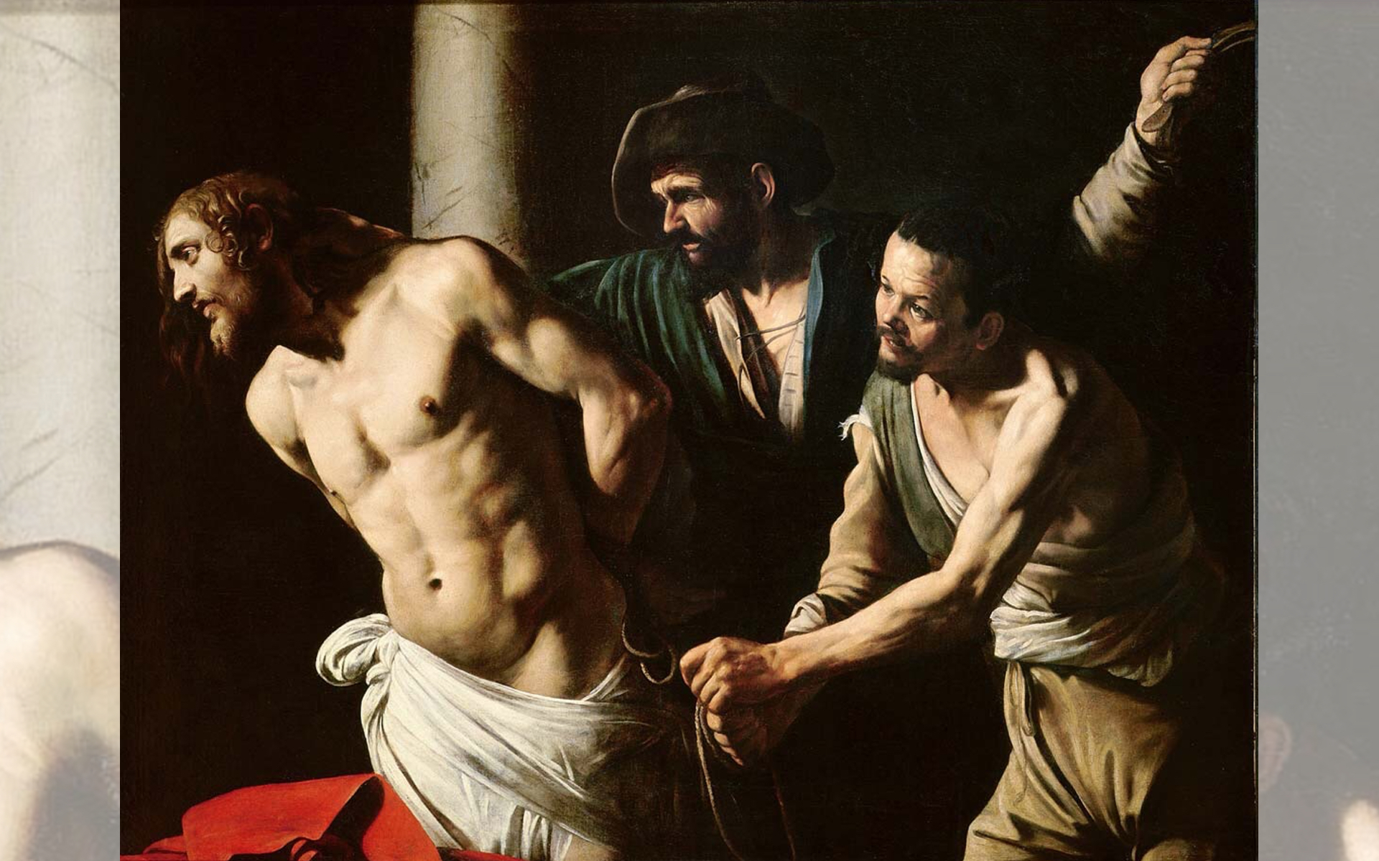
Title: Christ at the Column, Artist: Caravaggio, Year: c.1607

Slide 17
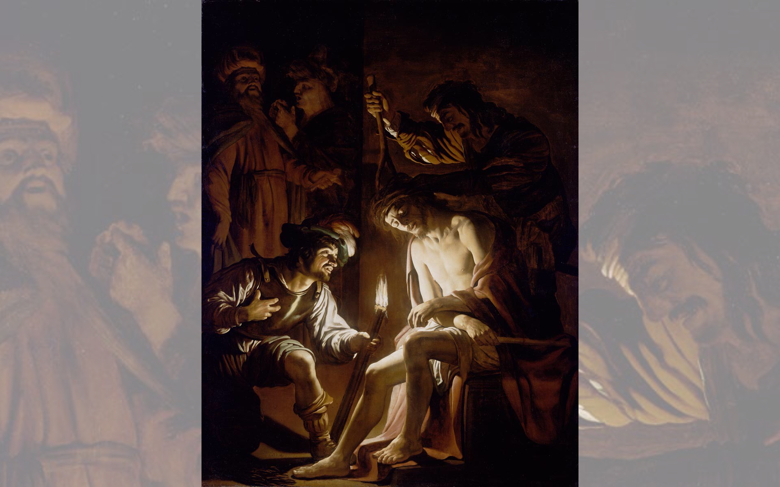
Title: Christ Crowned with Thorns
Artist: Gerrit van Honthorst
Year: c.1620

Slide 18
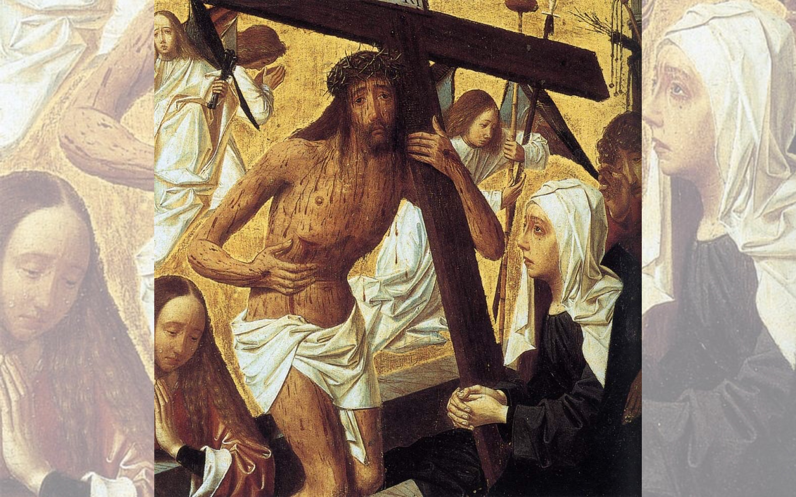
Title: Man of Sorrows
Artist: Geertgen toto Sint Jans
Year: 1495

Slide 19
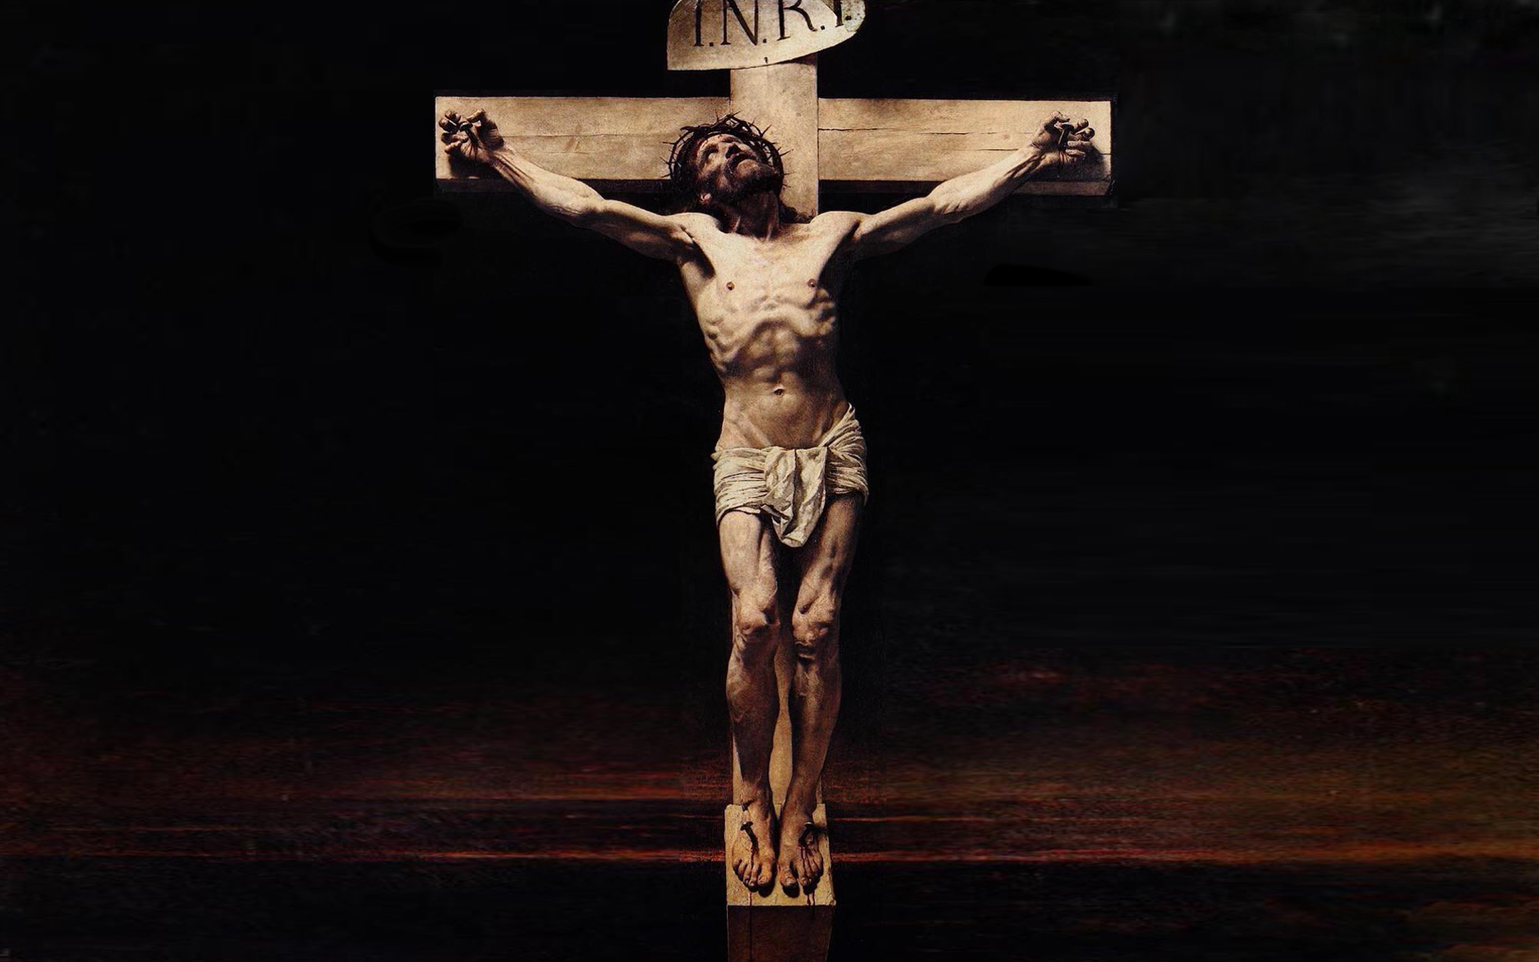
Title: Christ on the Cross, Artist: Léon Bonnat, Year: c.1874-1880

Slide 21
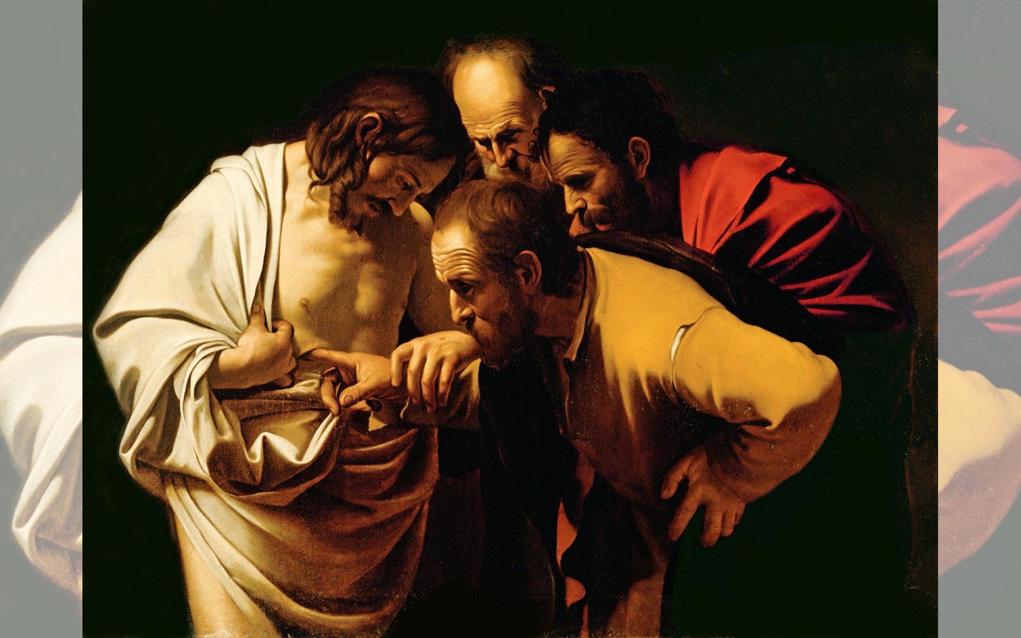
Title: Incredulity of Saint Thomas, Artist: Caravaggio, Year: 1601-1602

Slide 22
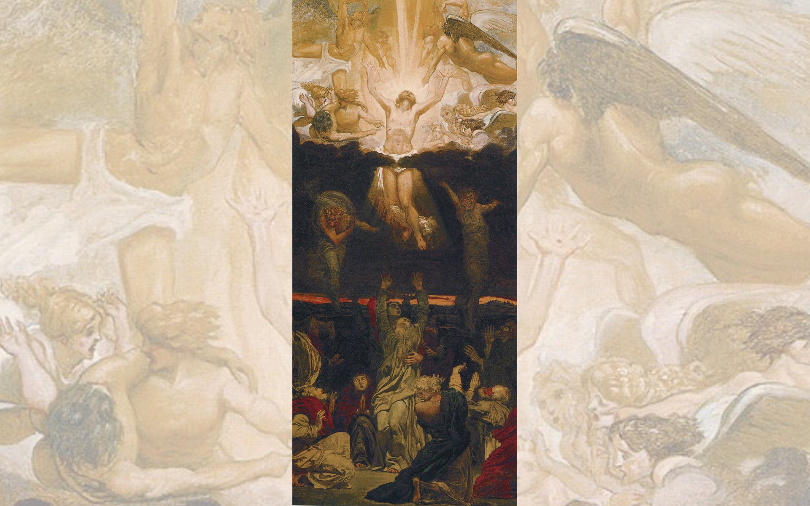
Title: Ascension,
Artist: Ford Madox Brown
Year: c.1843-1845

Slide 23
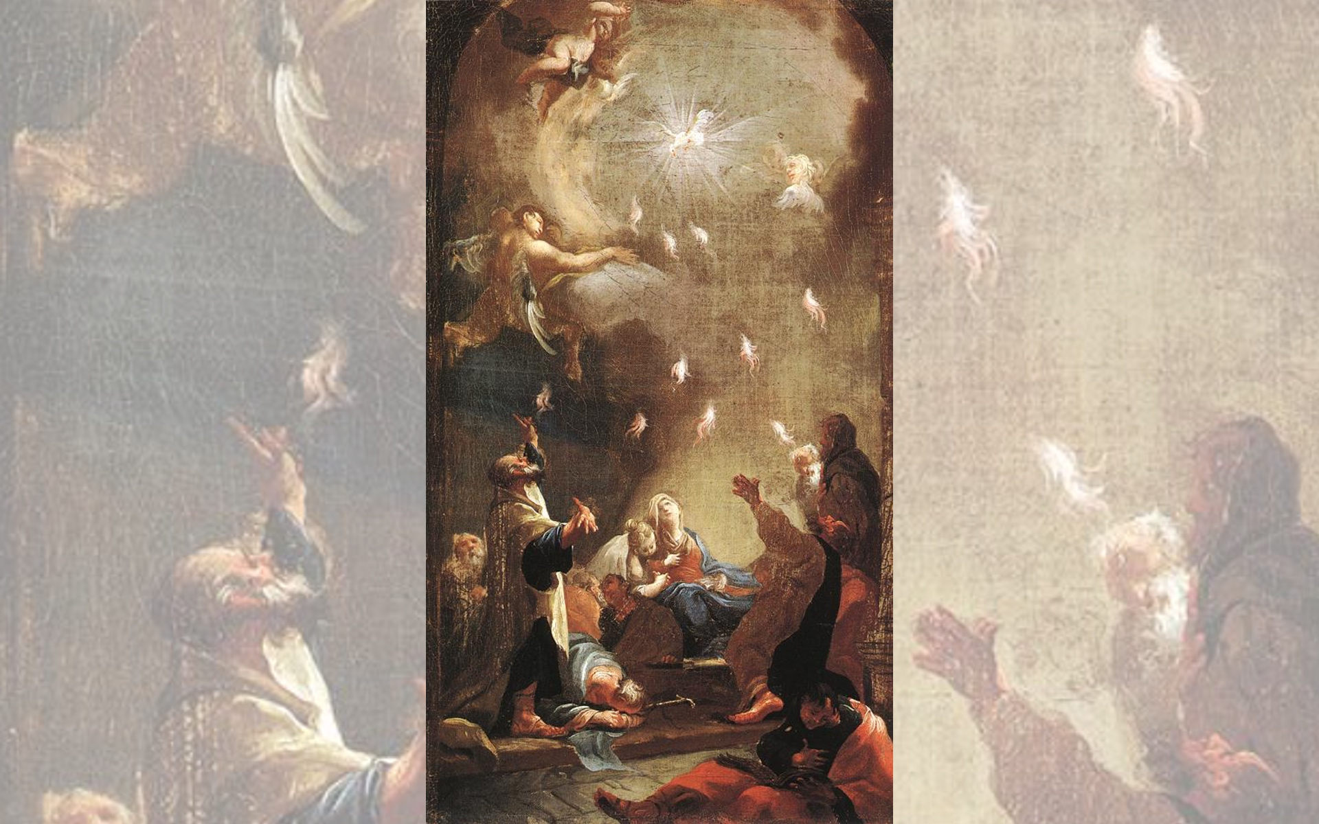
Title: Pentecost
Artist: Joseph Ignaz Mildorfer
Year: 1750s

Slide 24
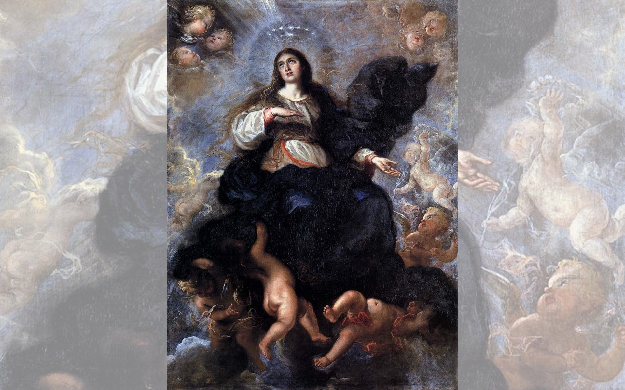
Title: Assumption of the Virgin
Artist: Juan Carreño de Miranda
Year: 1657

Slide 25
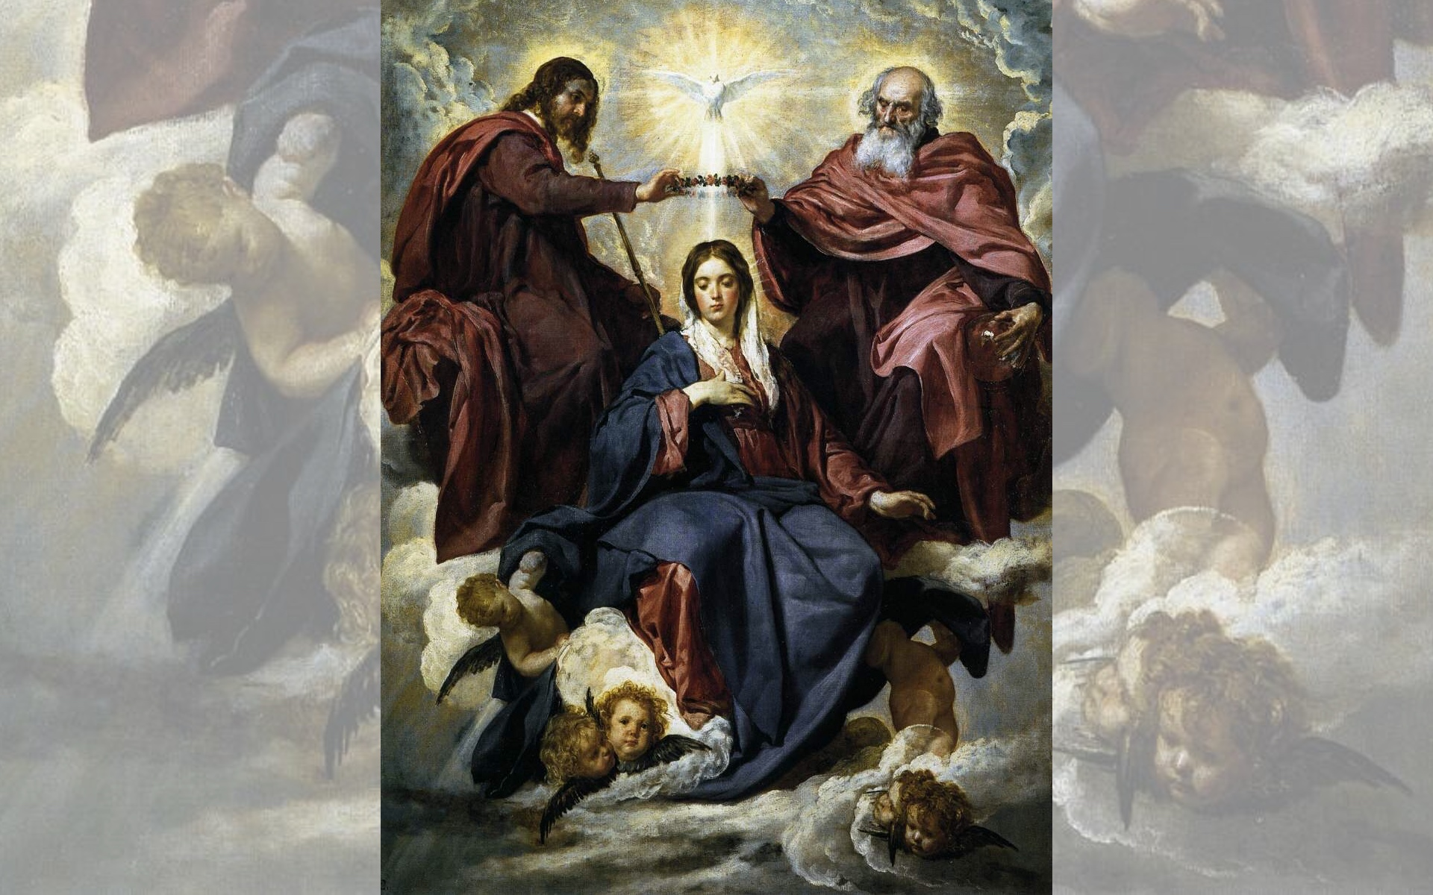
Title: The Coronation of the Virgin,
Artist: Diego Velázquez
Year: 1645

