Slide 3
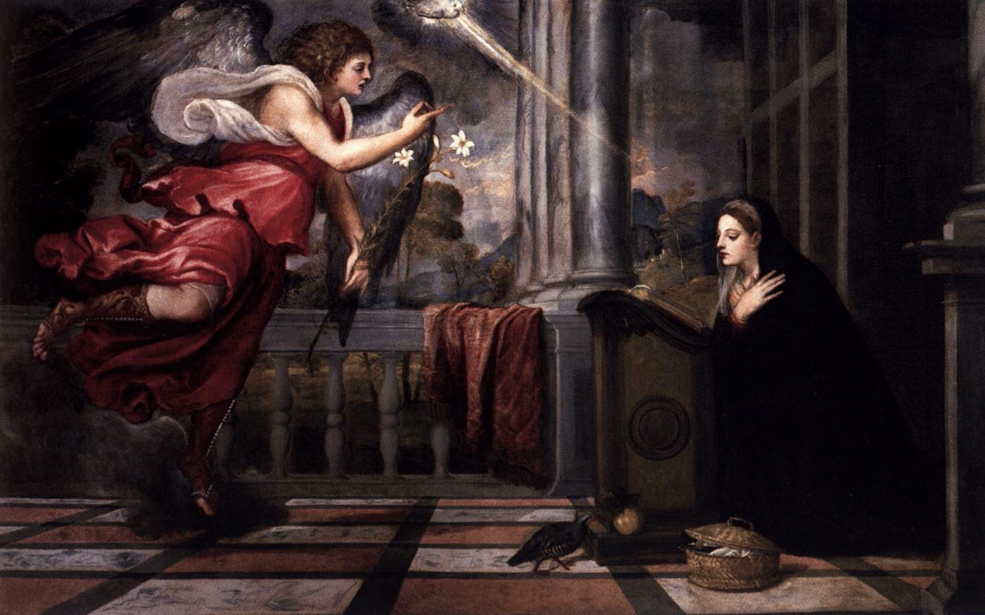
Title: Annunciation
Artist: Titian
Year: c. 1535

Slide 4
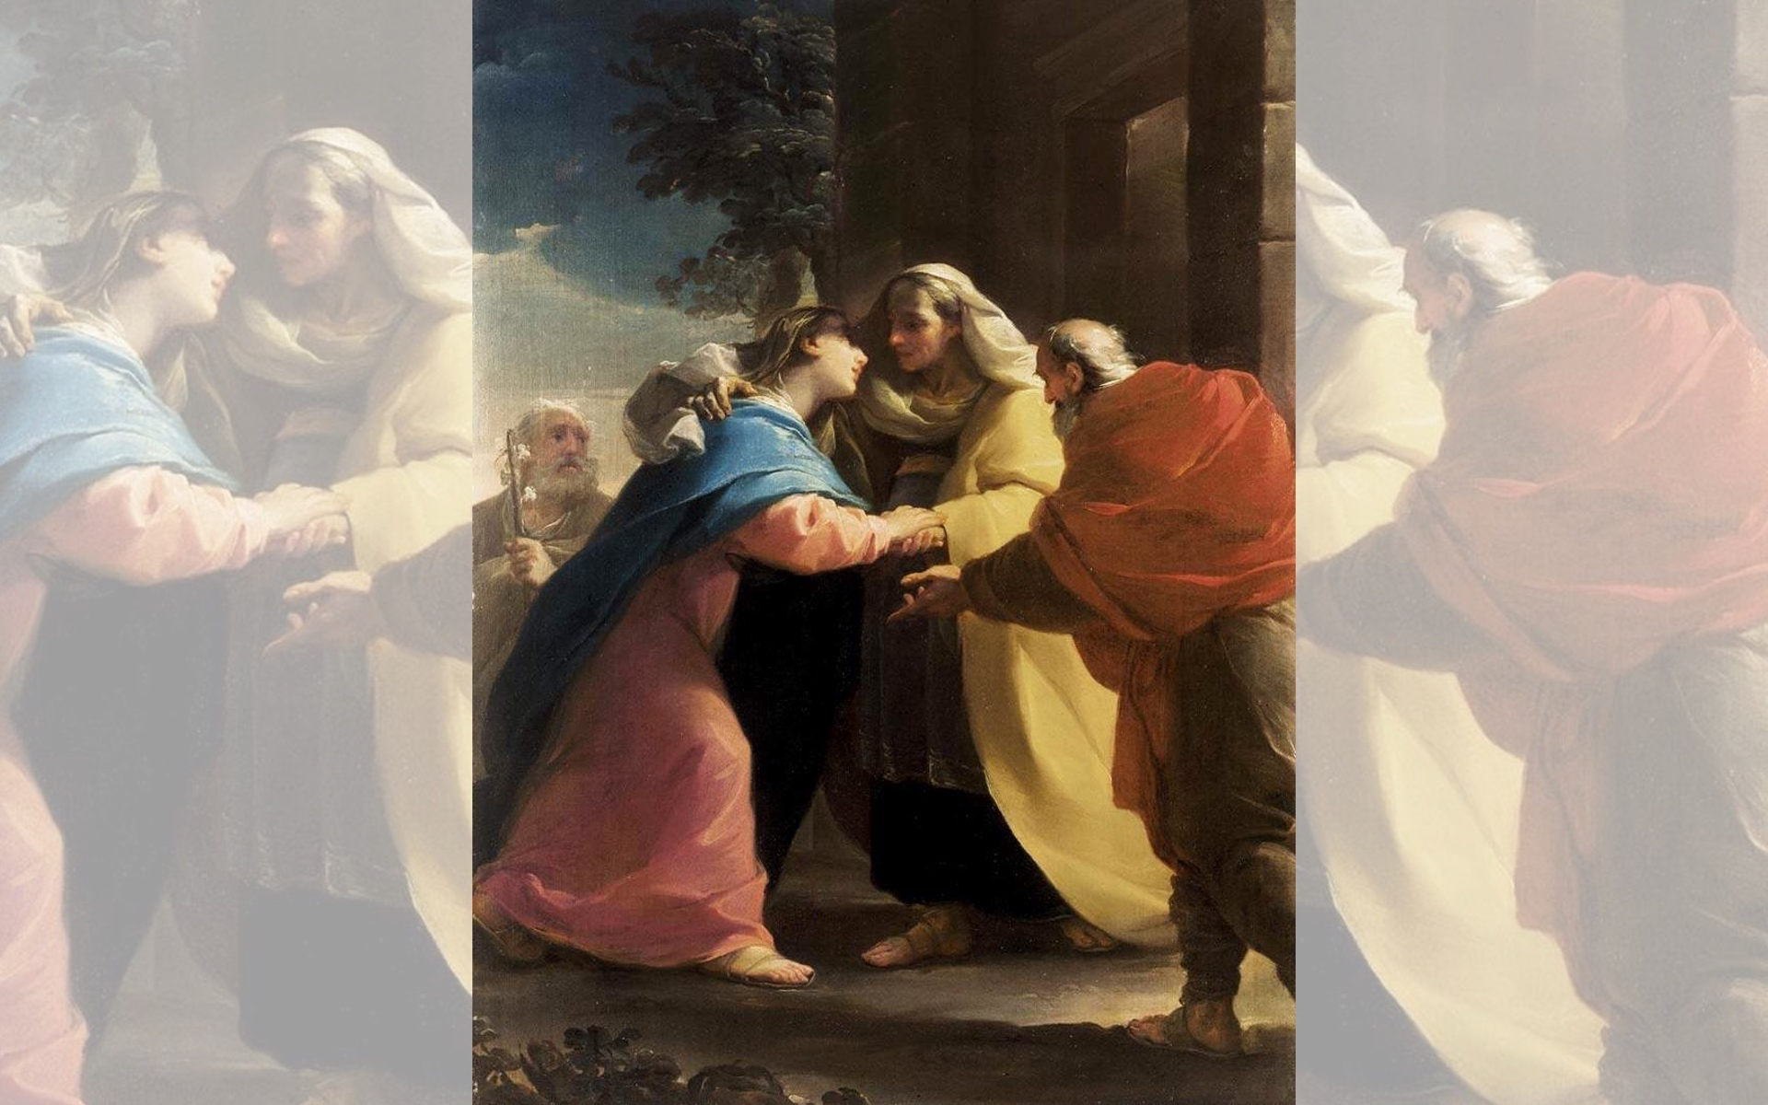
Title: The Visitation
Artist: Ubaldo Gandolfi
Year: c. 1767

Slide 5
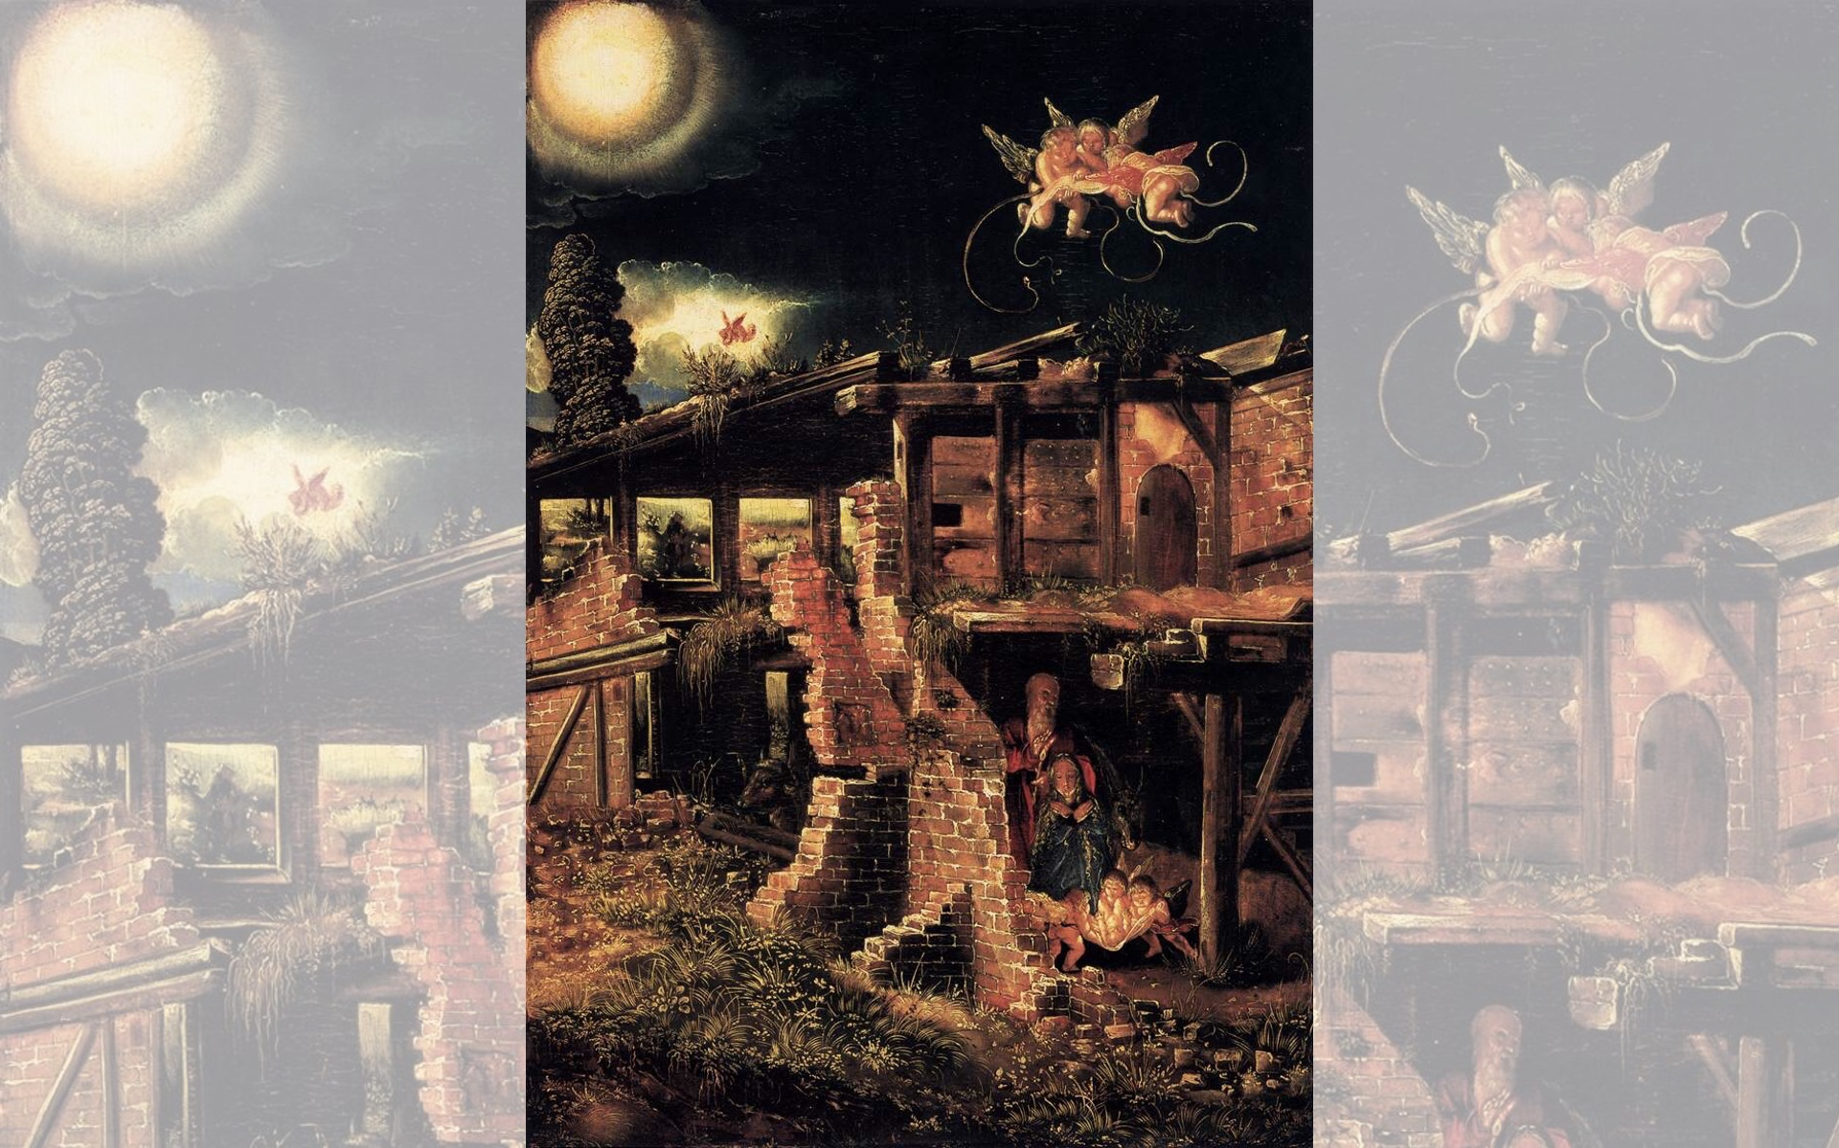
Title: Nativity
Artist: Albrecht Altdorfer
Year: 1513

Slide 6
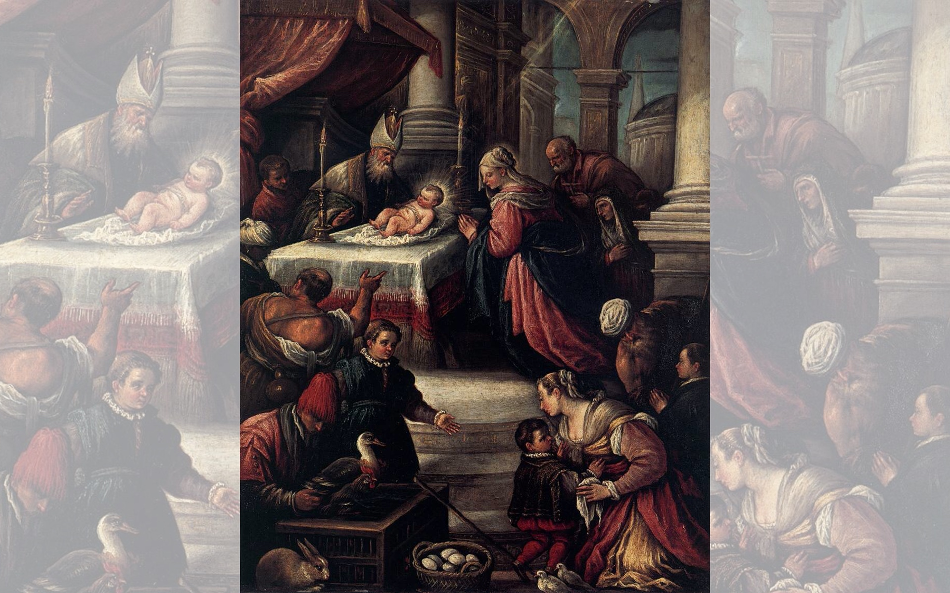
Title: The Presentation of Christ in the Temple
Artist: Francesco Bassano
Date Unknown

Slide 7
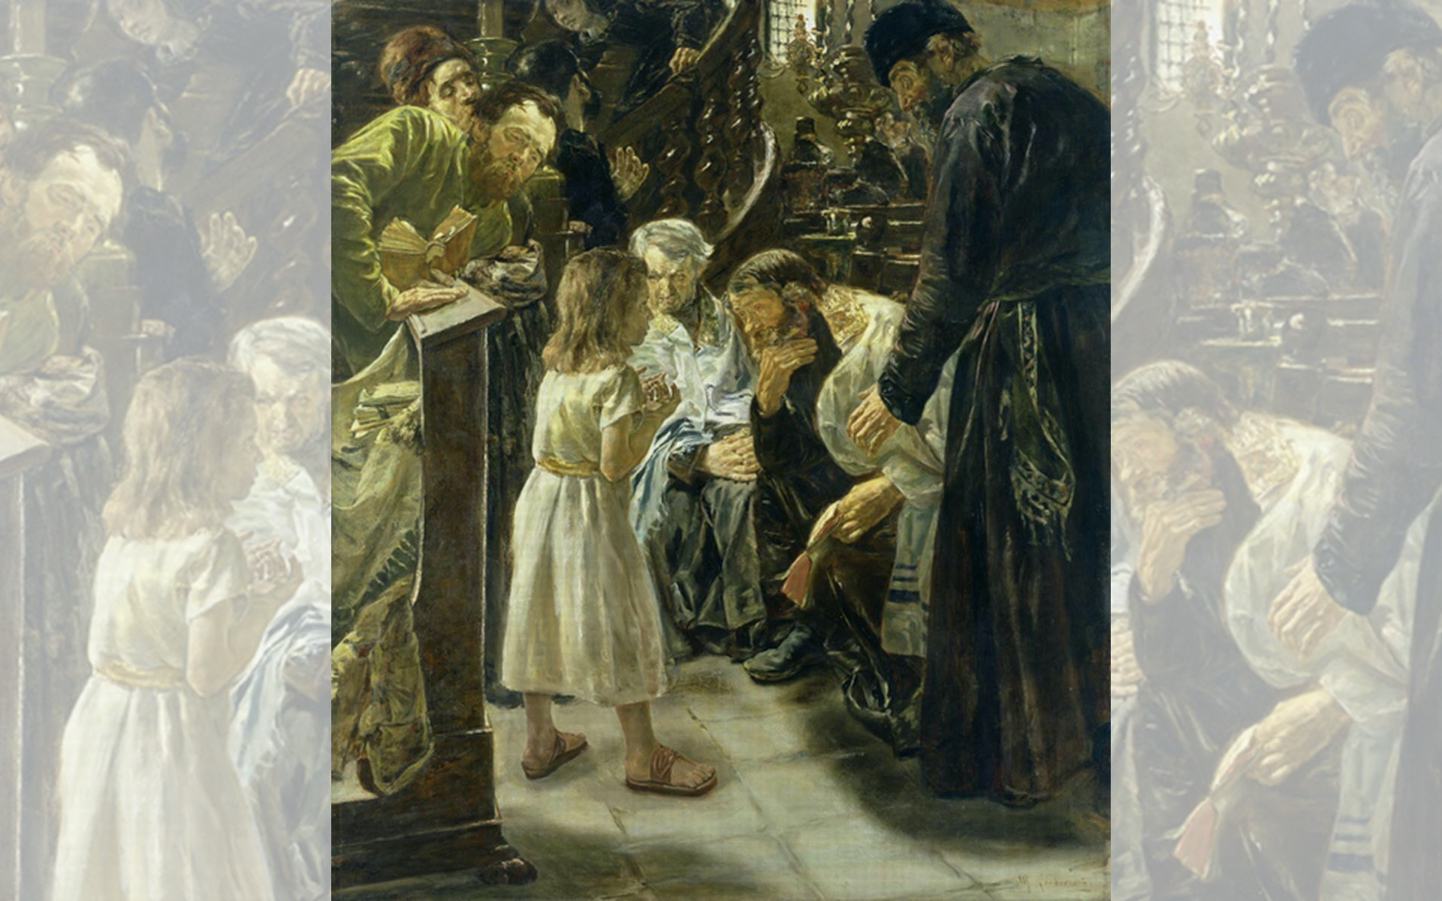
Title: The Twelve-Year-Old Jesus in the Temple
Artist: Max Liebermann
Year: 1879

Slide 9
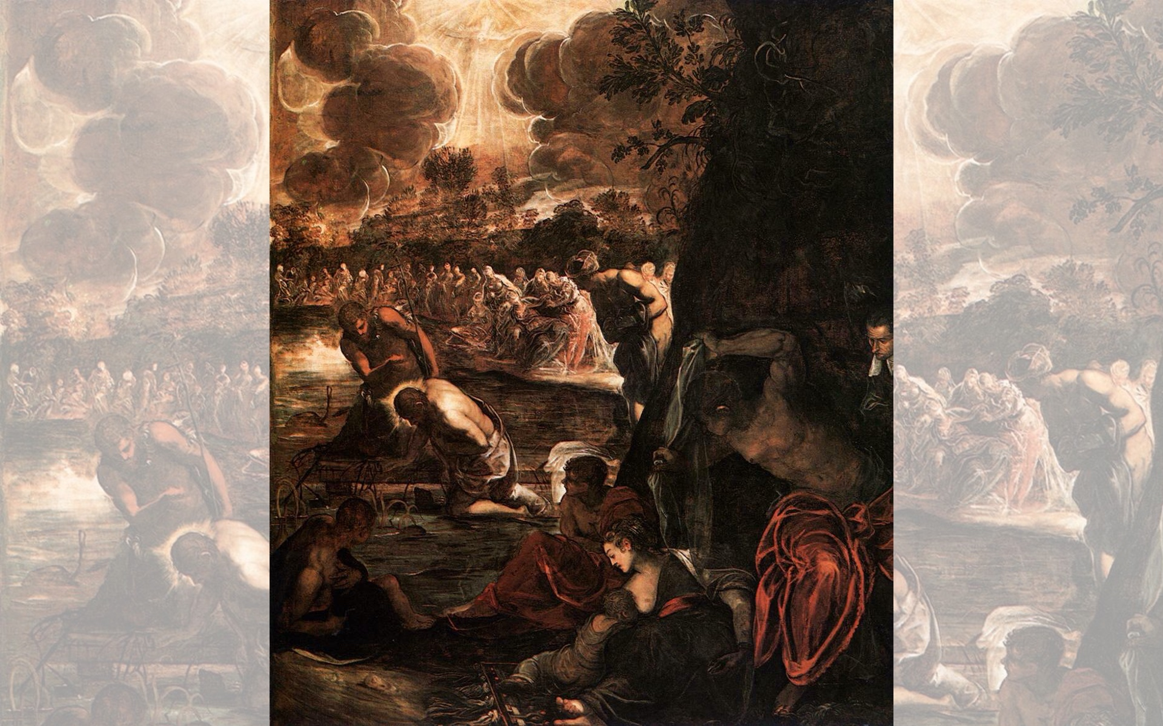
Title: The Baptism of Christ
Artist: Tintoretto
Year: 1579-1581

Slide 10
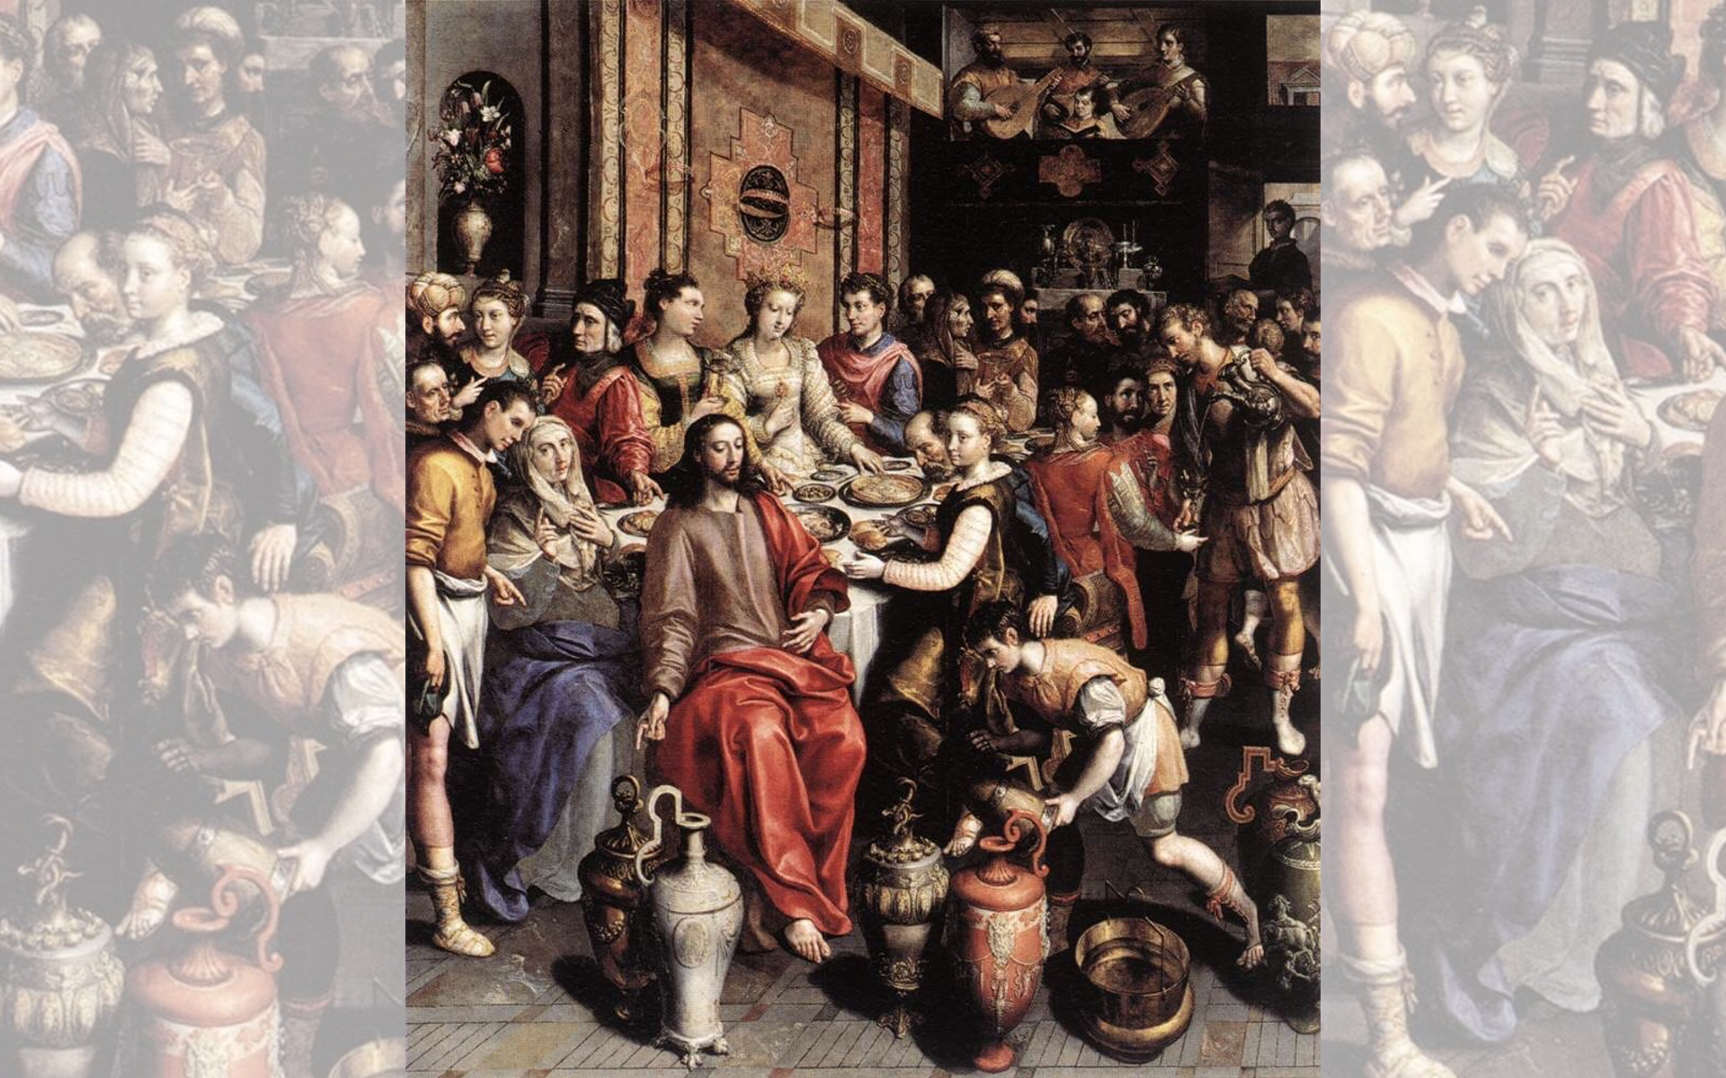
Title: The Marriage at Cana
Artist: Marten de Vos
Year: 1596-1597

Slide 11
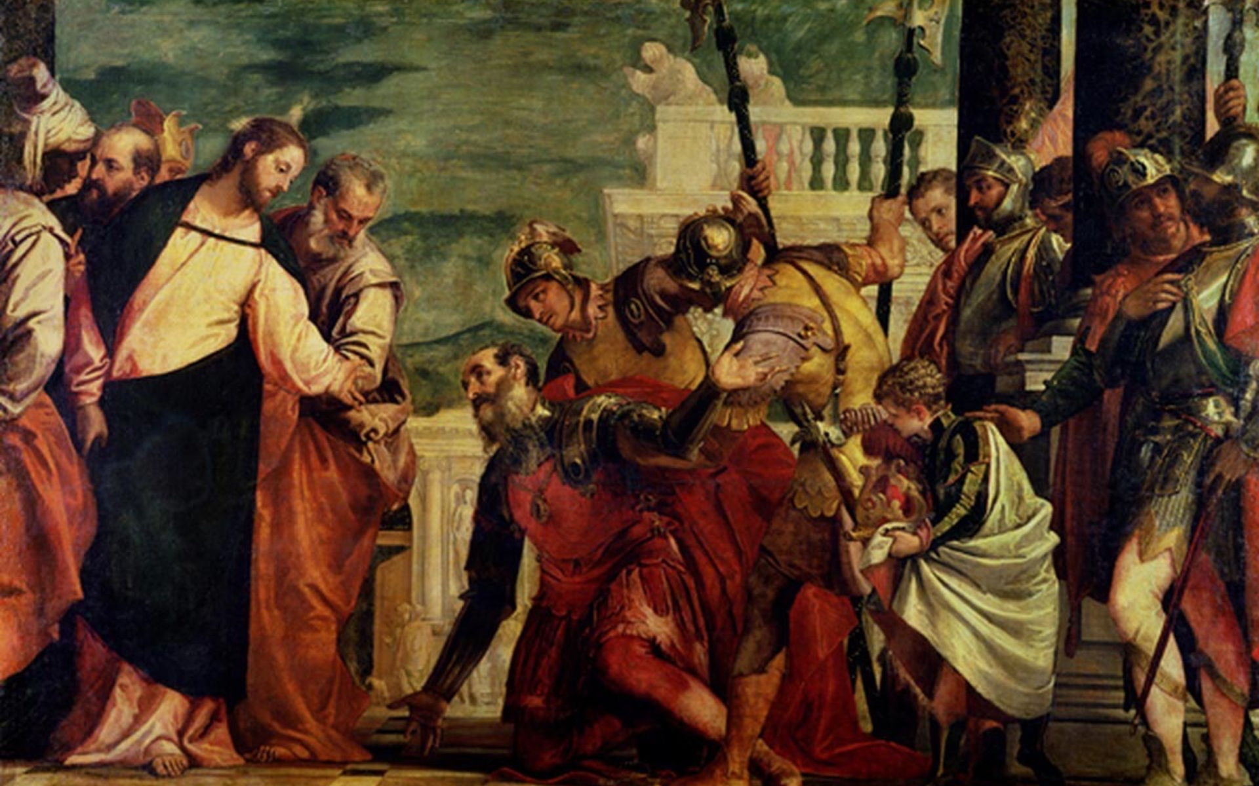
Title: Jesus and the Centurion — Artist: Paolo Veronese — Date Unknown

Slide 12
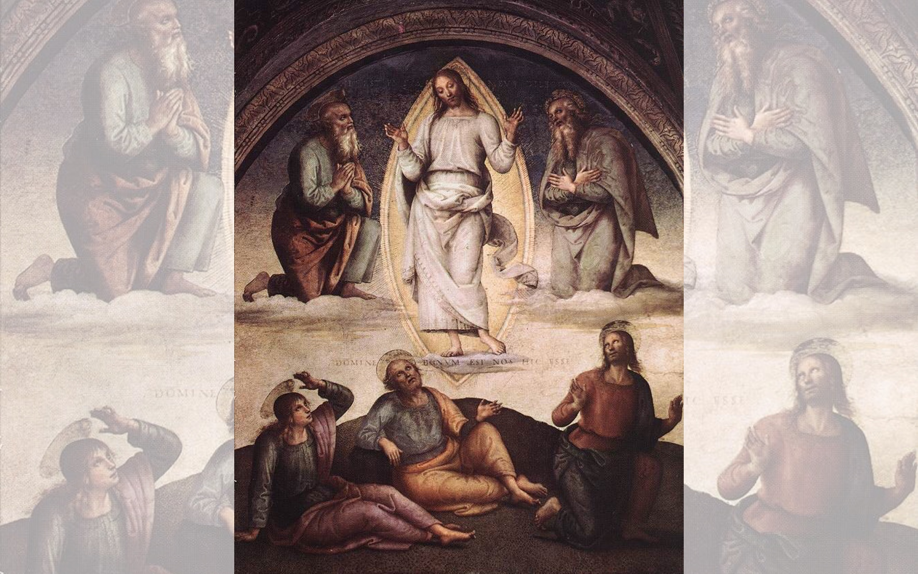
Title: The Transfiguration
Artist: Pietro Perugino
Year: 1498

Slide 13
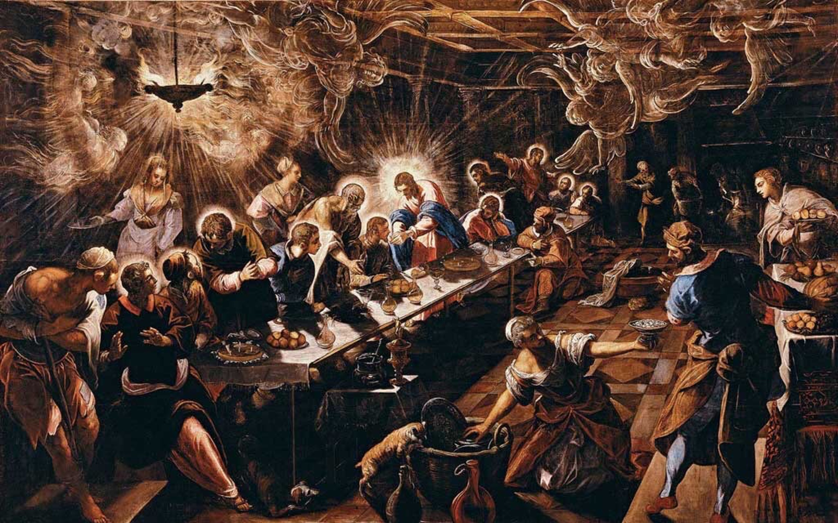
Title: The Last Supper — Artist: Tintoretto — Year: 1592-1594

Slide 15
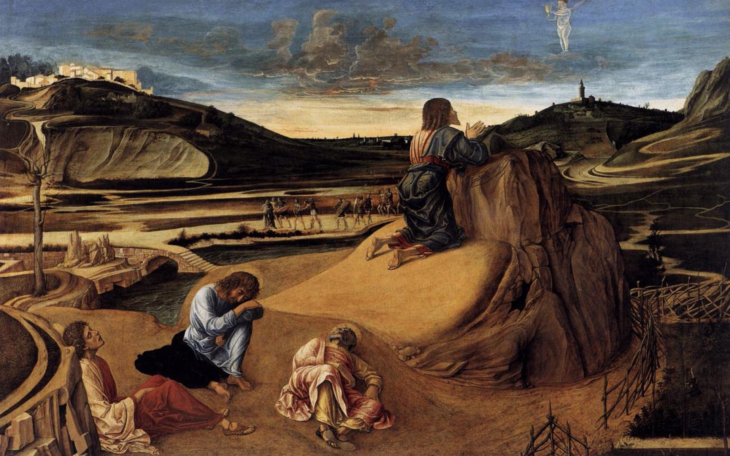
Title: Agony in the Garden — Artist: Giovanni Bellini — Year: 1459-1465

Slide 16
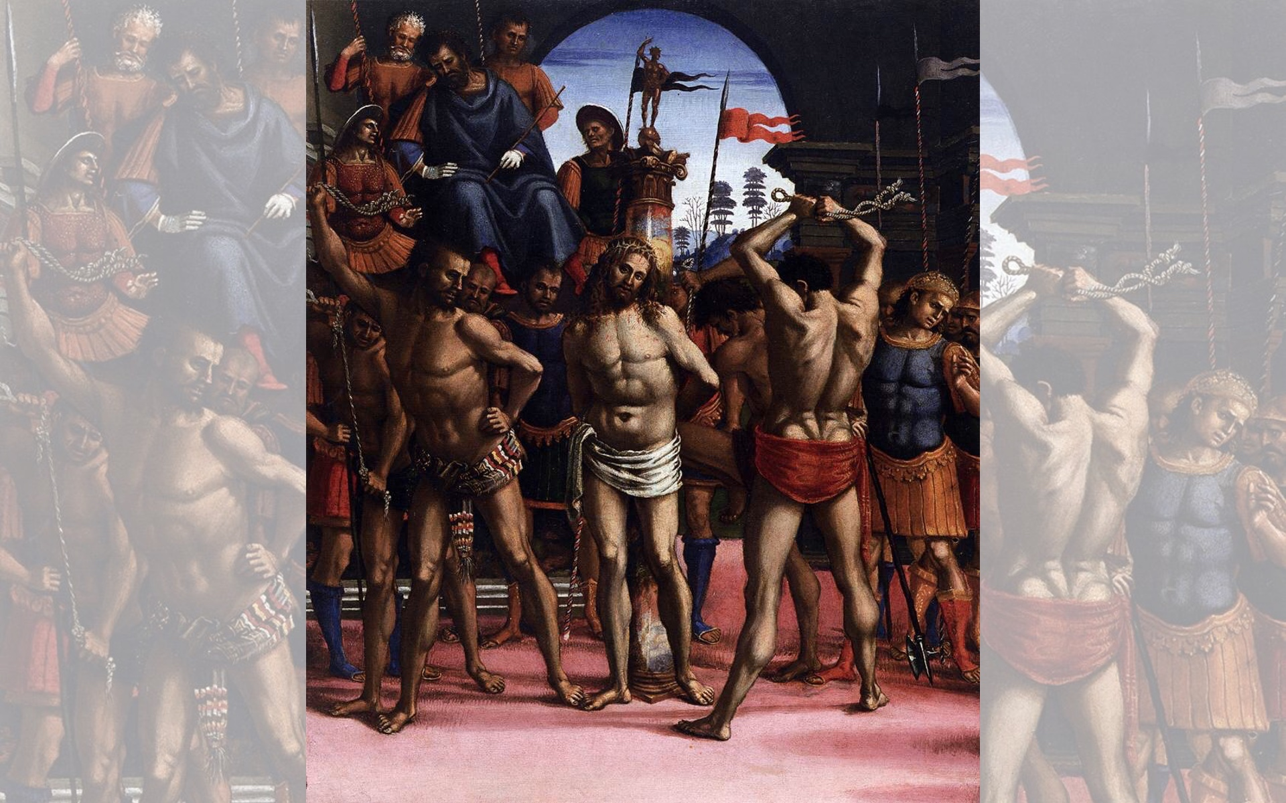
Title: Flagellation
Artist: Luca Signorelli
Year: 1505

Slide 17
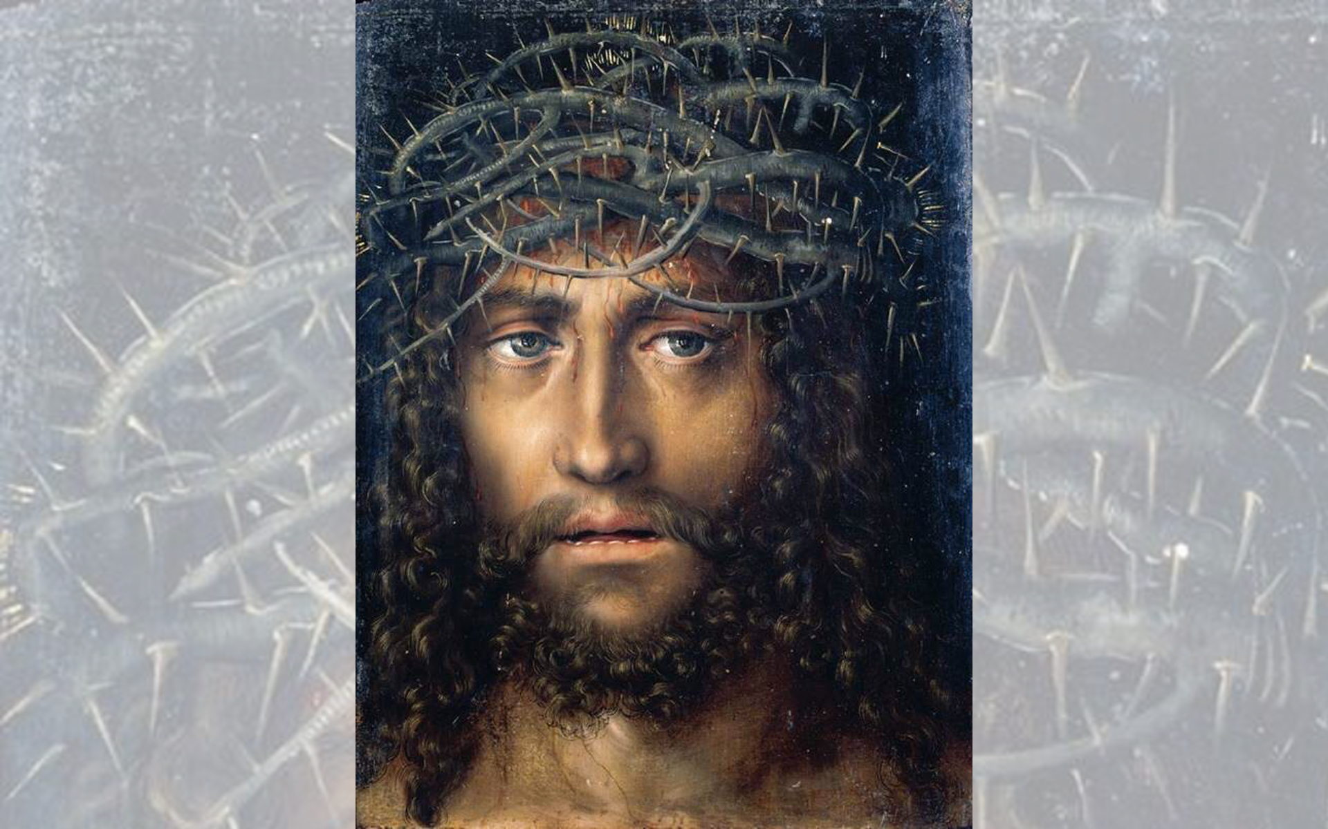
Title: Head of Christ Crowned with Thorns
Artist: Lucas Cranach the Elder
Year: 1520-1525

Slide 18
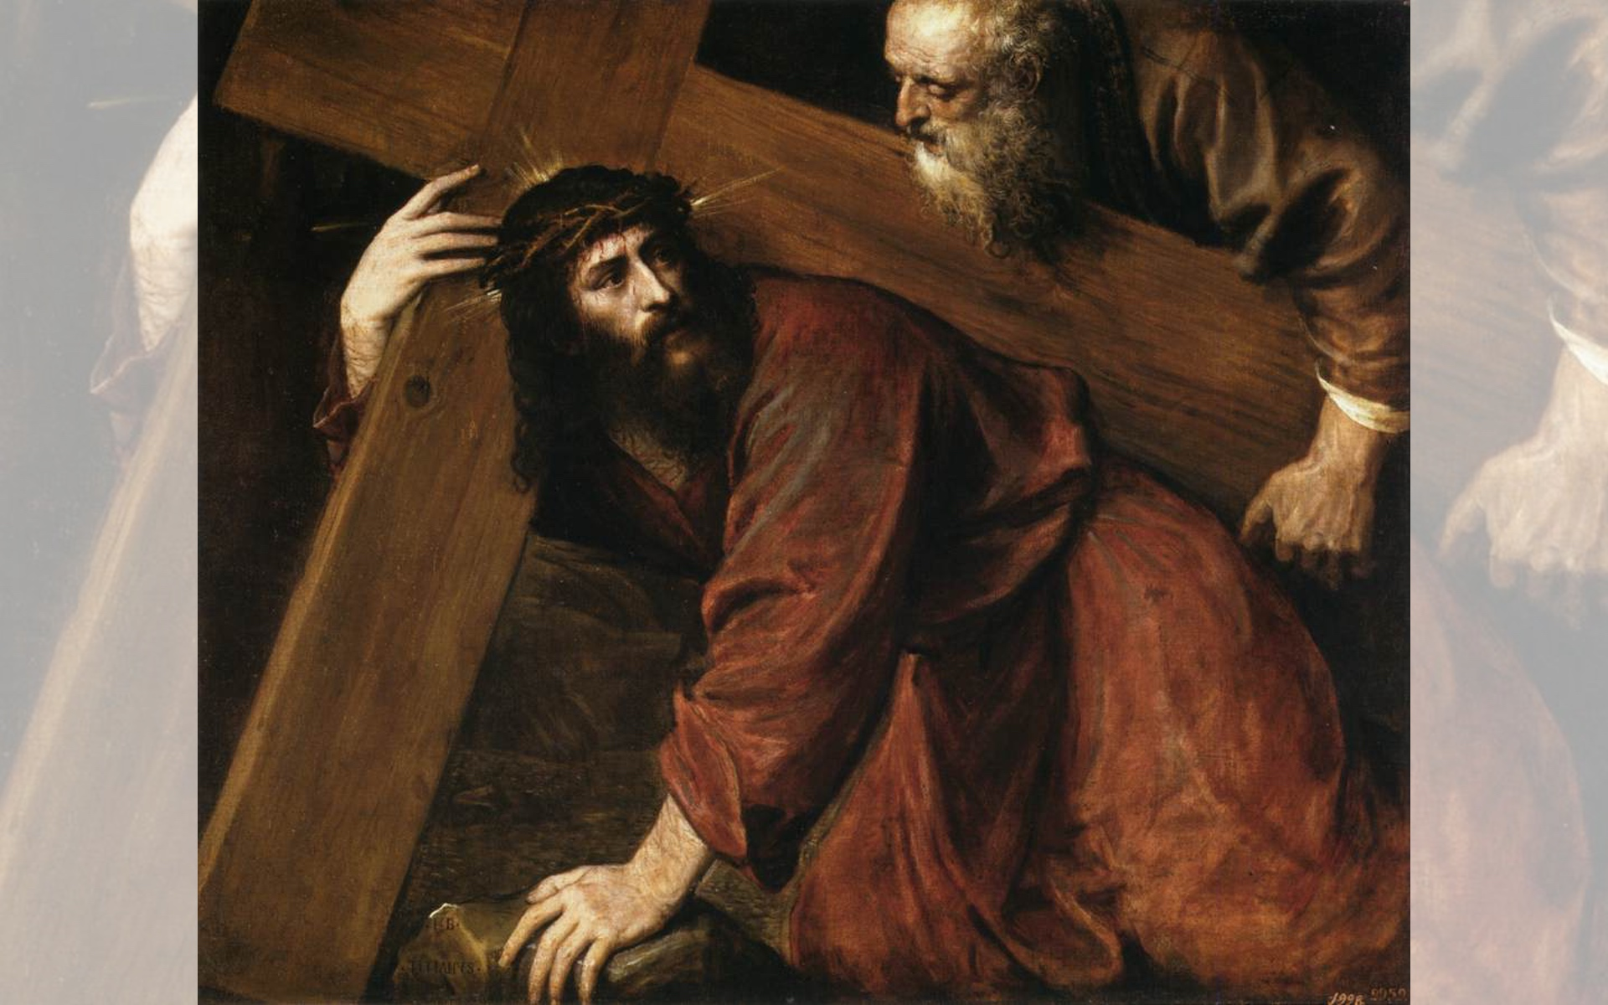
Title: Christ Carrying the Cross — Artist: Titian — Year: c. 1565

Slide 19
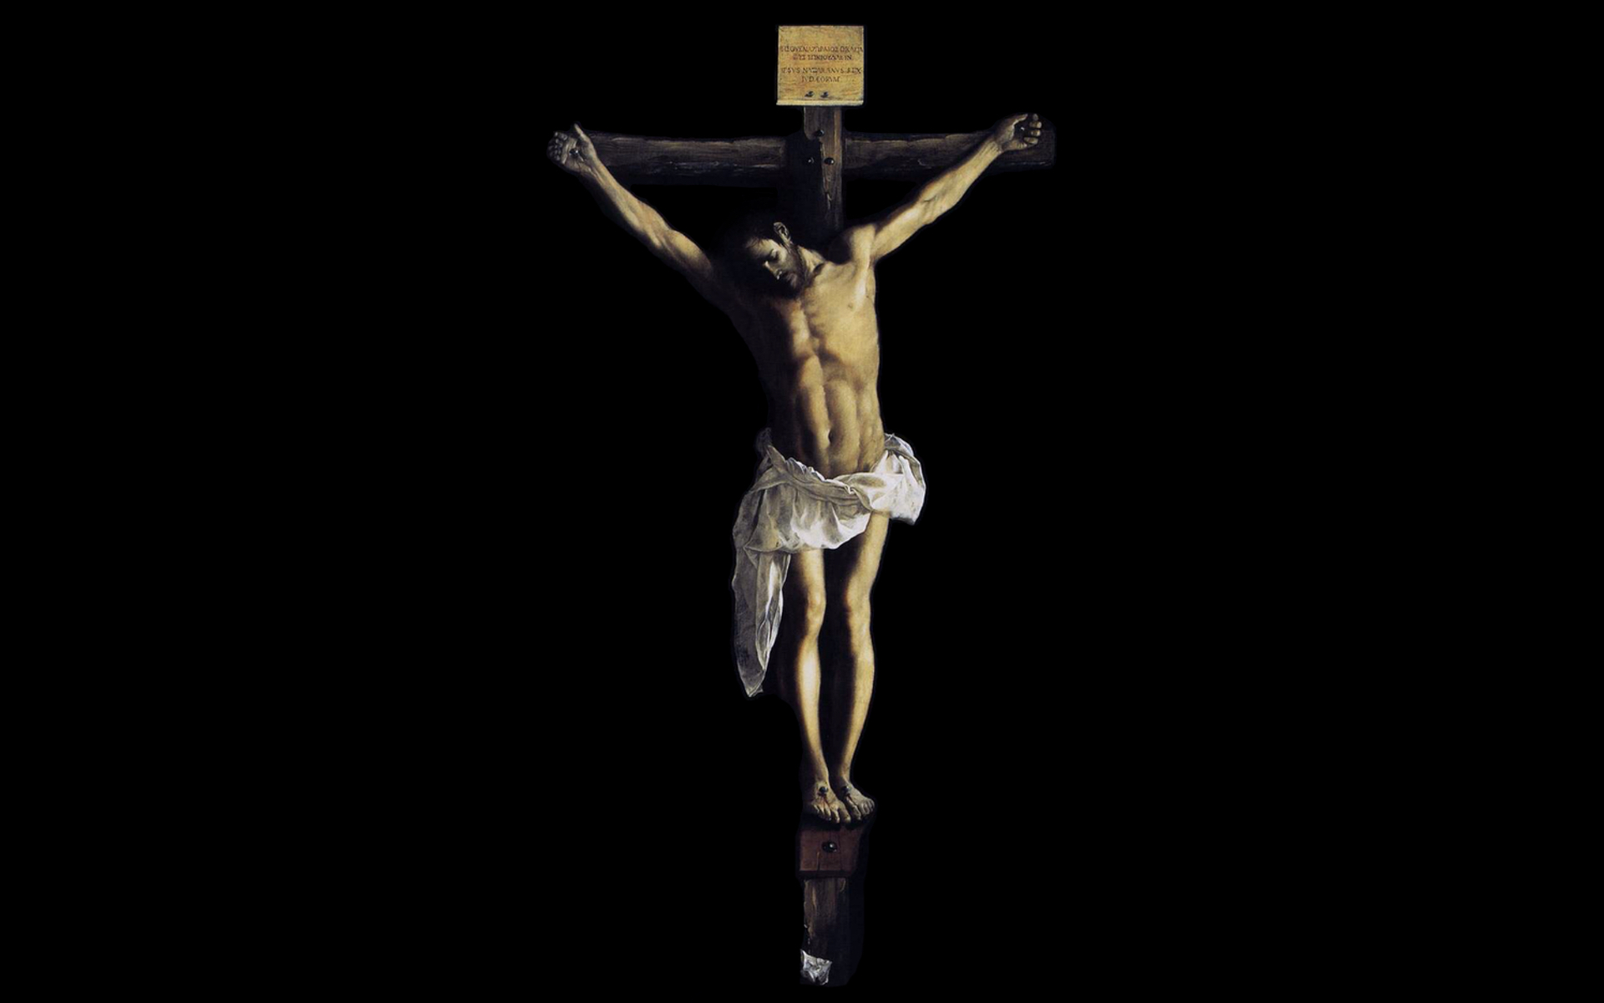
Title: Christ on the Cross — Artist: Francisco de Zurbarán — Year: 1627

Slide 21
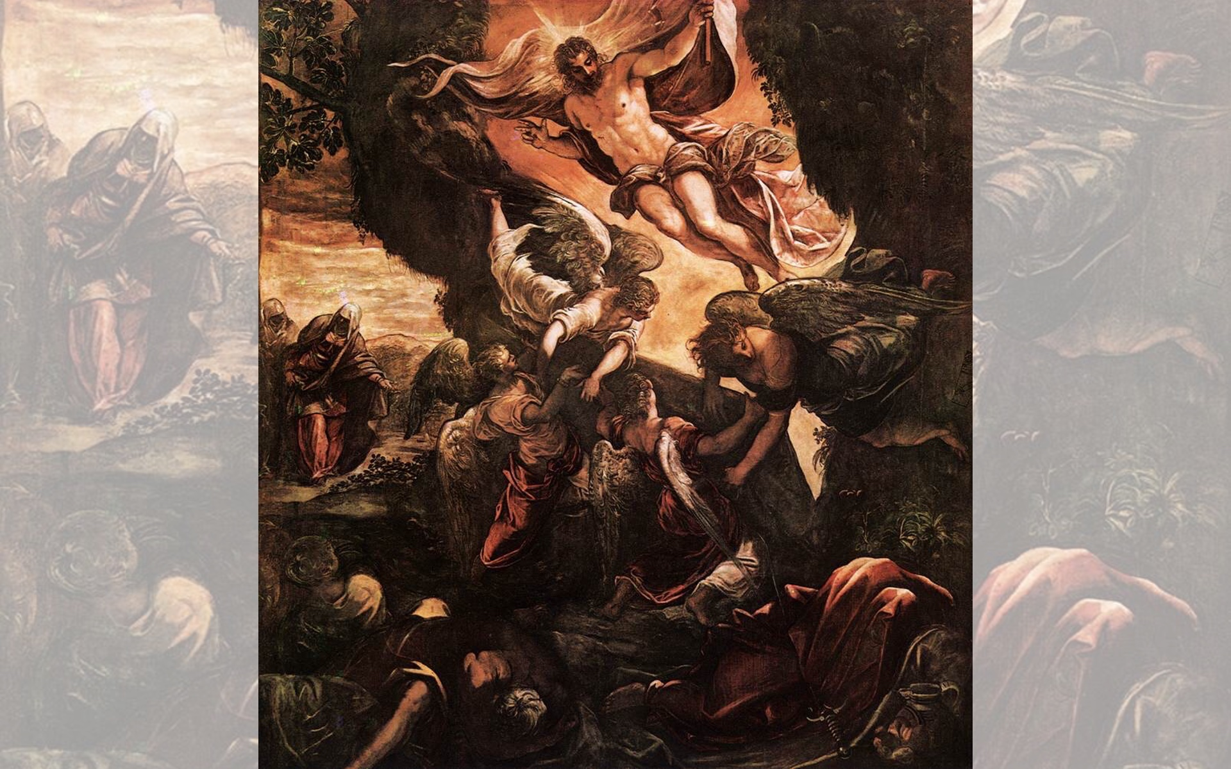
Title: The Resurrection of Christ
Artist: Tintoretto
Year: 1579-1581

Slide 22
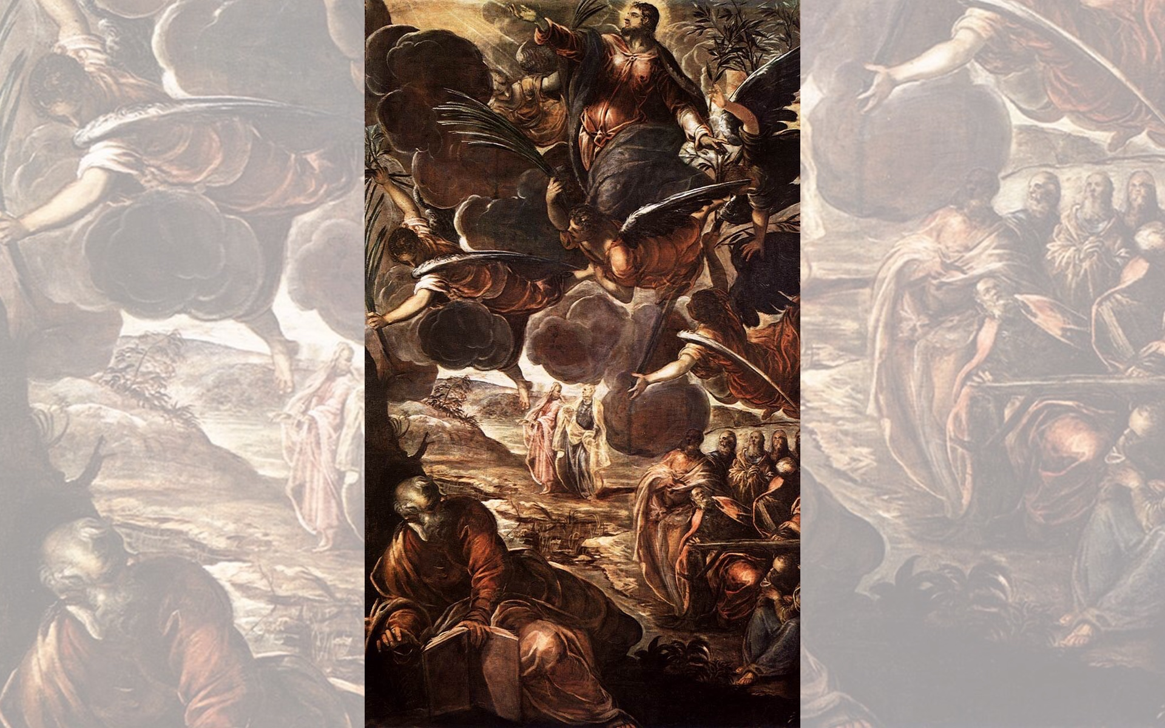
Title: The Ascension
Artist: Tintoretto
Year: 1579-1581

Slide 23
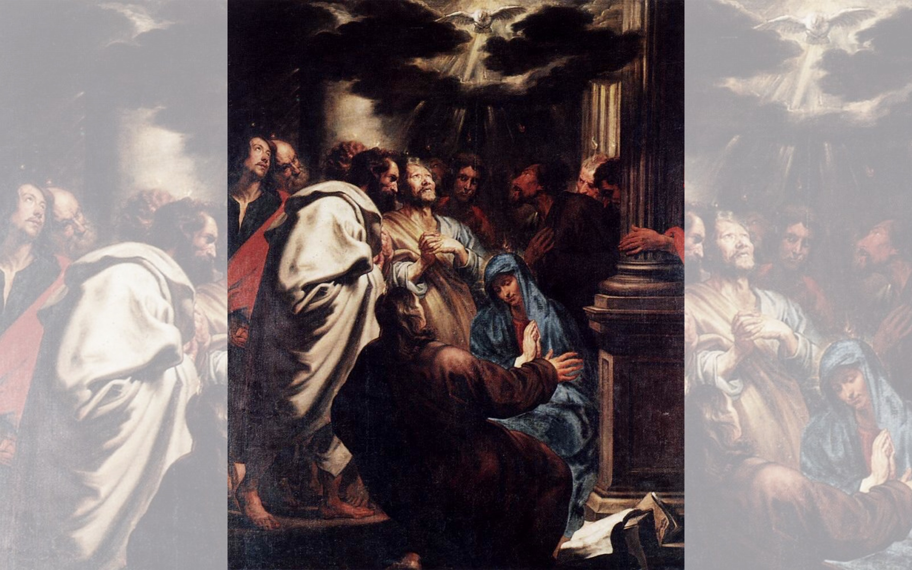
Title: Pentecost
Artist: Anthony van Dyck
Year: 1618-1620
Title: Pentecost — Artist: Jean II Restout — Year: 1732

Slide 24
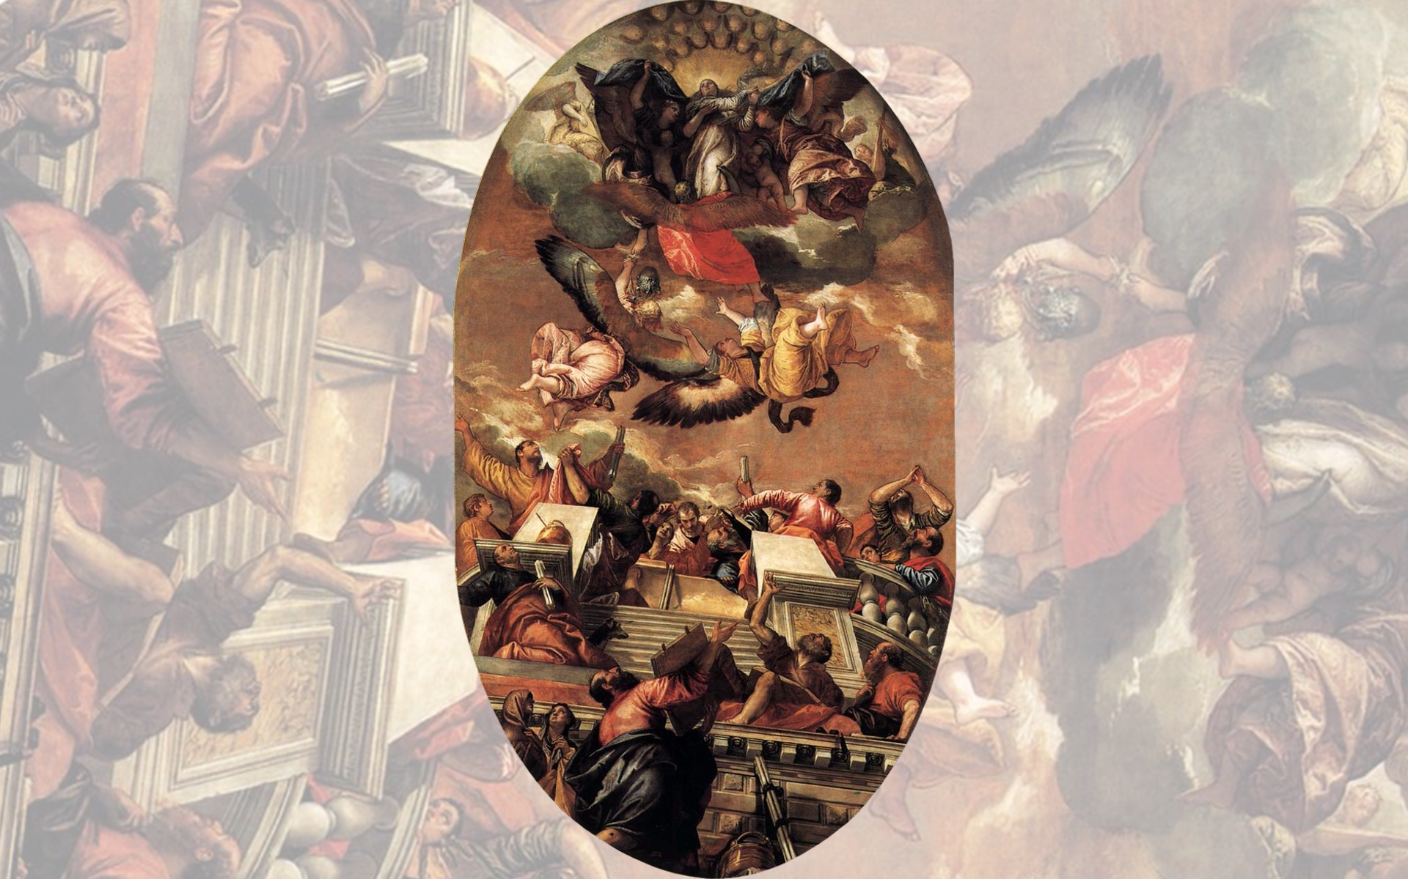
Title: Assumption
Artist: Paolo Veronese
Year: 1558

Slide 25
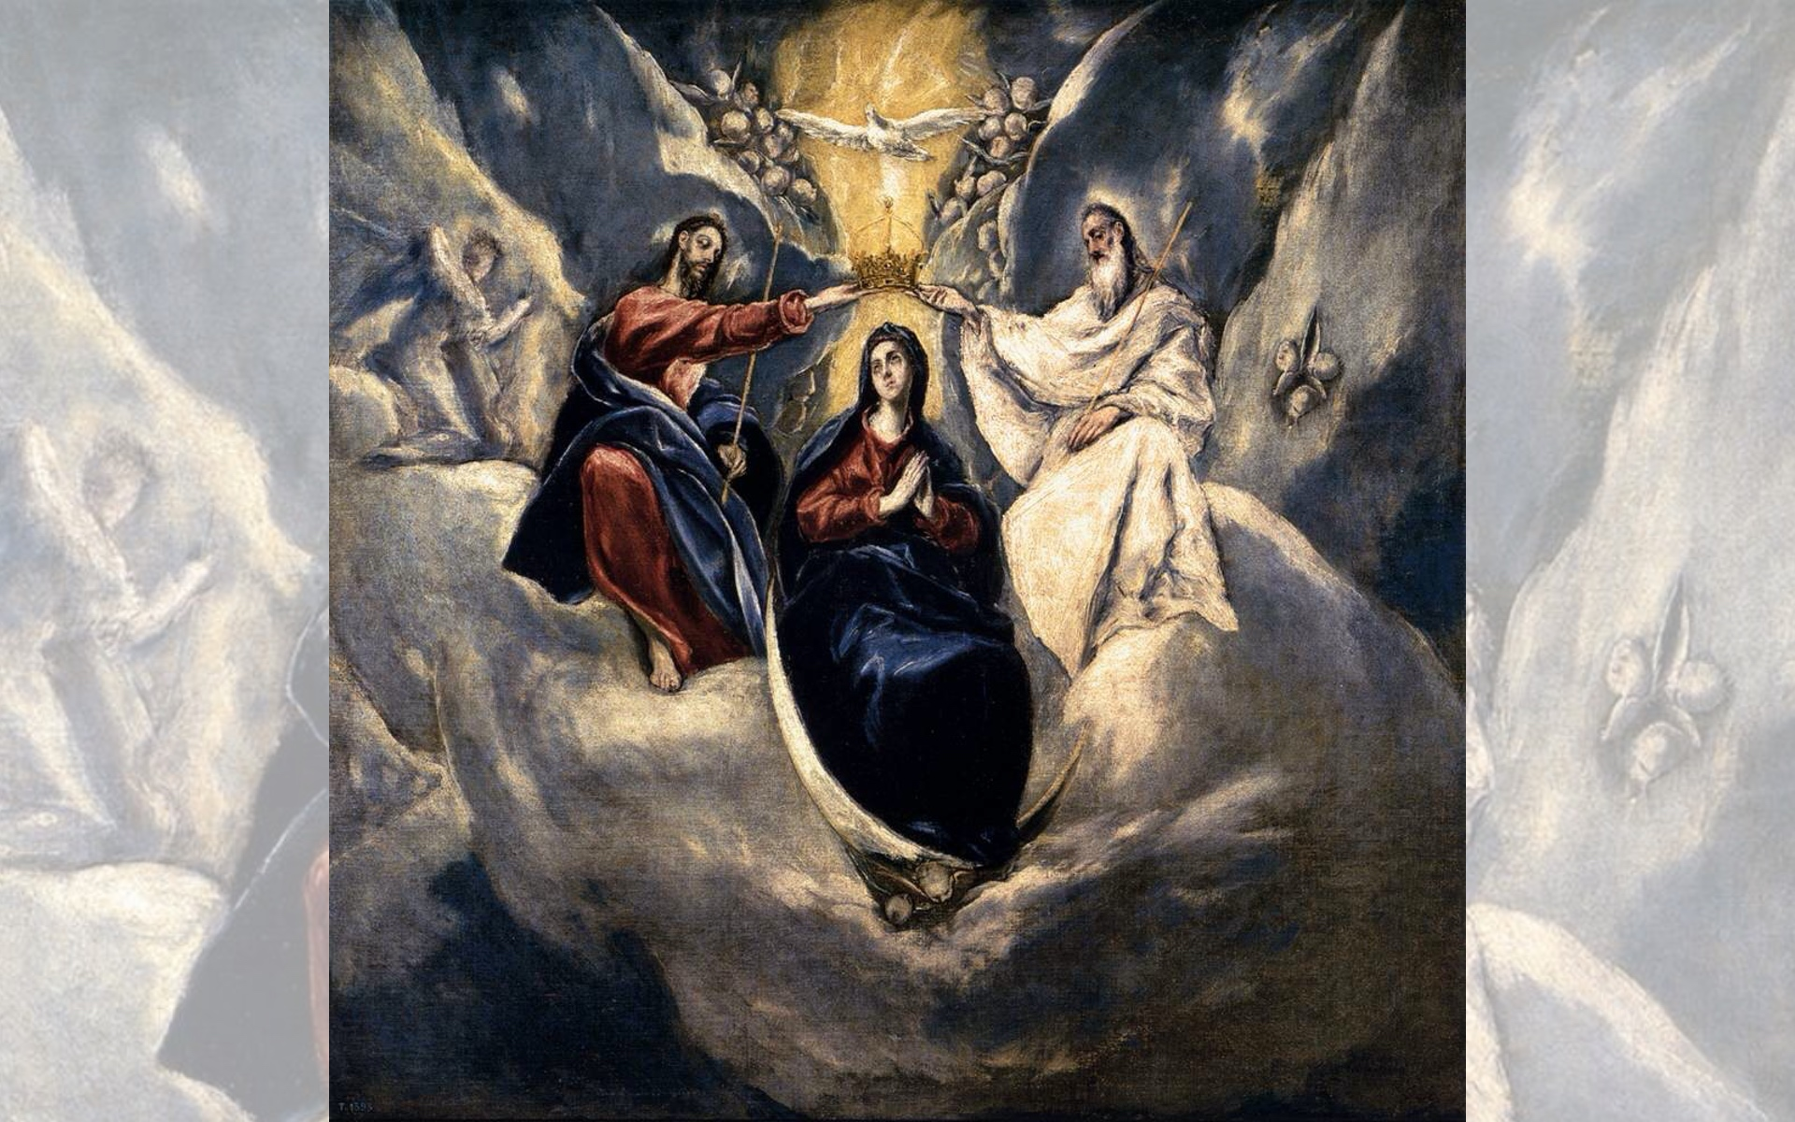
Title: The Coronation of the Virgin
Artist: El Greco
Year: 1591

