Slide 3
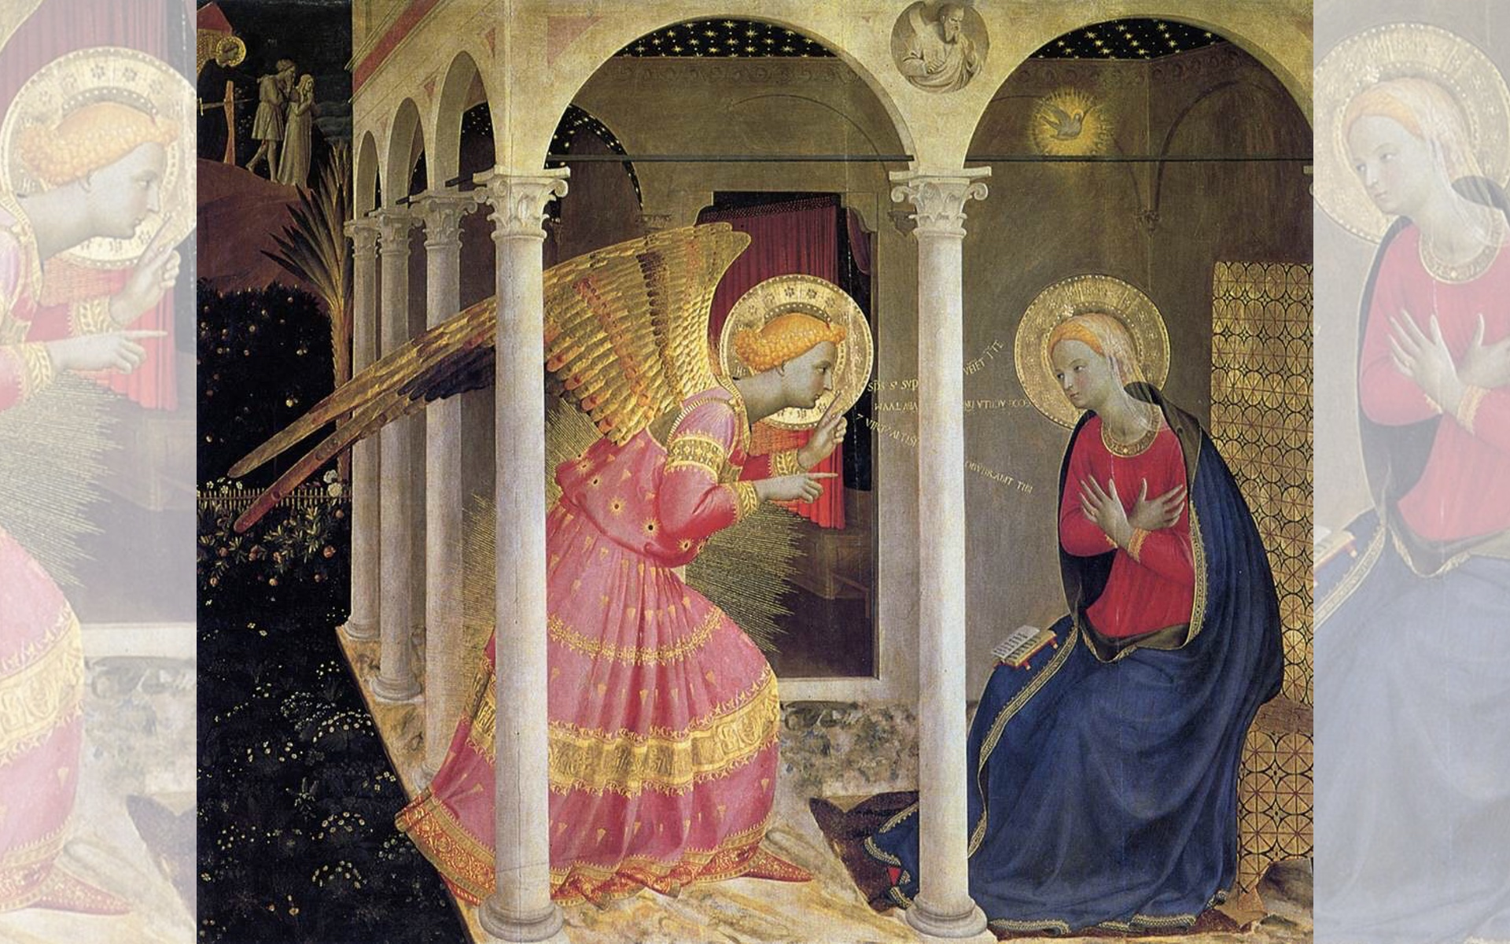
Title: Annunciation
Artist: Fra Angelico
Year: c. 1433-1434

Slide 4
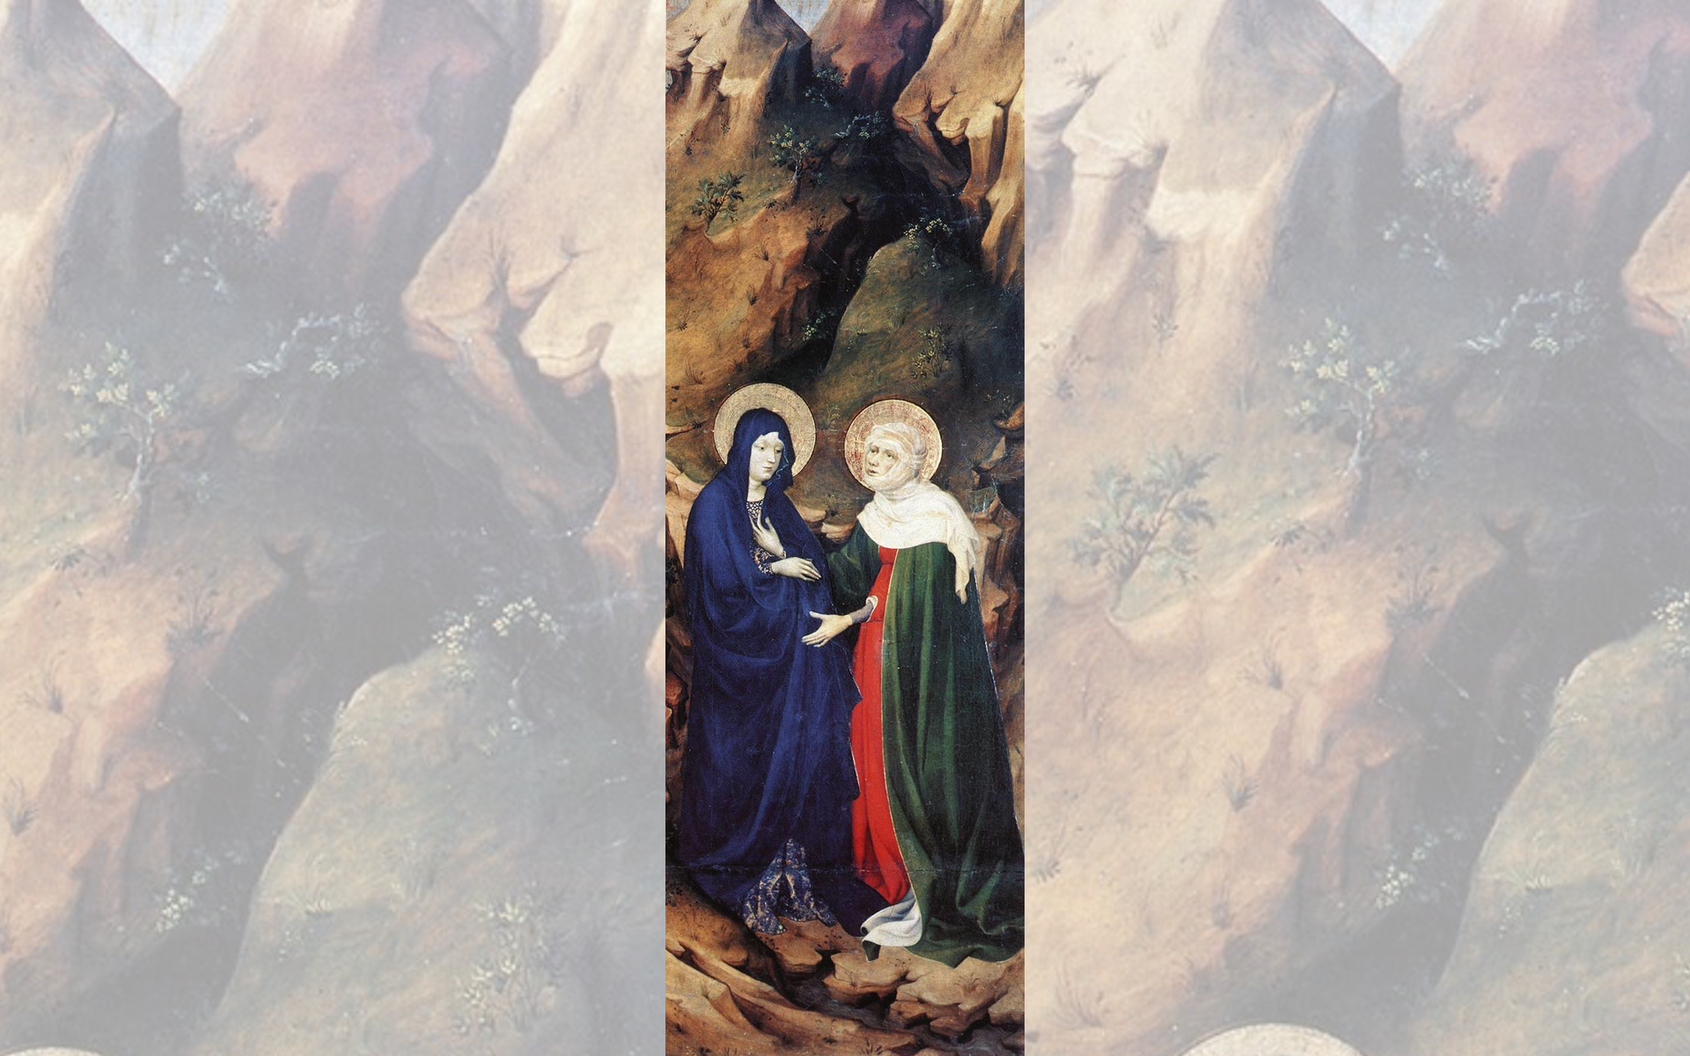
Title: The Visitation
Artist: Melchior Broederlam
Year: 1393-1399

Slide 5
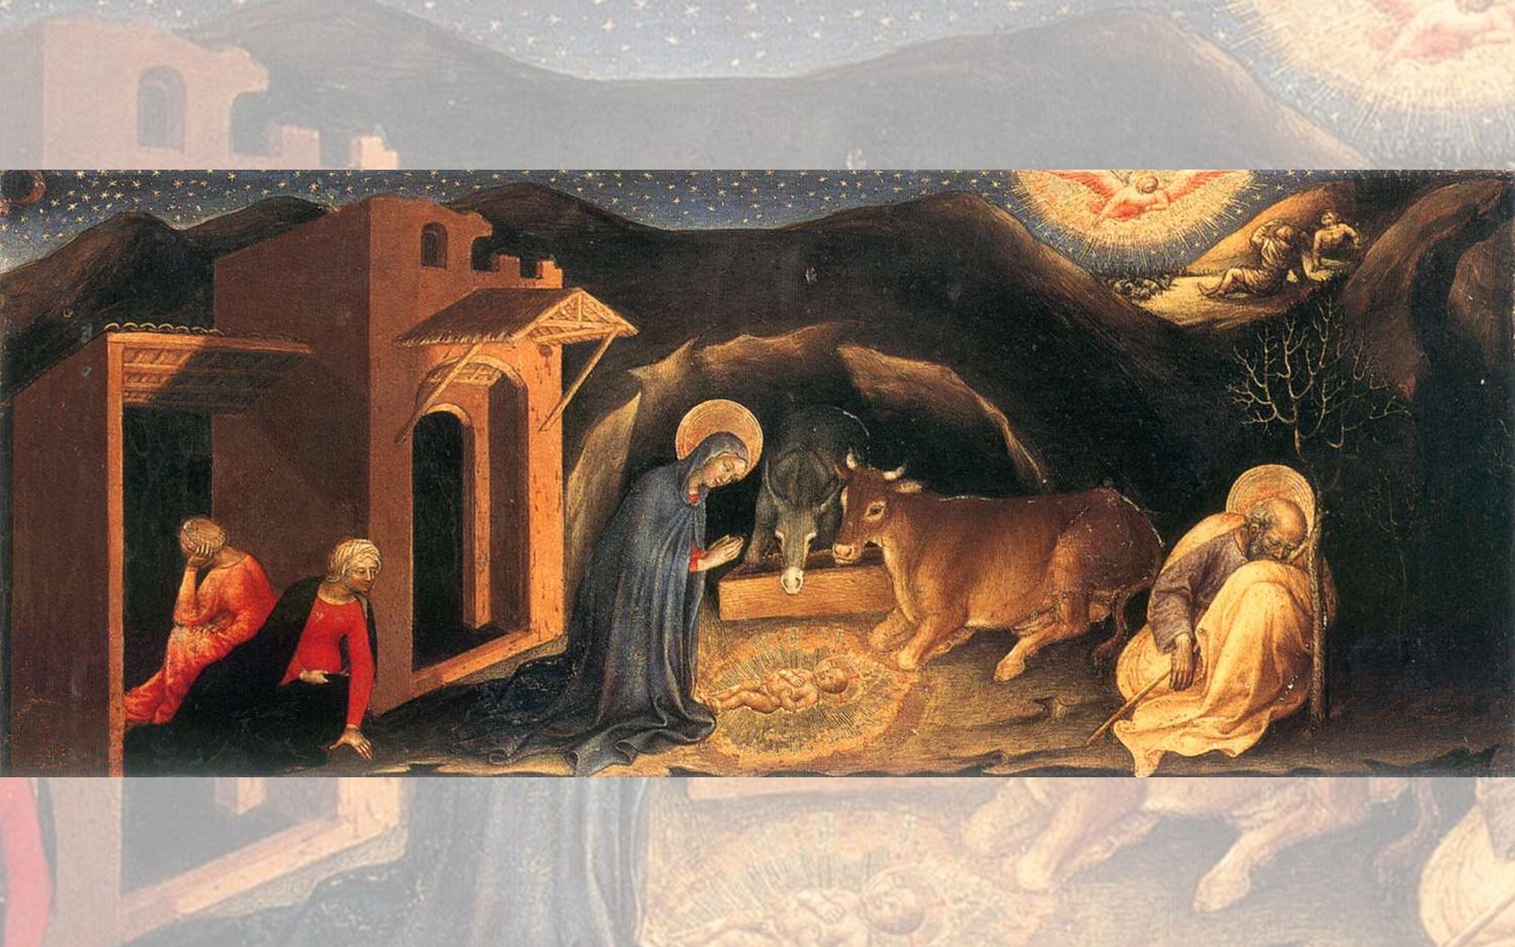
Title: Nativity (Adoration of the Magi left predella)
Artist: Gentile da Fabriano
Year: 1423

Slide 6
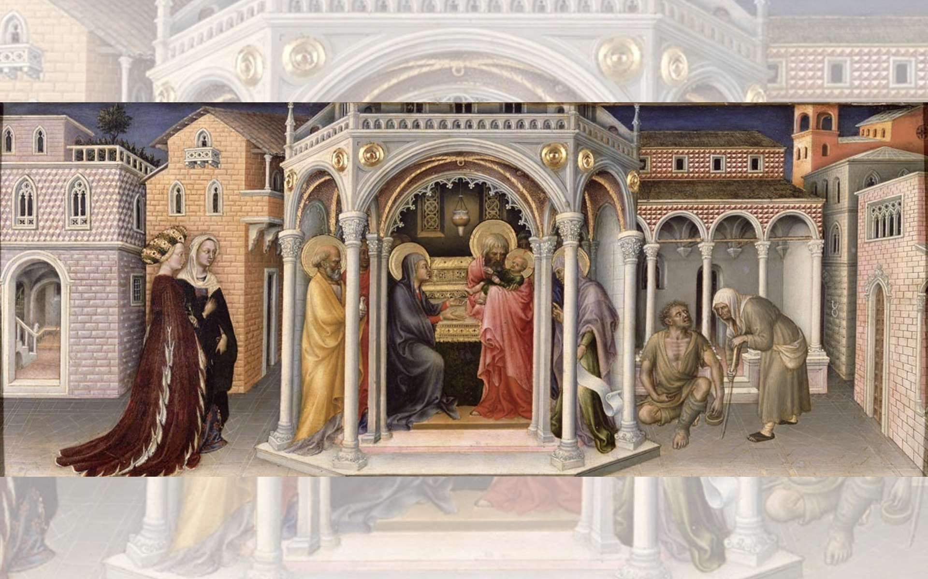
Title: Presentation of Christ in the Temple
Artist: Gentile da Fabriano
Year: 1423

Slide 7
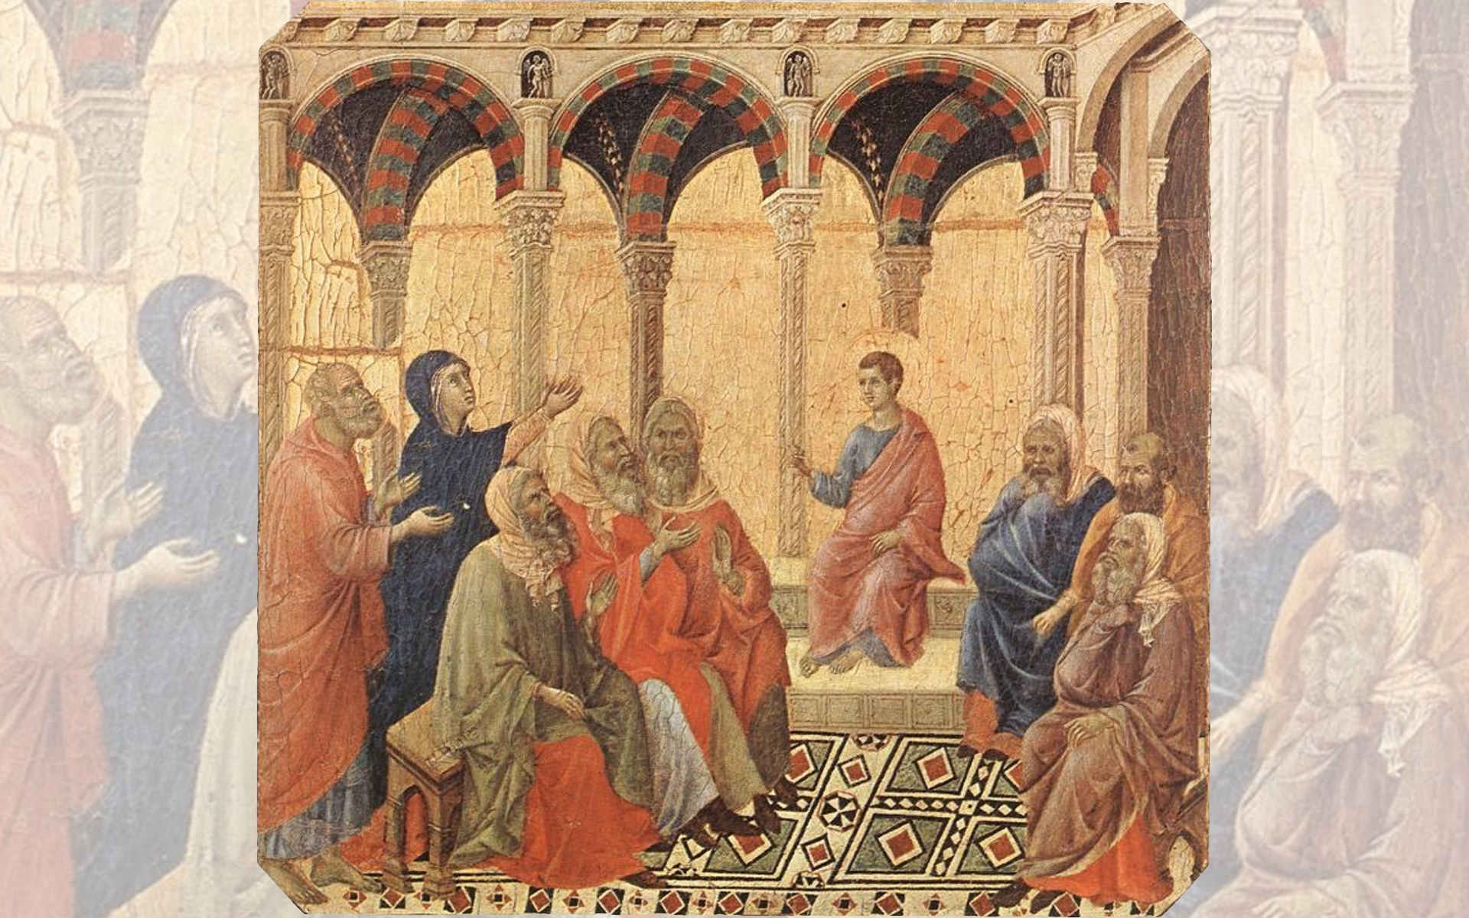
Title: Disputation with the Doctors
Artist: Duccio di Buoninsegna
Year: 1308-1311

Slide 9
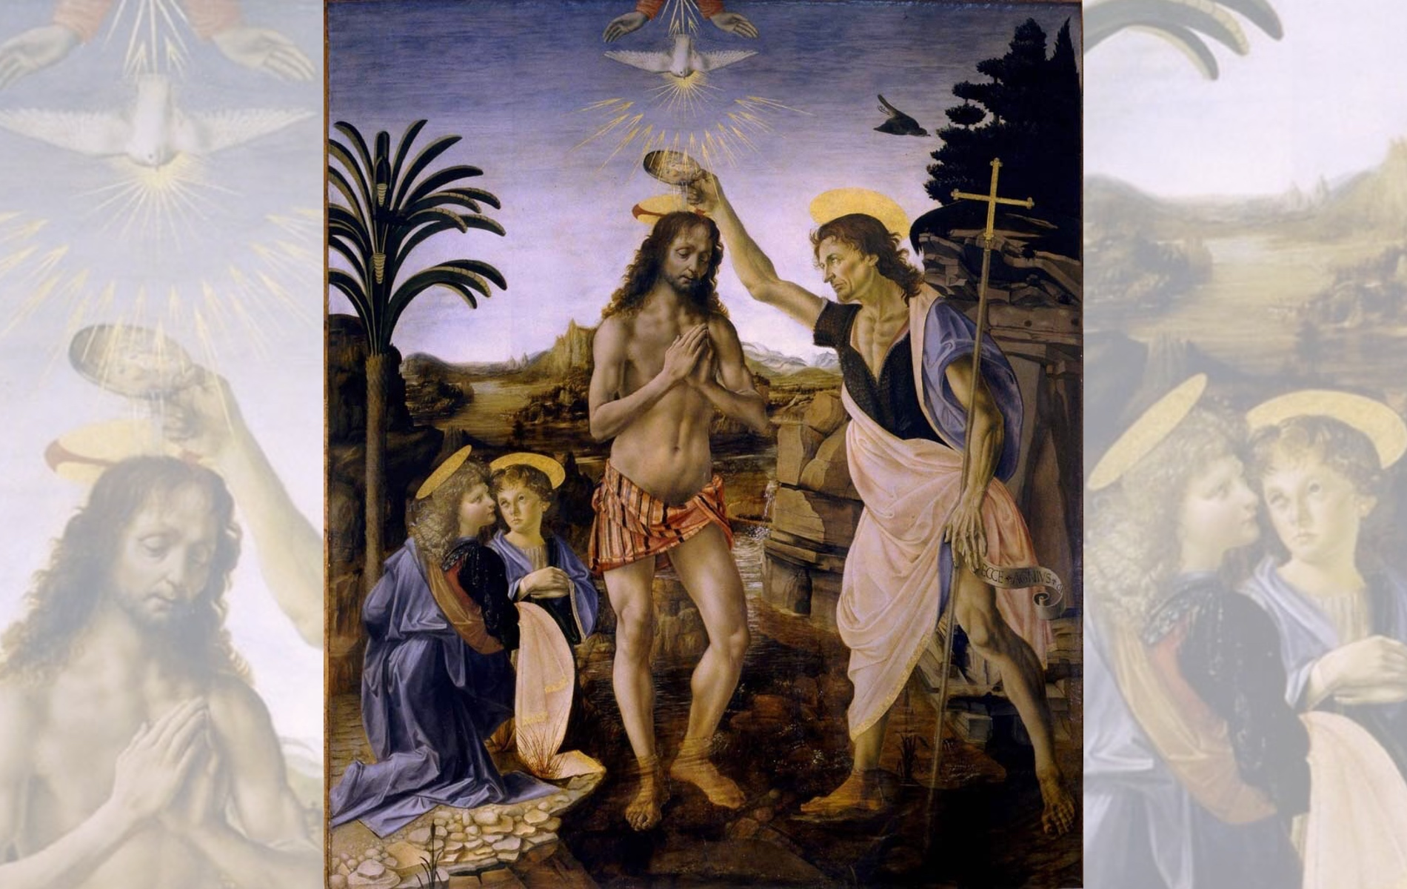
Title: The Baptism of Christ
Artist: Andrea del Verrocchio &
Leonardo da Vinci
Year: 1472-1475

Slide 10
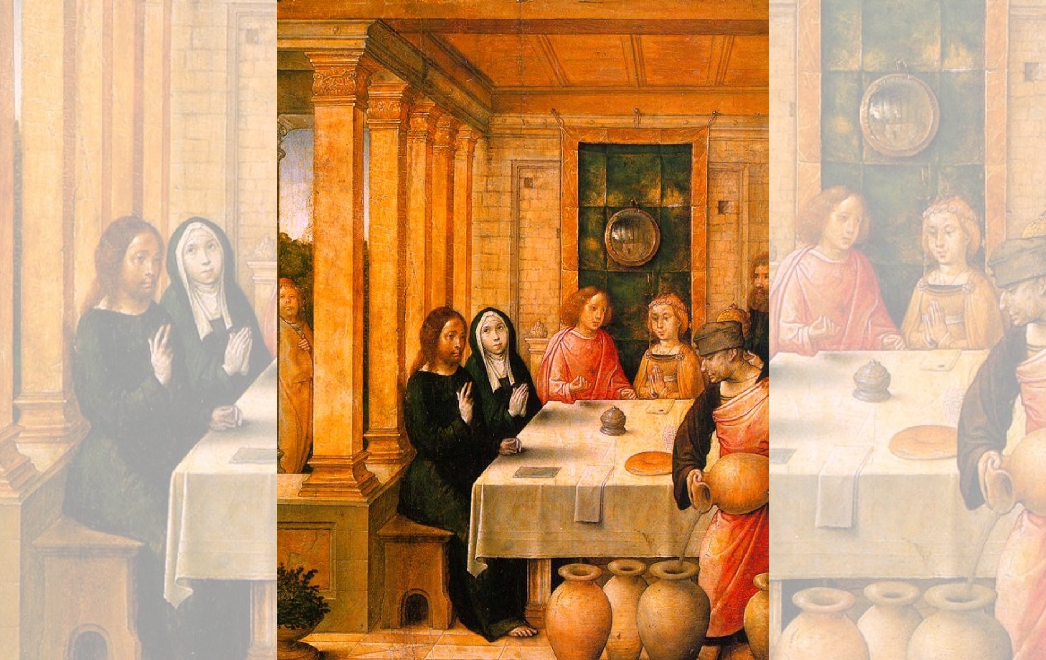
Title: The Marriage Feast at Cana
Artist: Juan de Flandes
Year: 1500

Slide 11
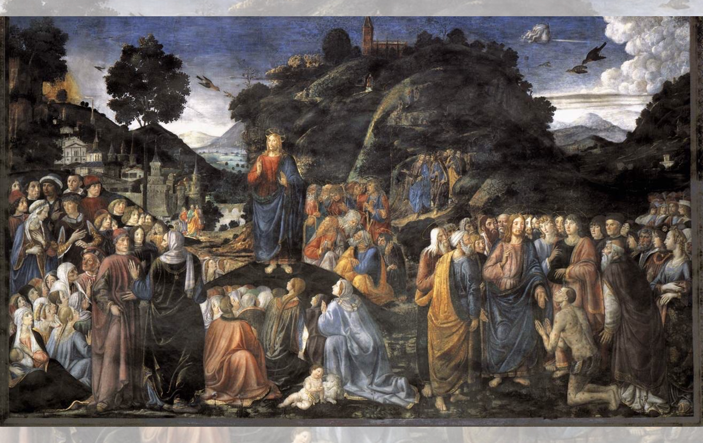
Title: Sermon on the Mount — Artist: Cosimo Rosselli — Year: 1481-1482

Slide 12
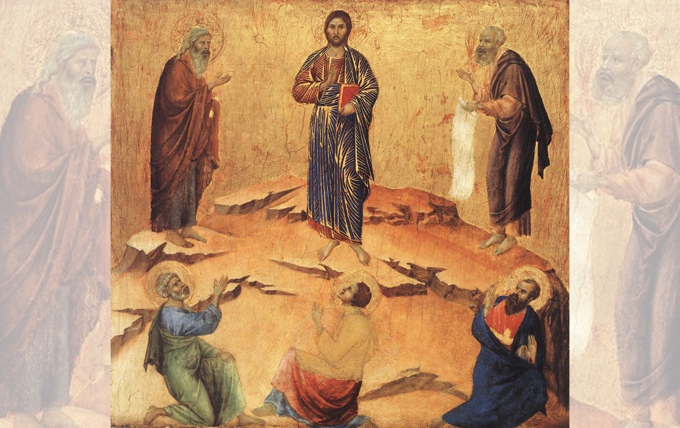
Title: Transfiguration
Artist: Duccio di Buoninsegna
Year: 1308-1311

Slide 13
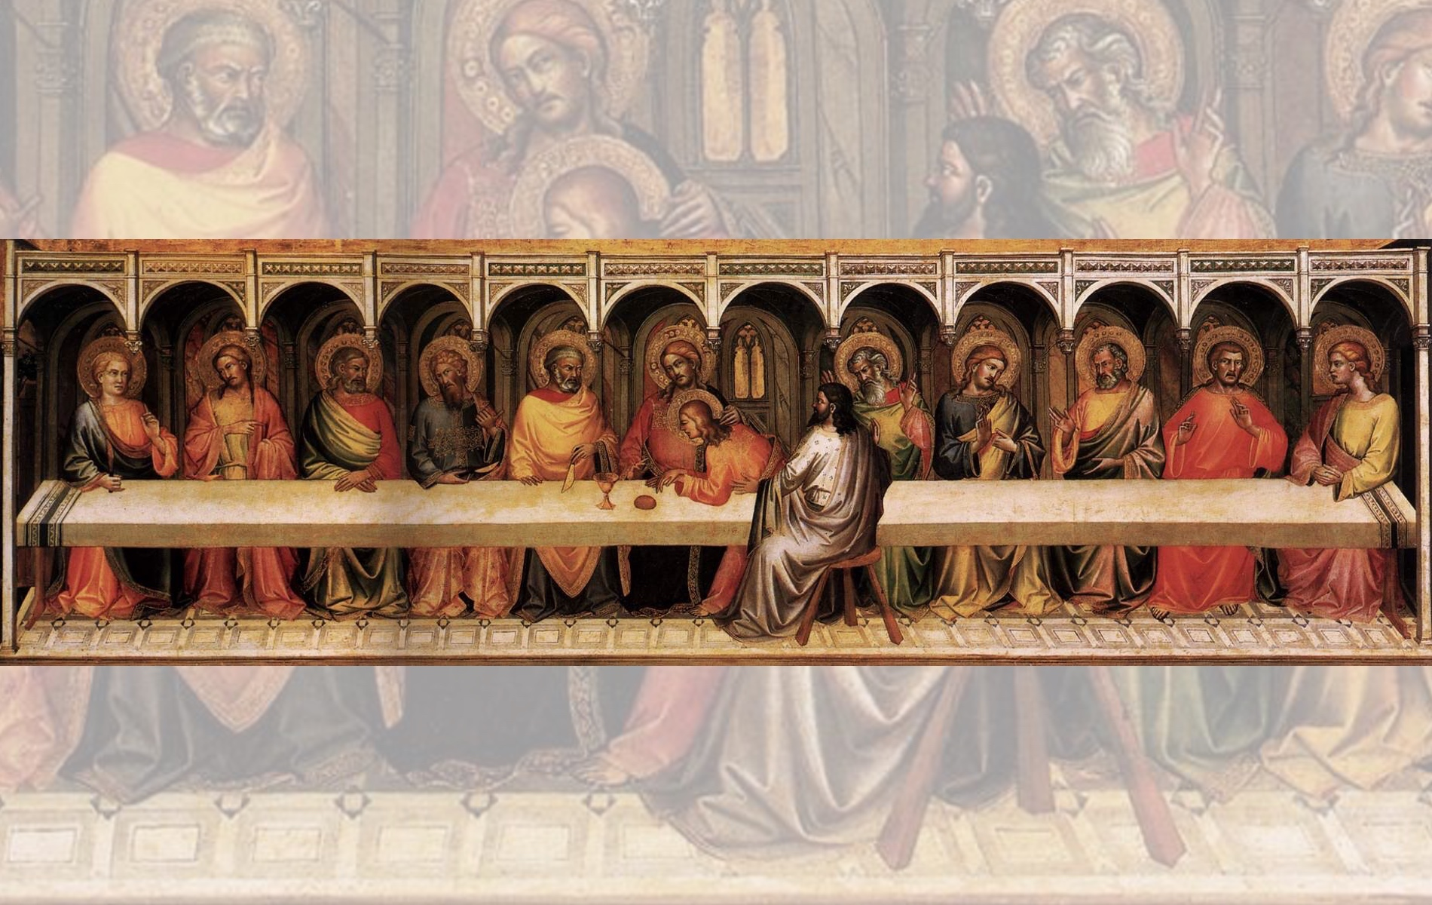
Title: The Last Supper
Artist: Lorenzo Monaco
Year: 1394

Slide 15
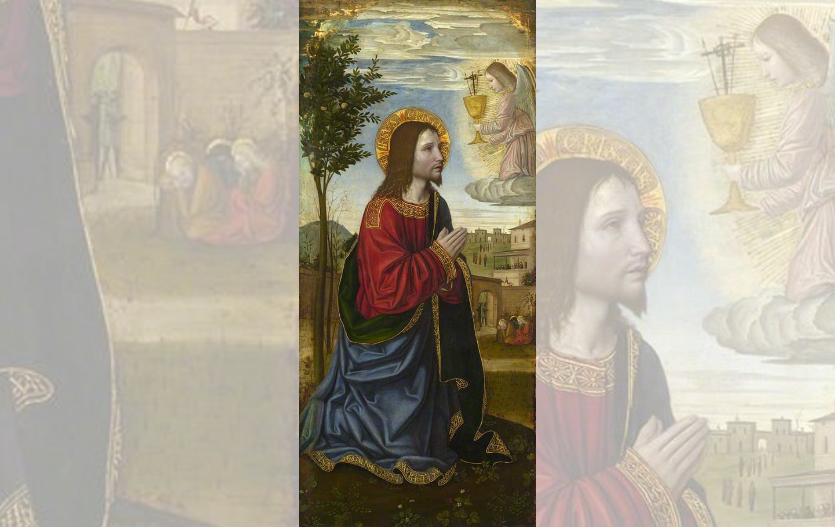
Title: The Agony in the Garden
Artist: Ambrogio Bergognone
Year: 1501

Slide 16
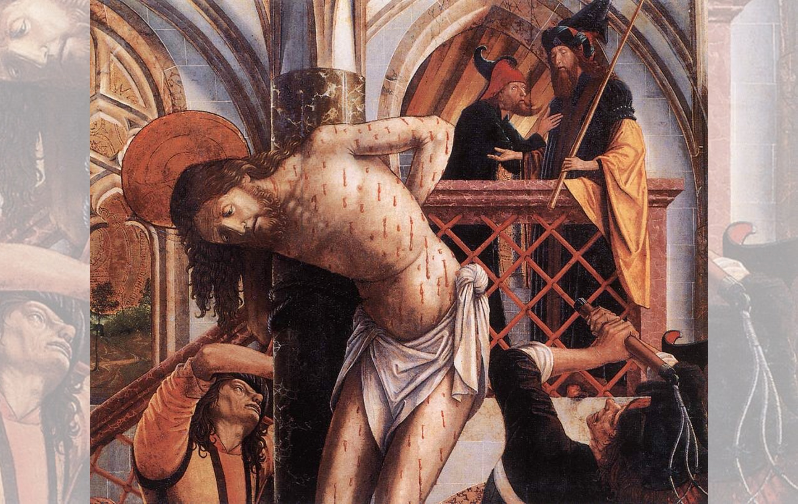
Title: Flagellation
Artist: Michael Pacher
Year: 1495-1498

Slide 17
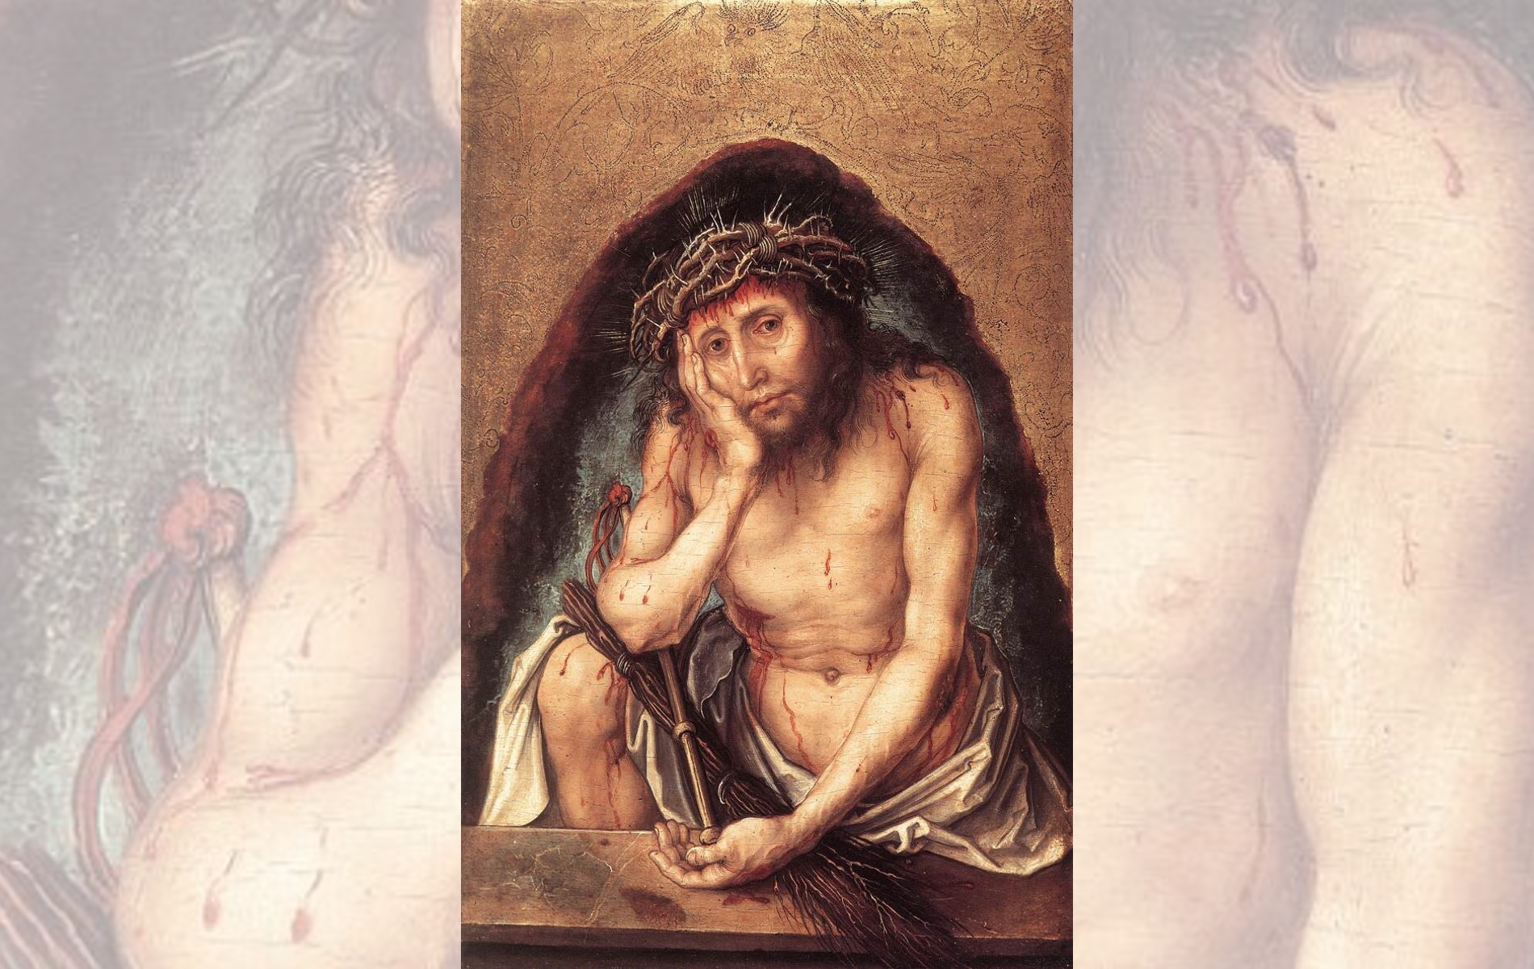
Title: Christ as the Man of Sorrows
Artist: Albrecht Dürer
Year: 1493

Slide 18
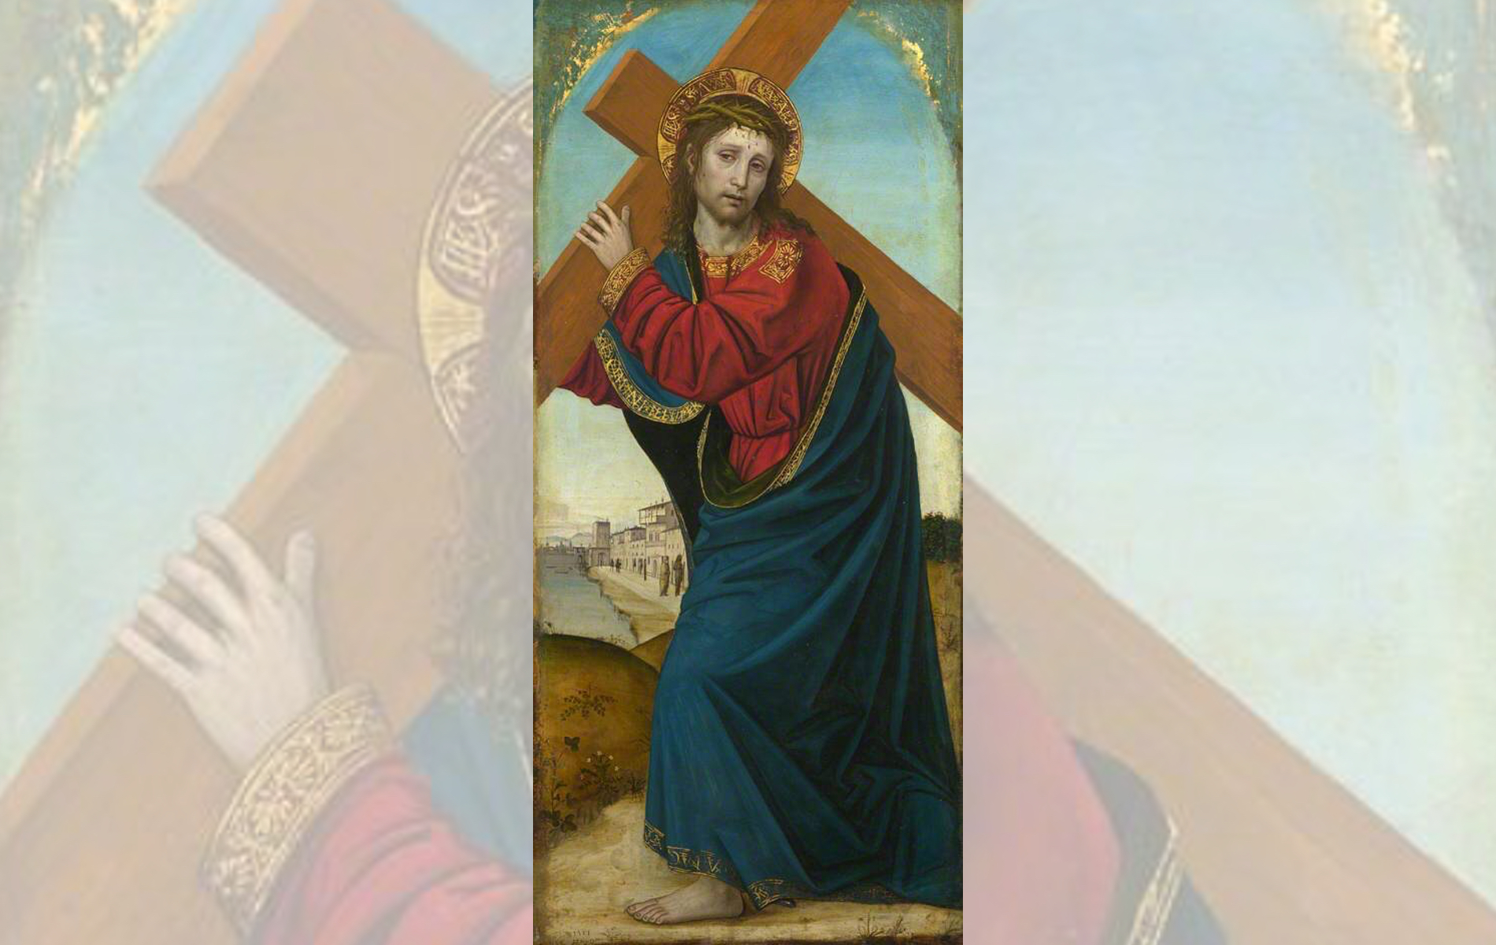
Title: Christ carrying the Cross
Artist: Ambrogio Bergognone
Year: 1501

Slide 19
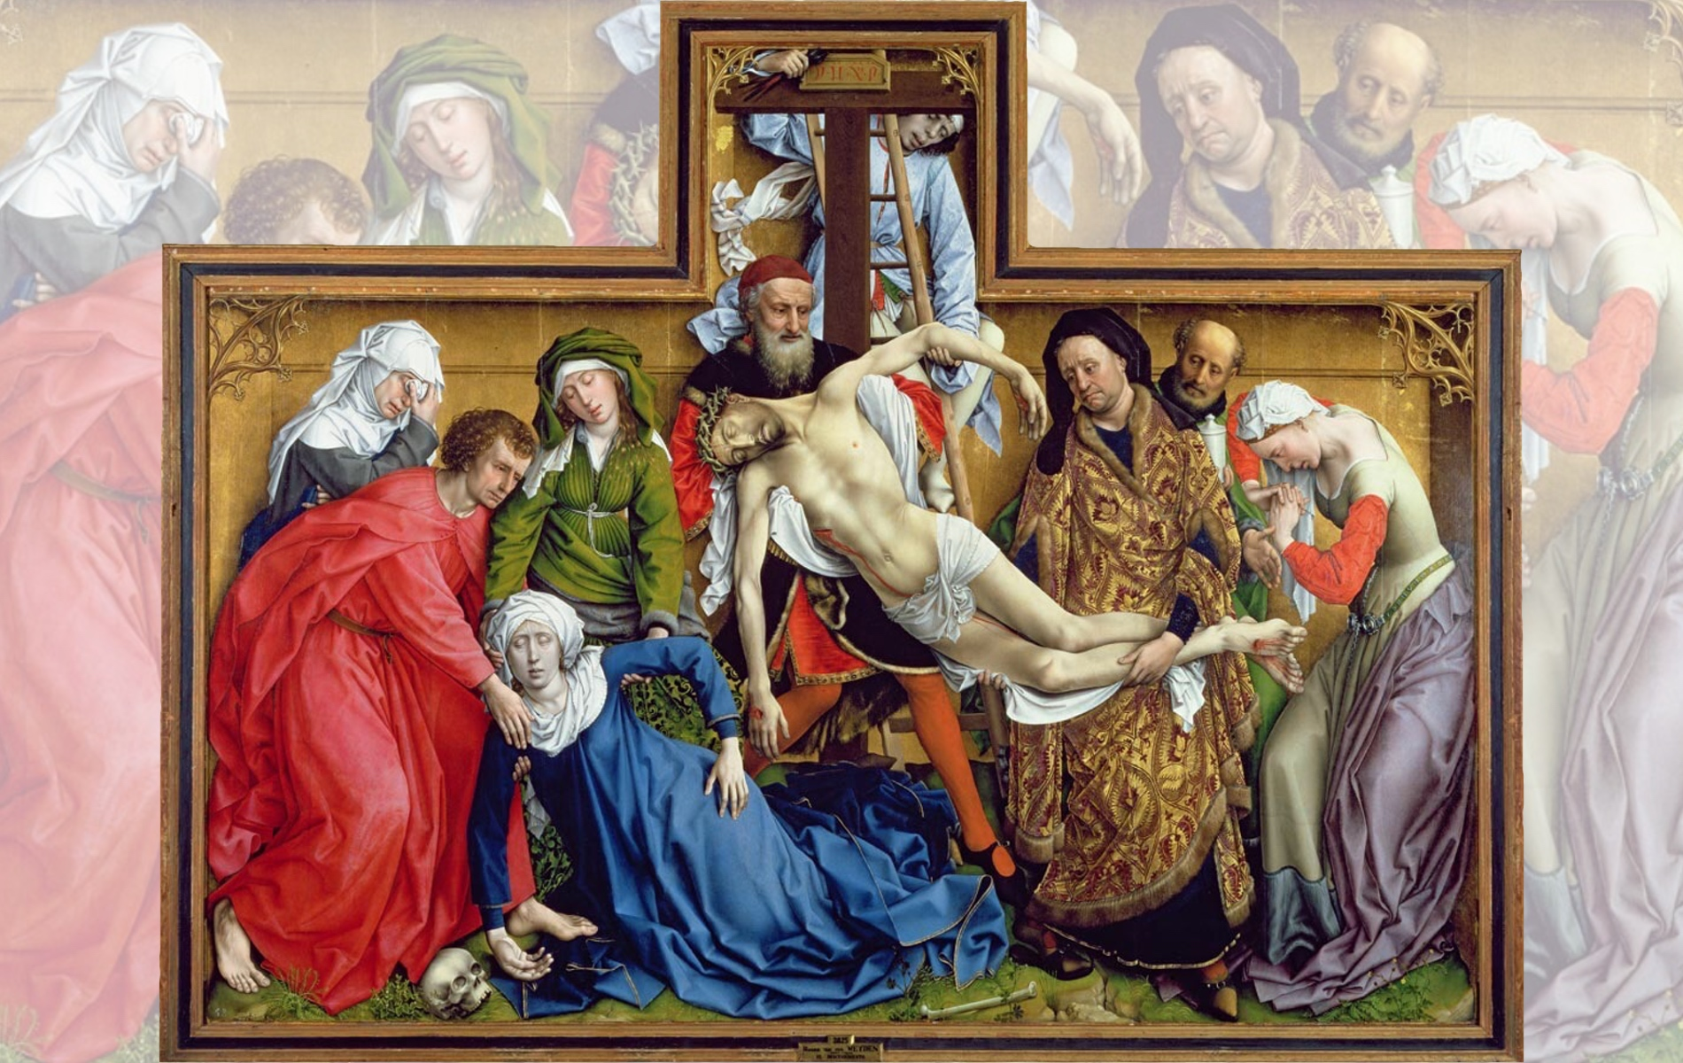
Title: Deposition (Descent from the Cross) — Artist: Rogier van der Weyden — Year: 1435

Slide 21
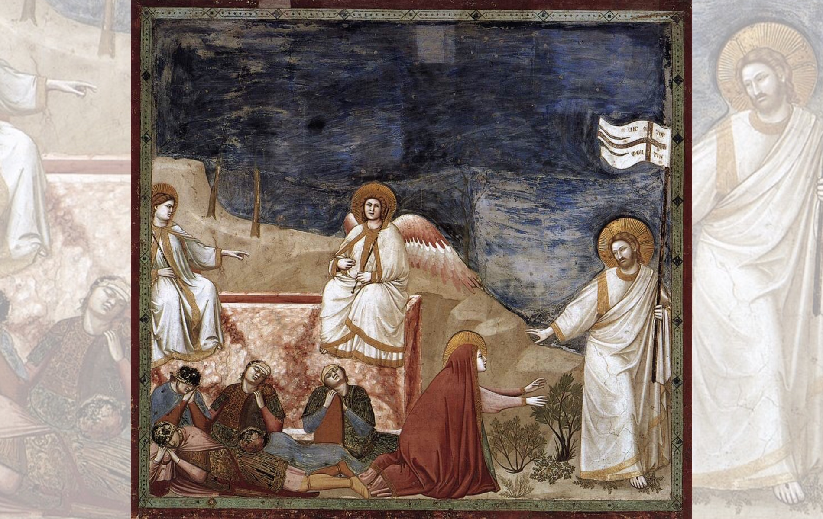
Title: Resurrection (Noli me tangere)
Artist: Giotto di Bondone
Year: 1304-1306

Slide 22
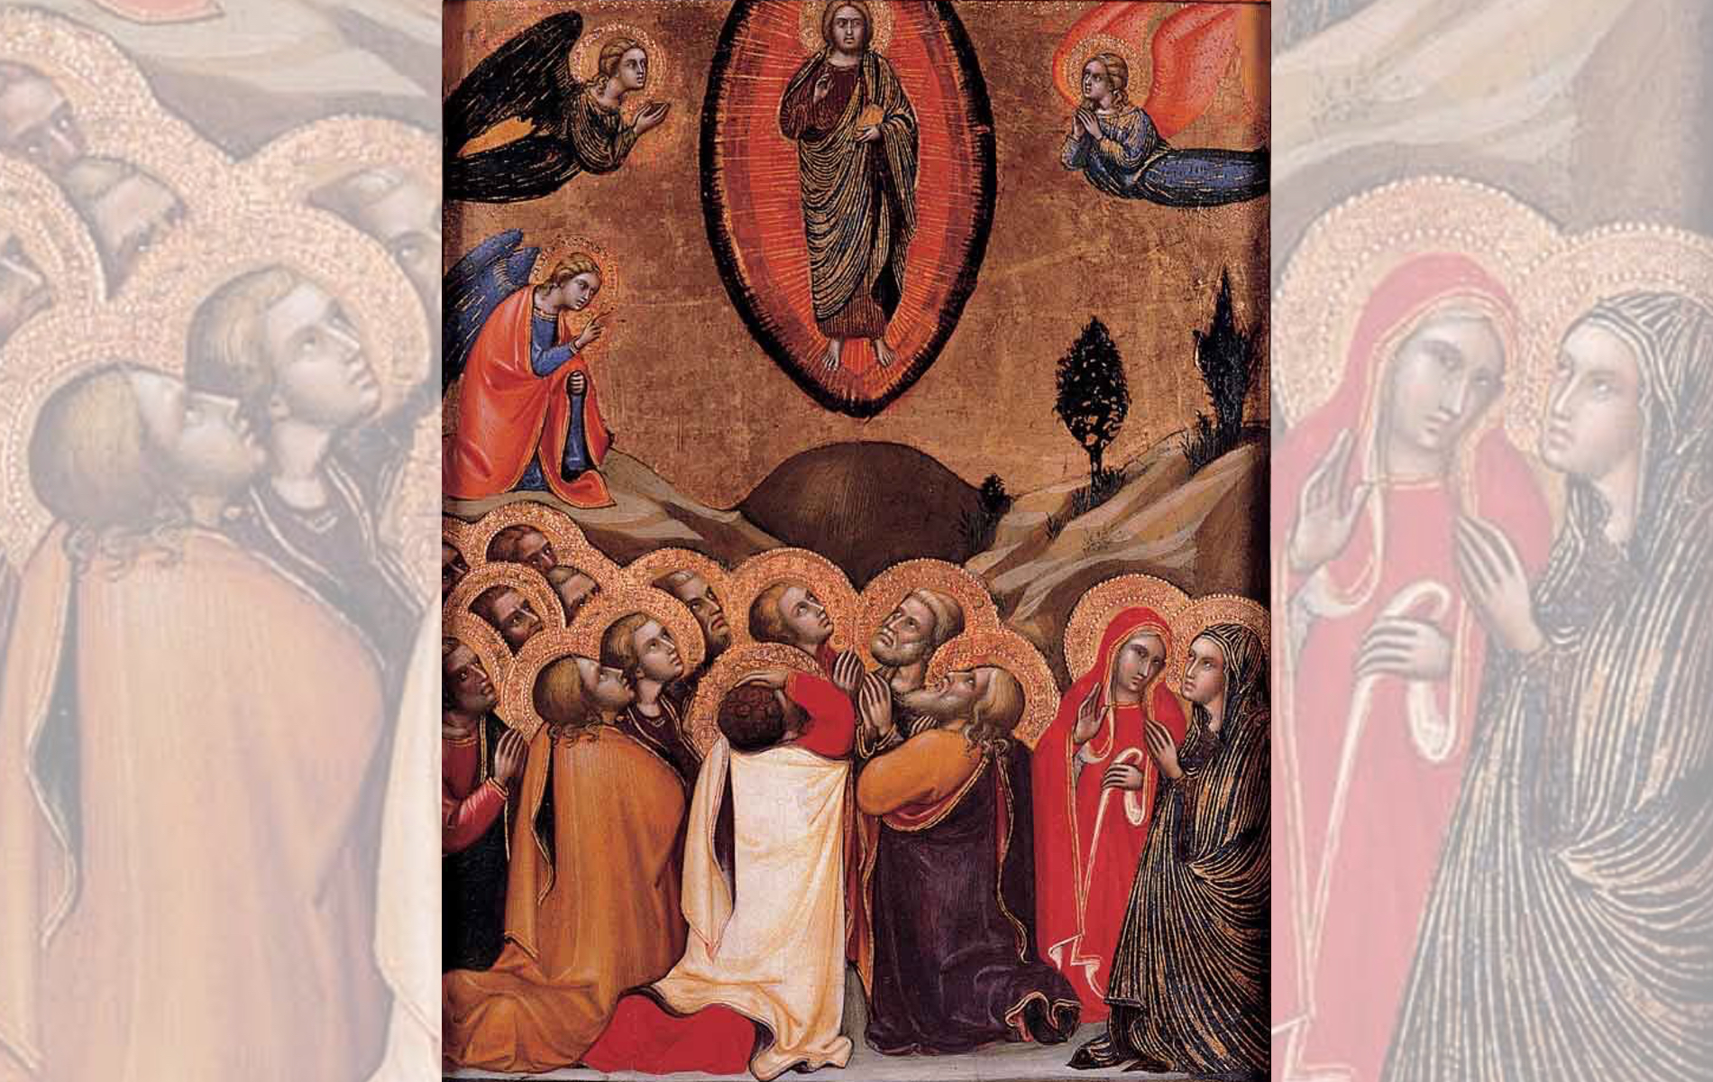
Title: The Ascension
Artist: Barnaba da Modena
Year: 1372-1374

Slide 23
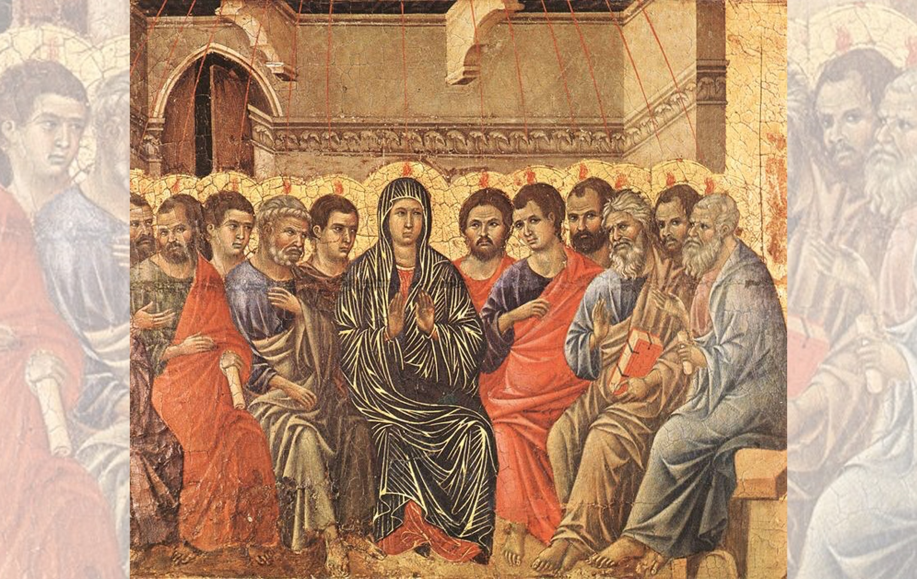
Title: Pentecost
Artist: Duccio di Buoninsegna
Year: 1308-1311
Title: Pentecost — Artist: Jean II Restout — Year: 1732

Slide 24
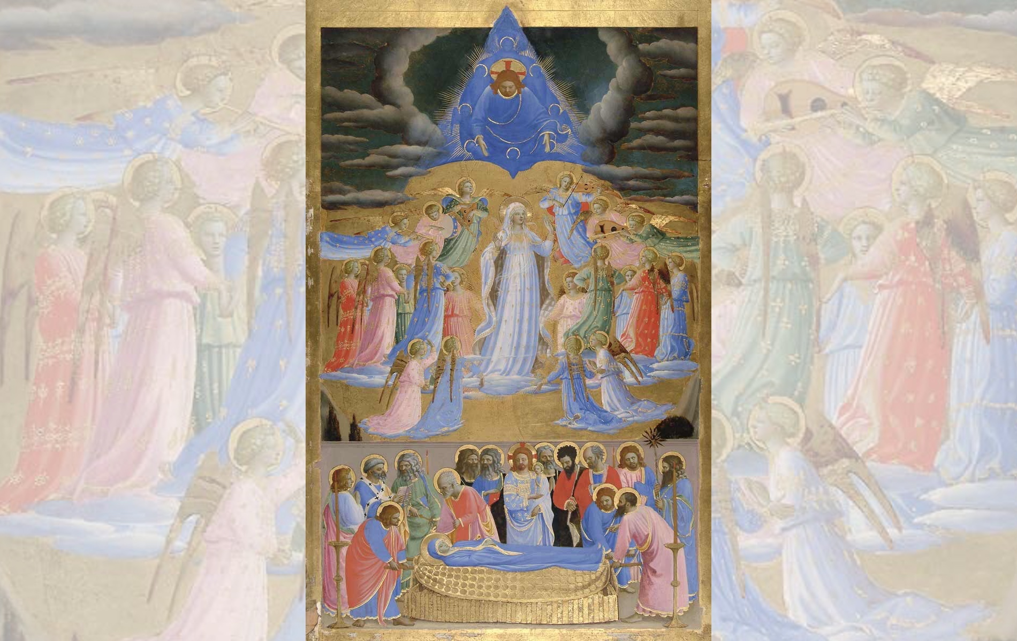
Title: The Death and Assumption of the Virgin
Artist: Fra Angelico
Year: c.1432

Slide 25
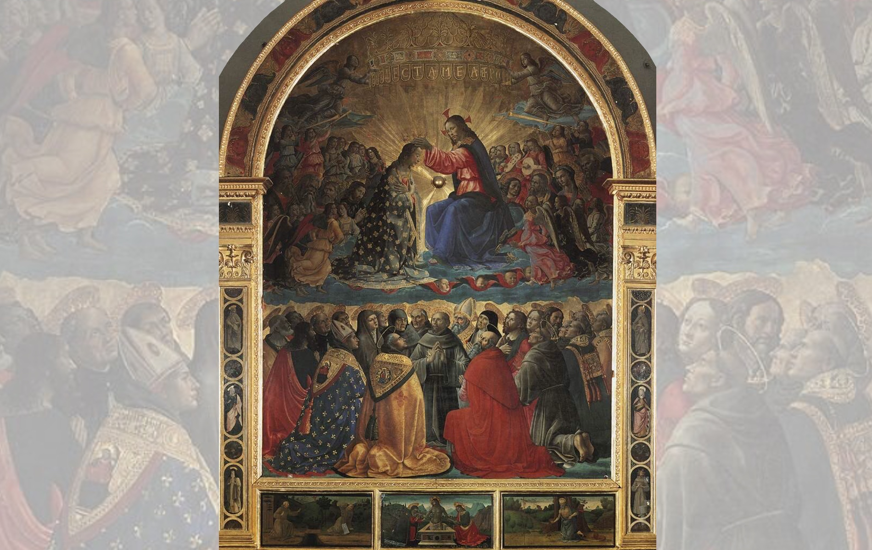
Title: Coronation of the Virgin
Artist: Domenico Ghirlandaio
Year: 1486

