Slide 3
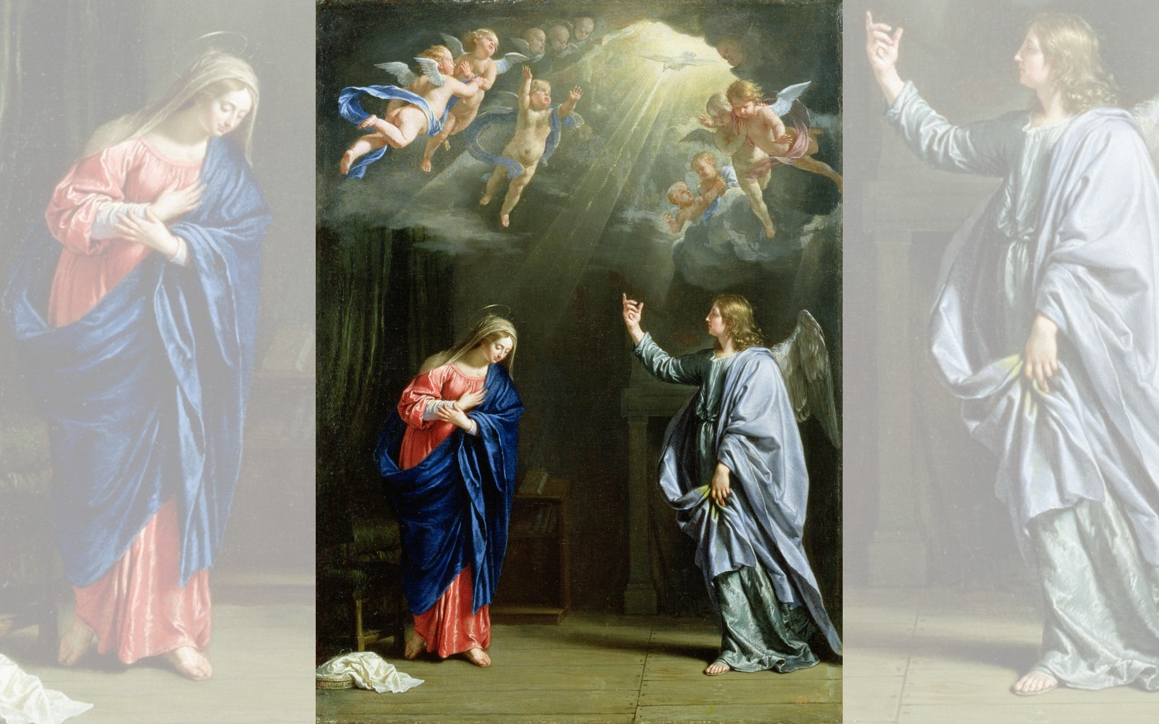
Title: Annunciation
Artist: Philippe de Champaigne
Year: 1644

Slide 4
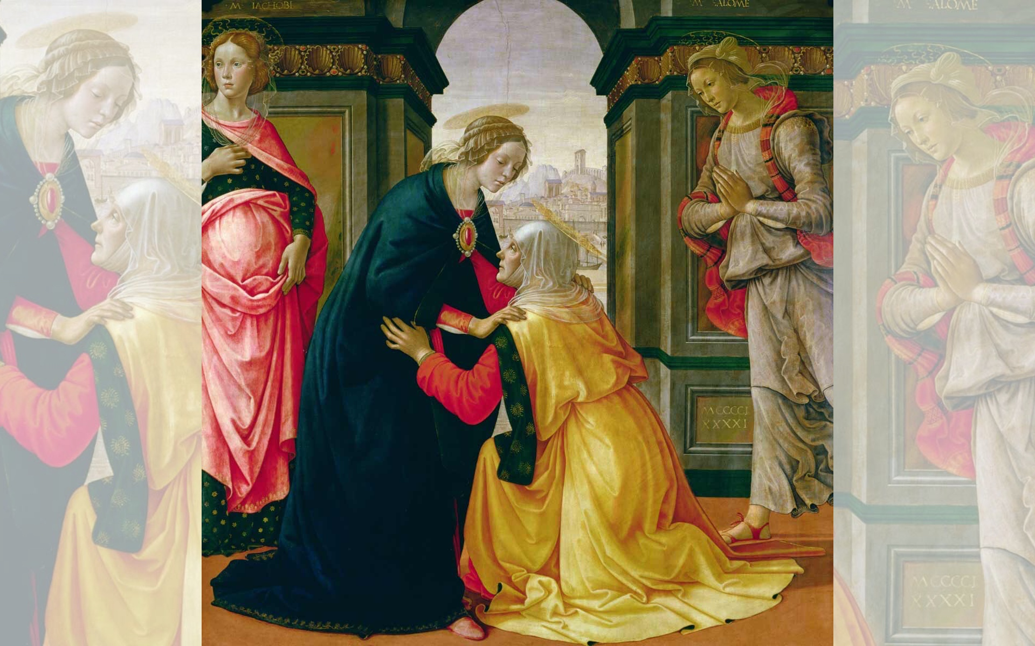
Title: The Visitation
Artist: Domenico Ghirlandaio
Year: 1491

Slide 5
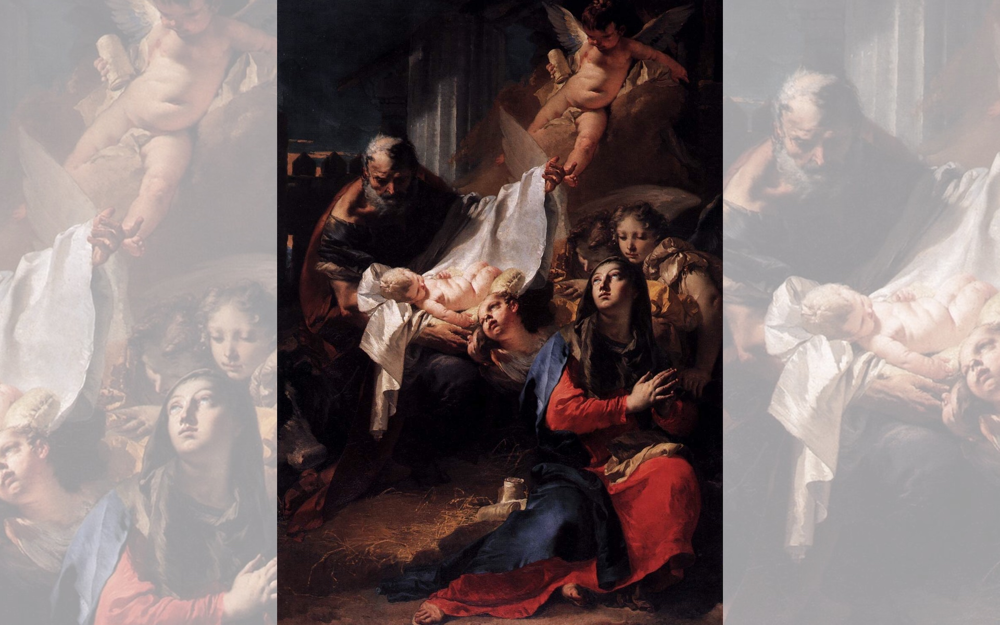
Title: Nativity
Artist: Giovanni Battista Tiepolo
Year: 1732

Slide 6
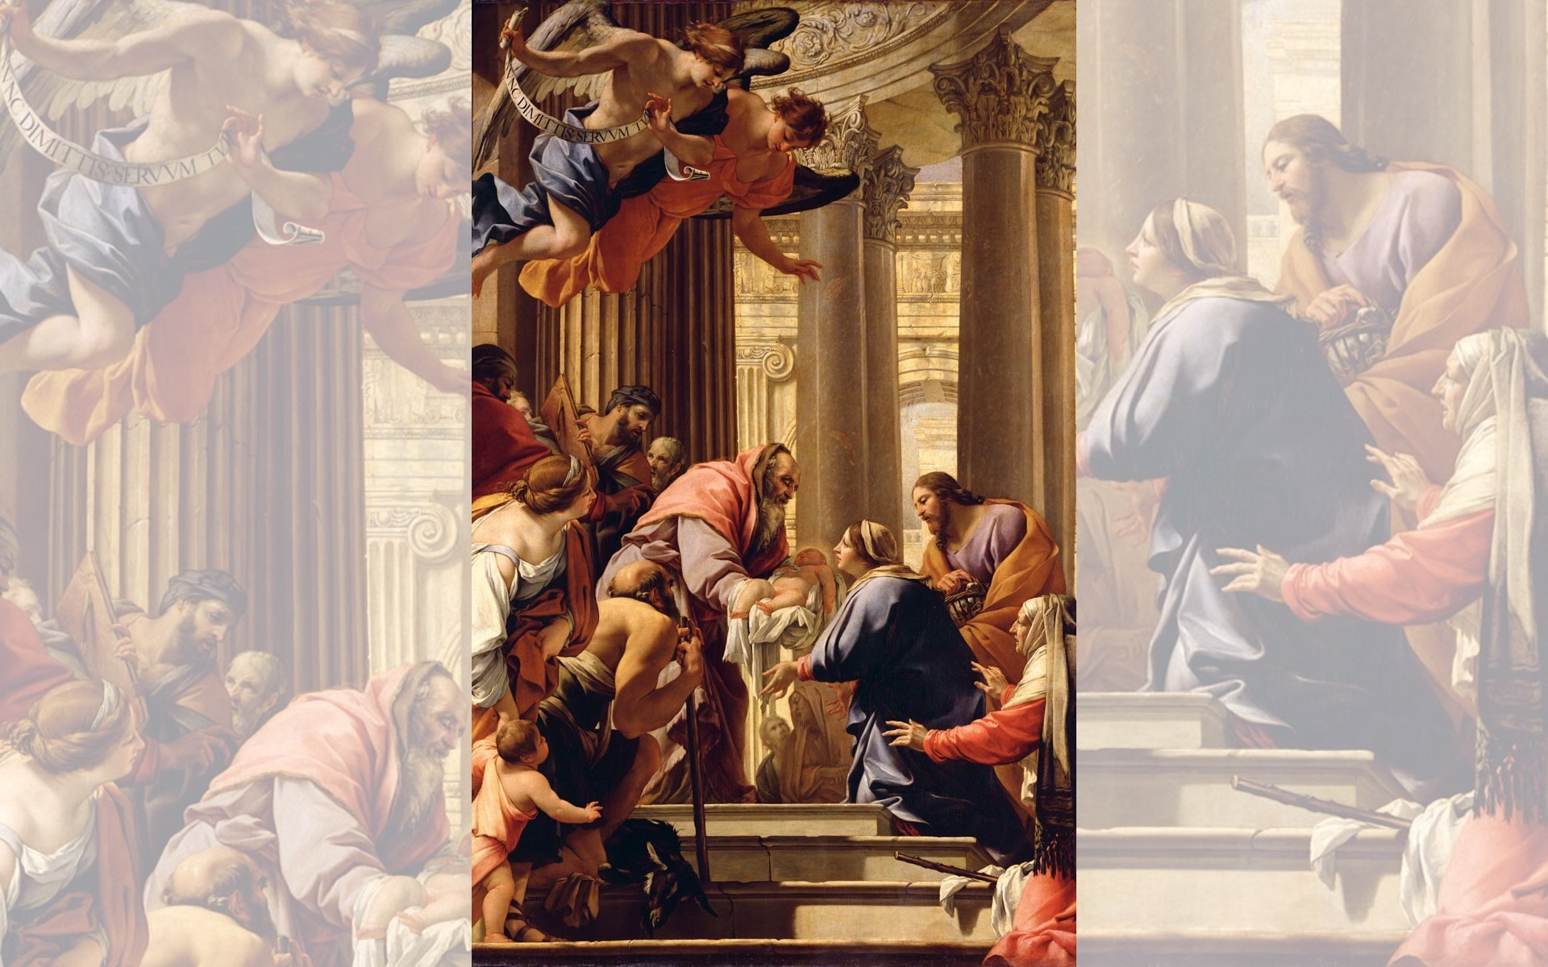
Title: Presentation in the Temple
Artist: Simon Vouet
Year: 1640-1641

Slide 7
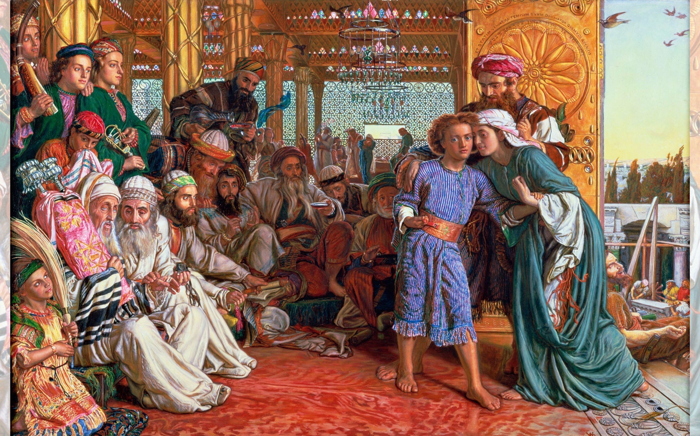
Title: The Finding of the Saviour in the Temple — Artist: William Holman Hunt — Year: 1860

Slide 9
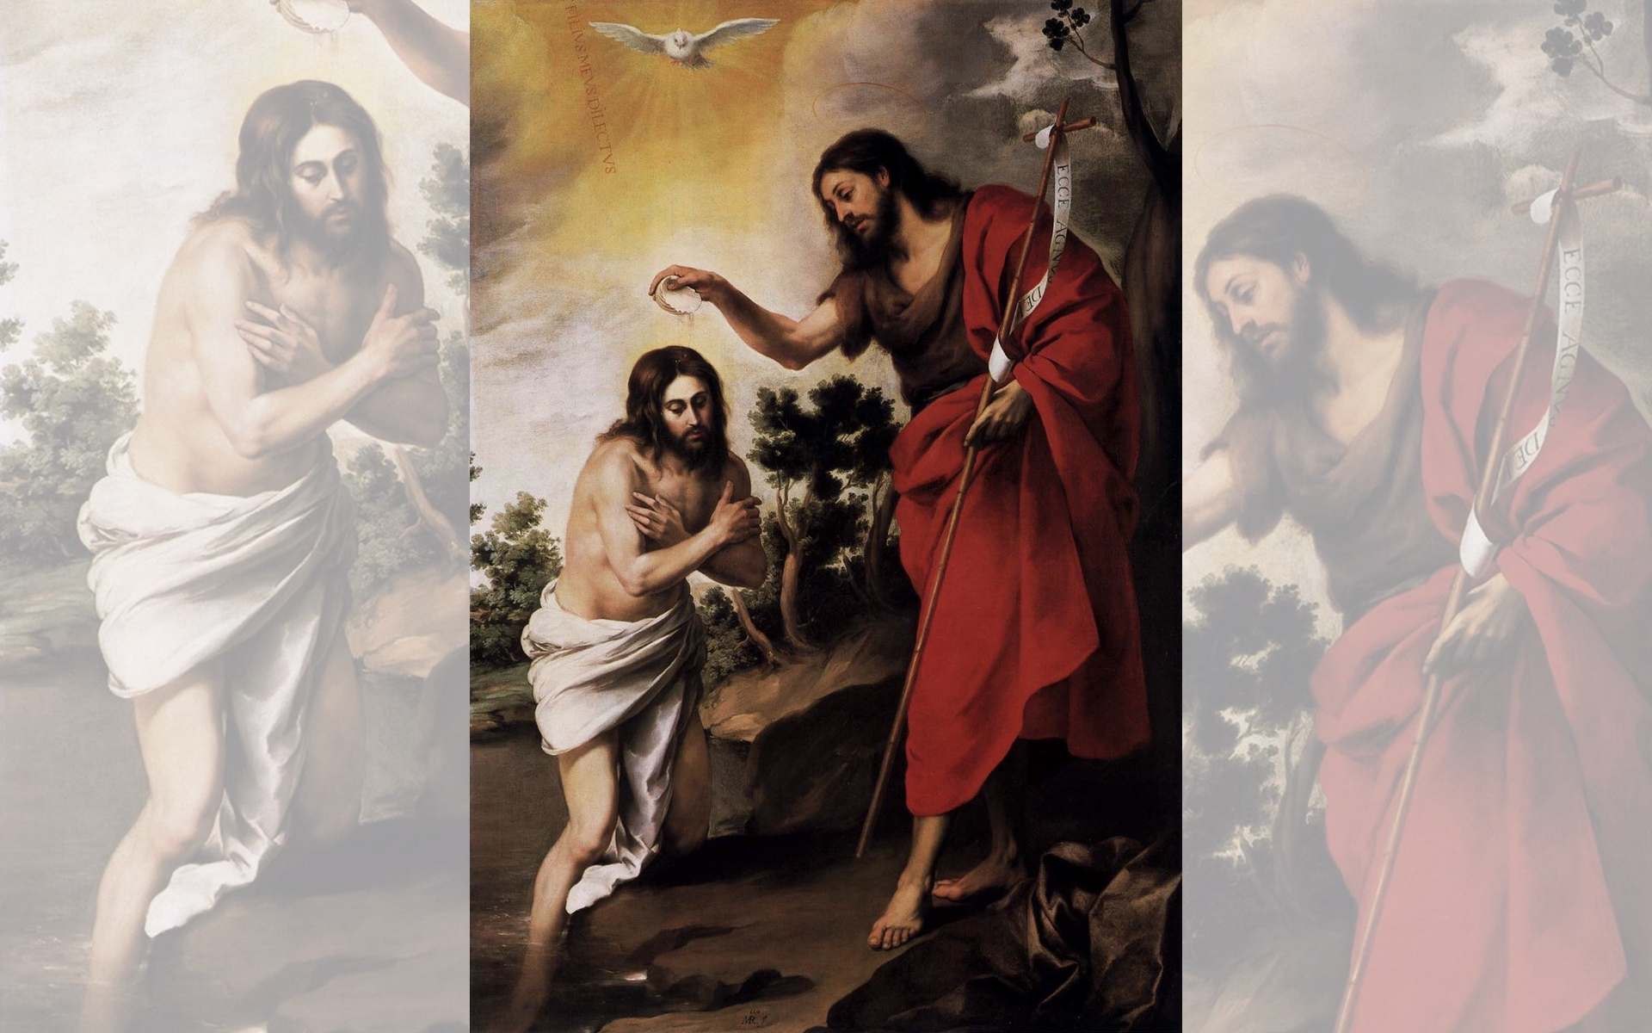
Title: Baptism of Christ
Artist: Bartolomé Esteban Murillo
Year: 1655

Slide 10
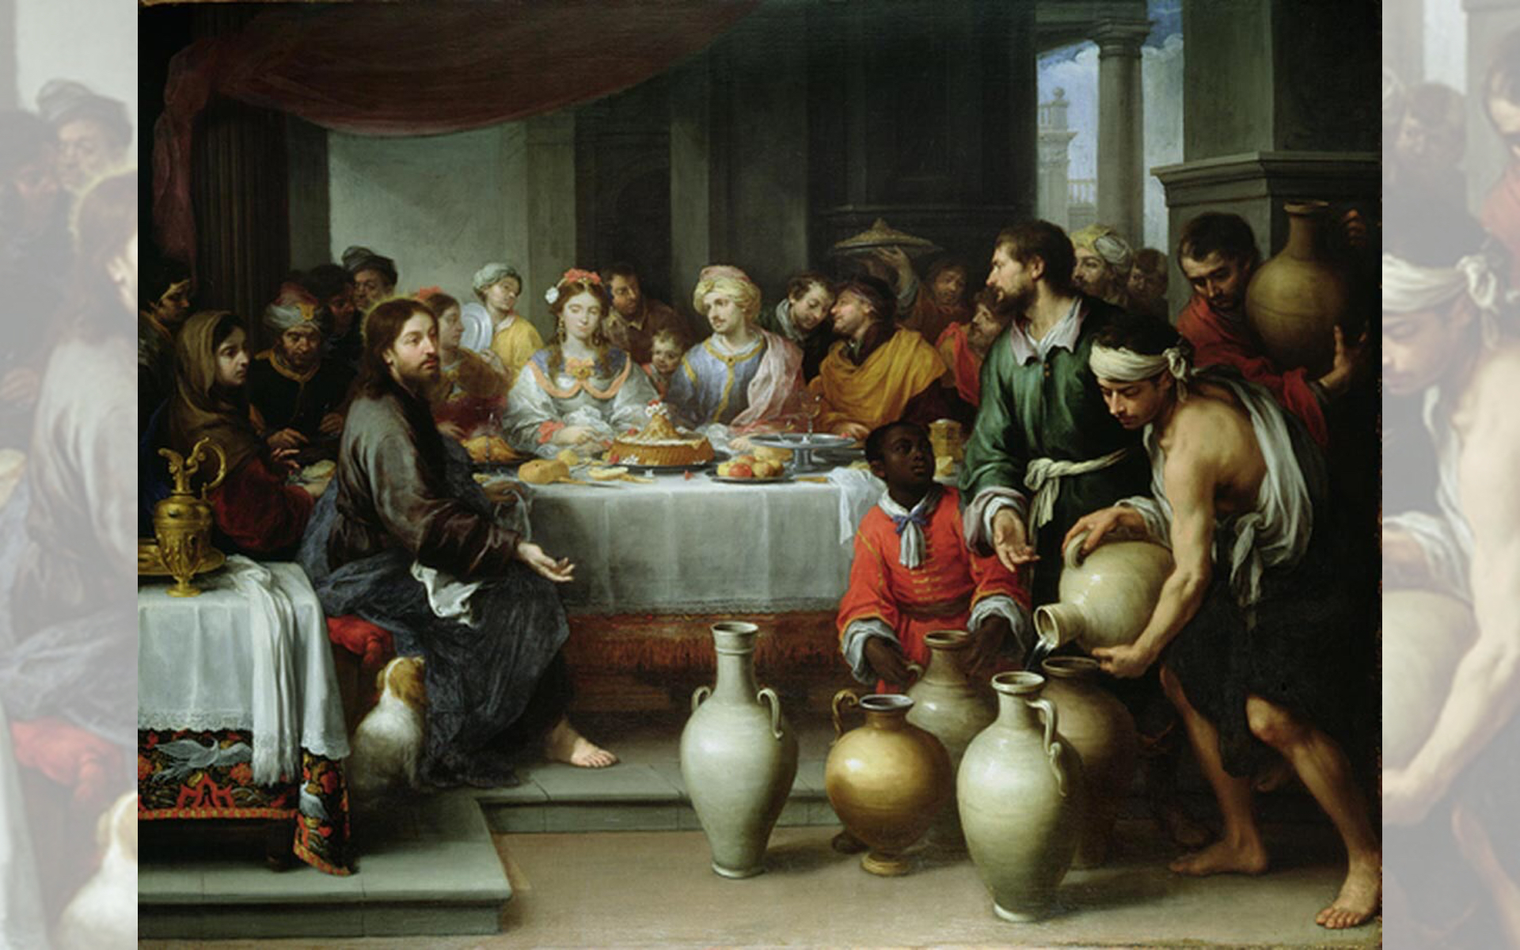
Title: The Marriage Feast at Cana — Bartolomé Esteban Murillo — c.1665-1675

Slide 11
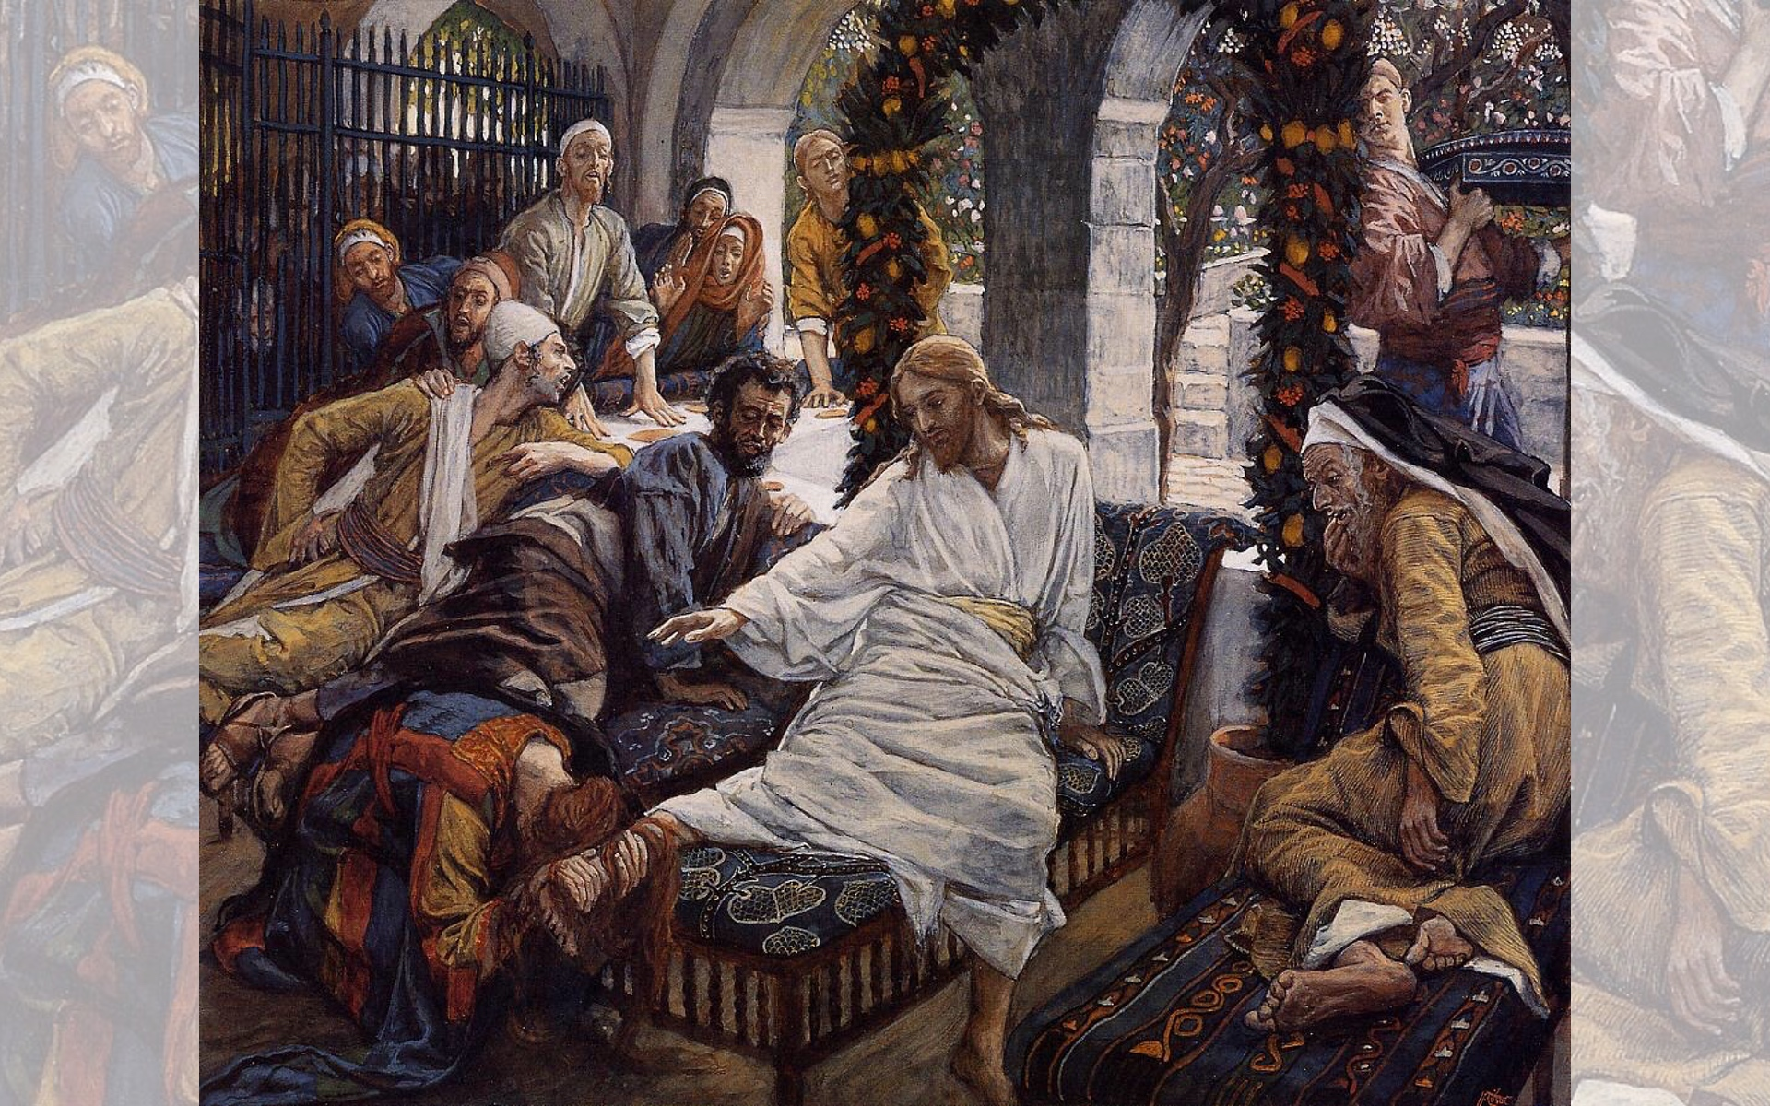
Title: Mary Magdalene's Box of Very Precious Ointment — Artist: James Tissot — Year: 1886

Slide 12
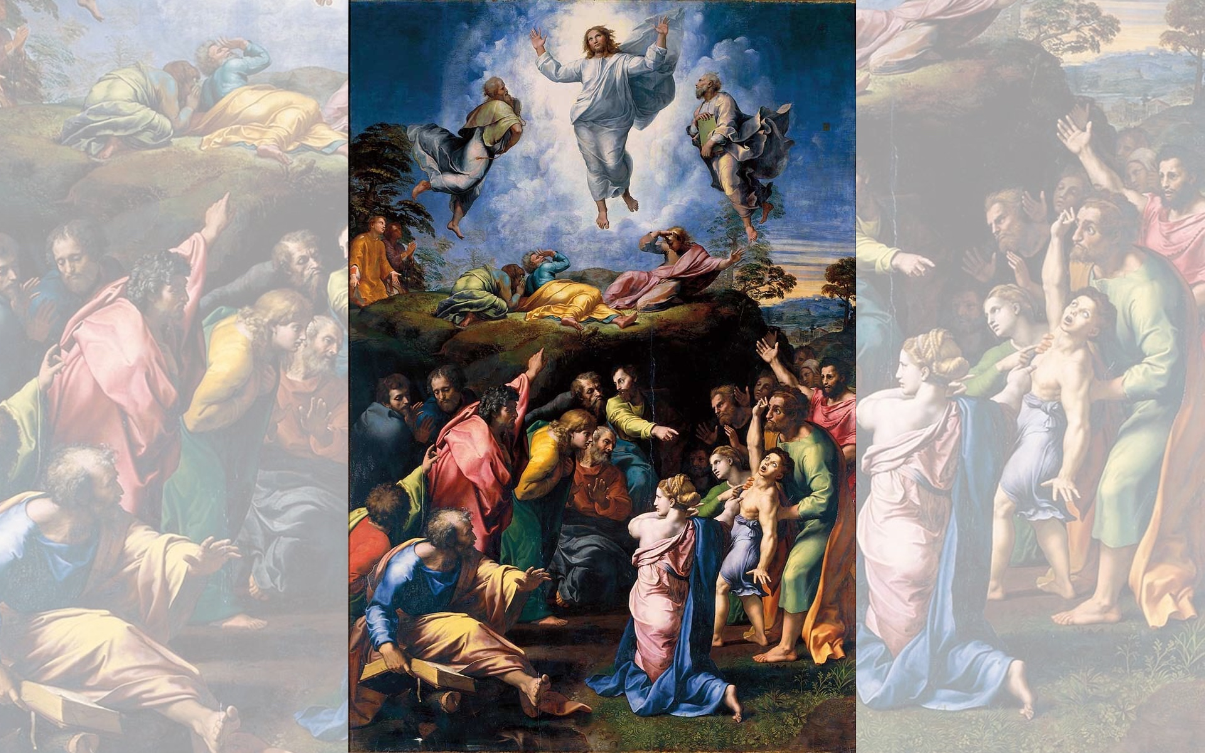
Title: The Transfiguration
Artist: Raphael
Year: 1518-1520

Slide 13
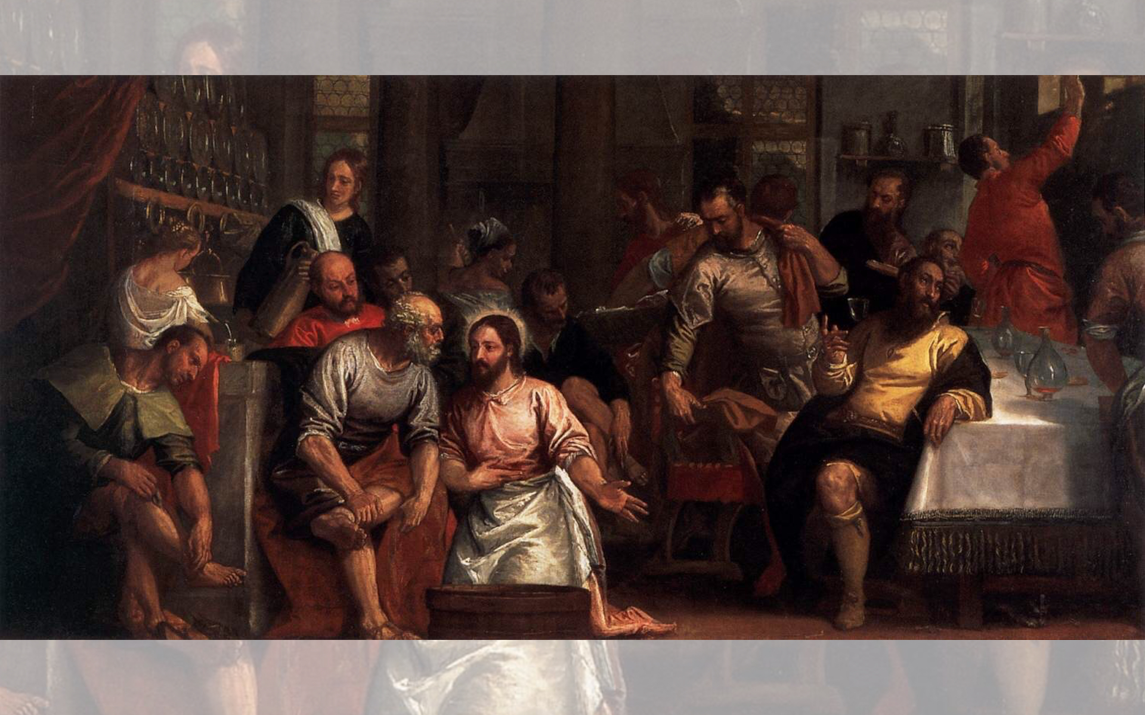
Title: Christ Washing the Feet of the Disciples
Artist: Paolo Veronese
Year: 1580s

Slide 15
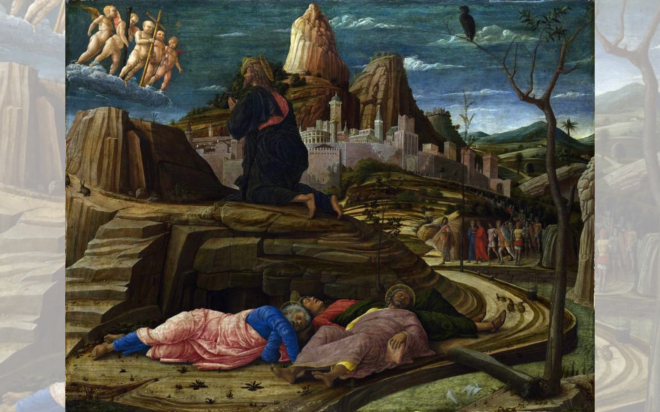
Title: Agony in the Garden
Artist: Andrea Mantegna
Year: 1459

Slide 16
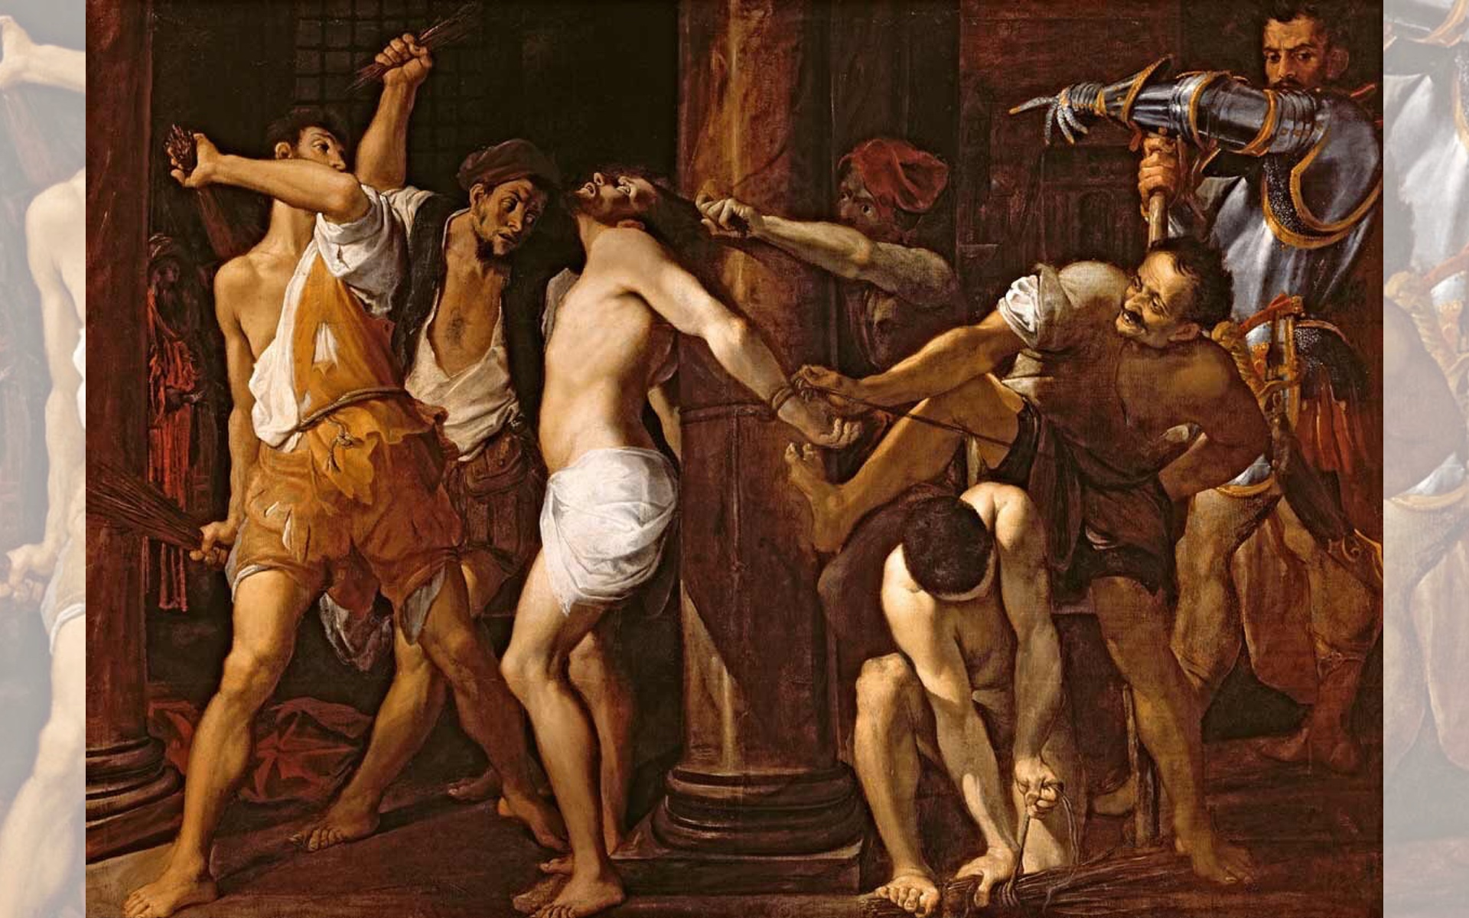
Title: The Flagellation of Christ — Artist: Lodovico Carracci — Year: 1586-1587

Slide 17
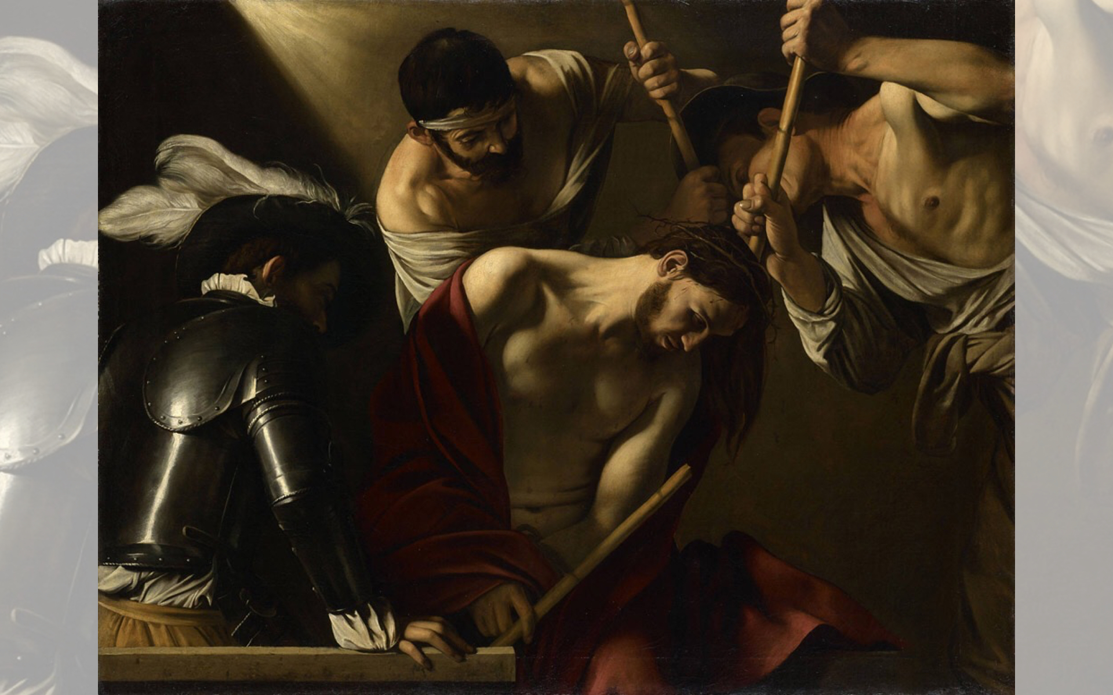
Title: The Crowning with Thorns
Artist: Caravaggio
Year: 1602-1605

Slide 18
Title: Christ Carrying the Cross,
Artist: Eustache Le Sueur
Year: c.1651

Slide 19
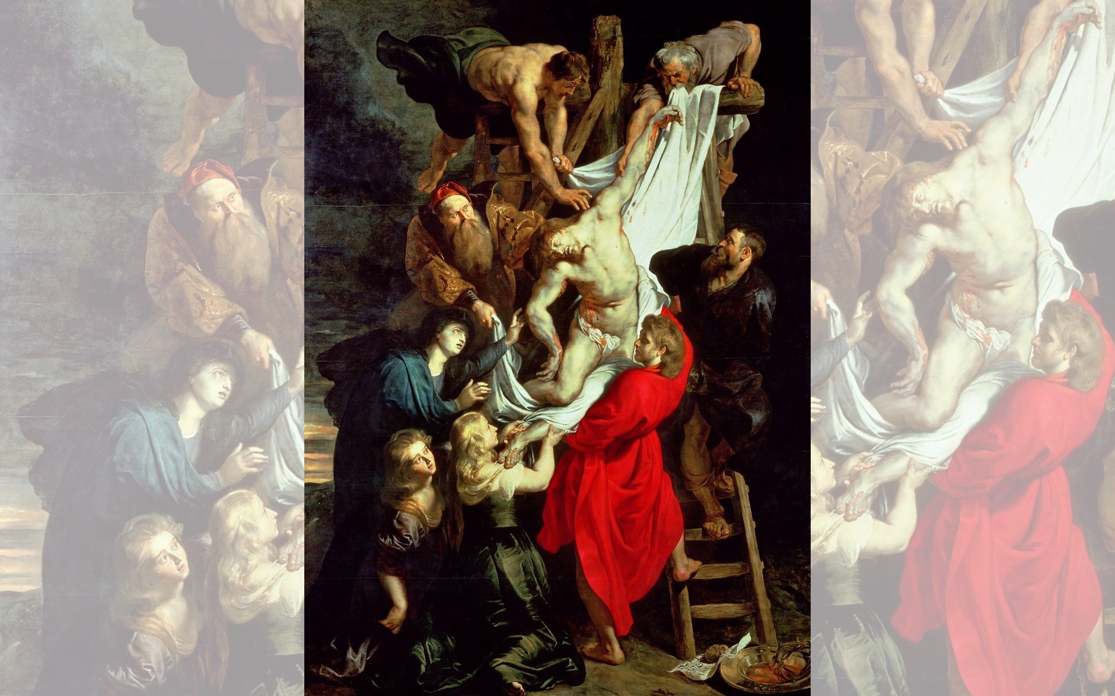
Title: Descent from the Cross (center panel)
Artist: Peter Paul Rubens
Year: 1612-1614

Slide 21
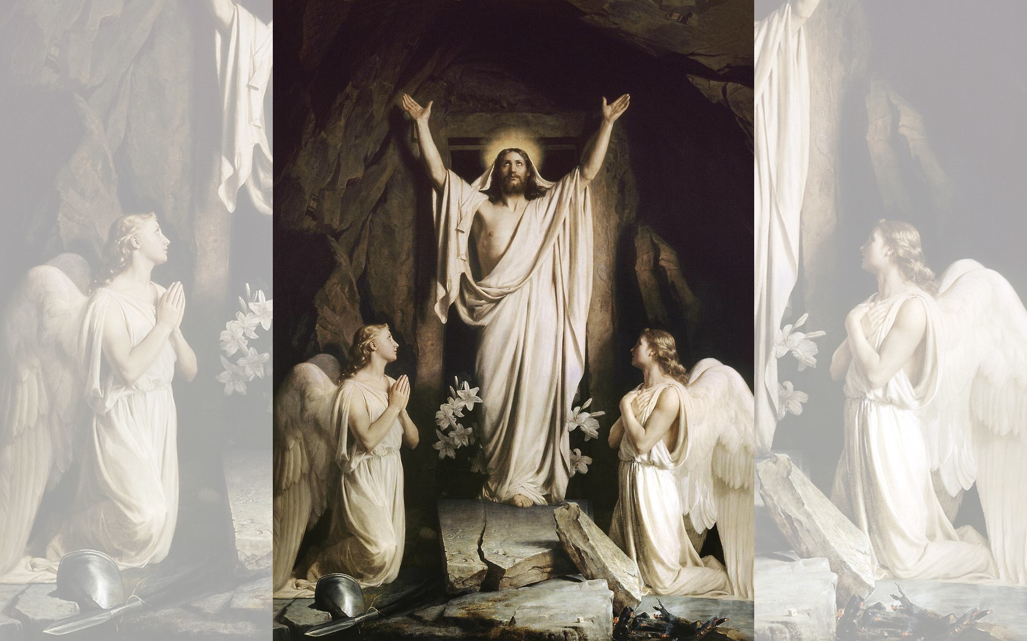
Title: The Resurrection
Artist: Carl Heinrich Bloch
Year: 1873

Slide 22
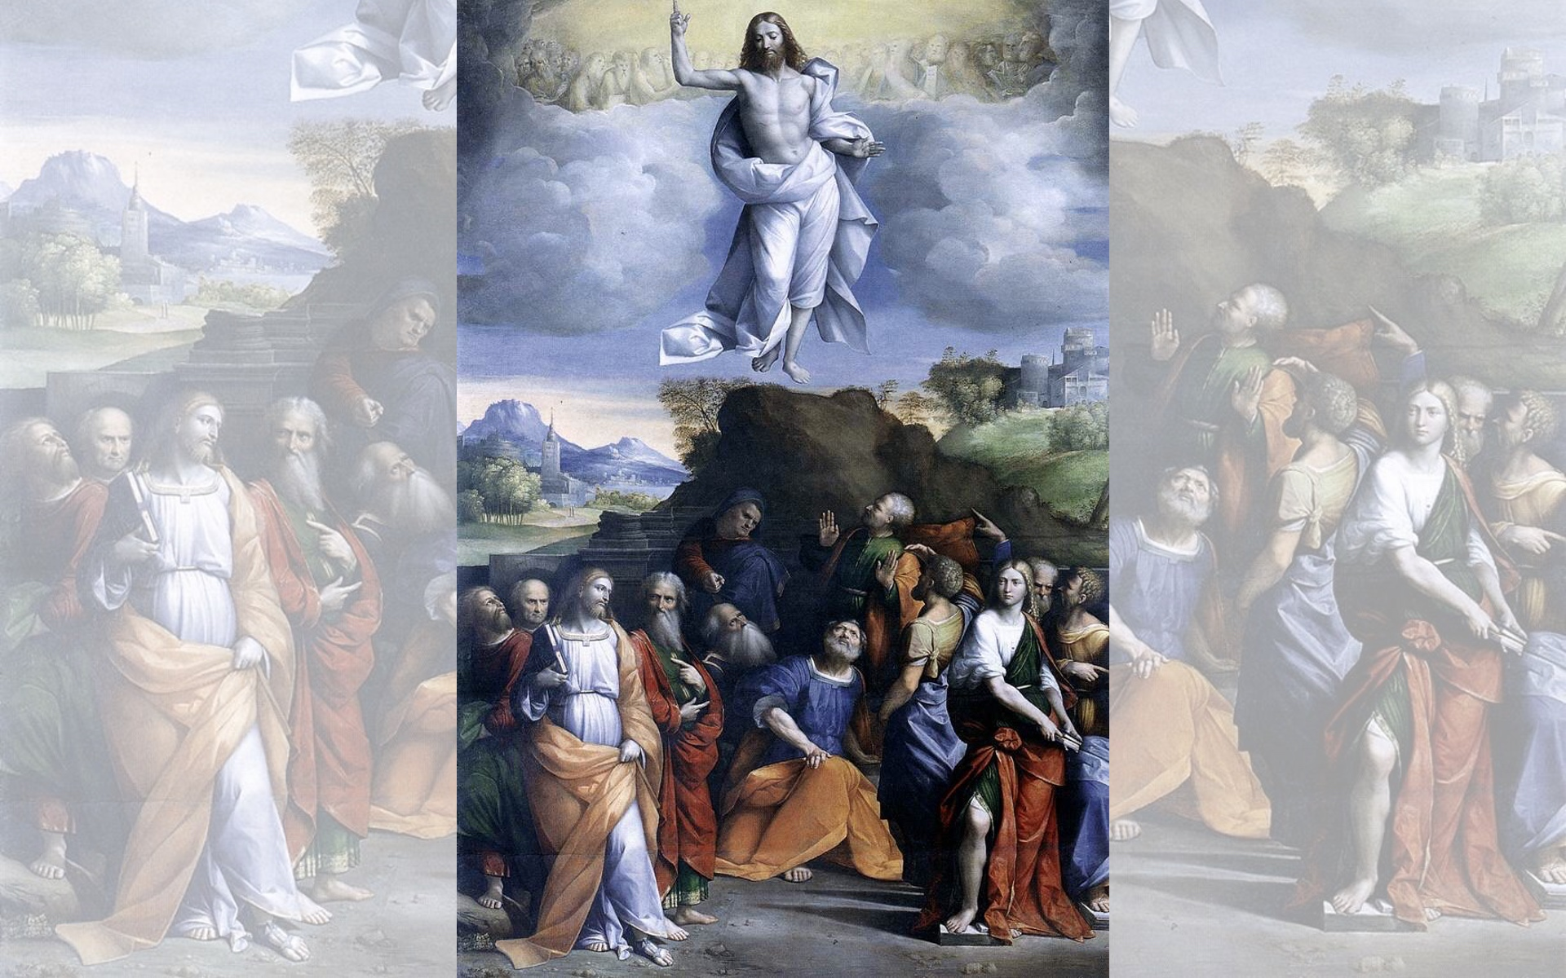
Title: The Ascension of Christ
Artist: Garofalo
Year: 1510-1520

Slide 23
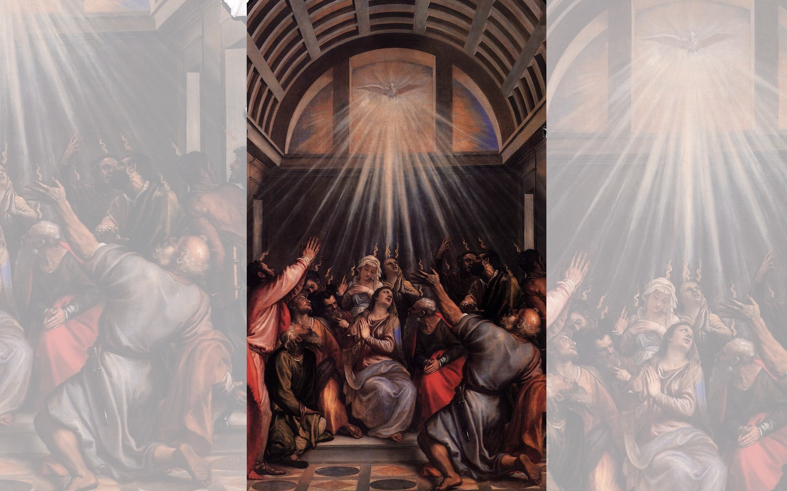
Title: The Descent of the Holy Ghost
Artist: Titian
Year: 1545
Title: Pentecost — Artist: Jean II Restout — Year: 1732

Slide 24
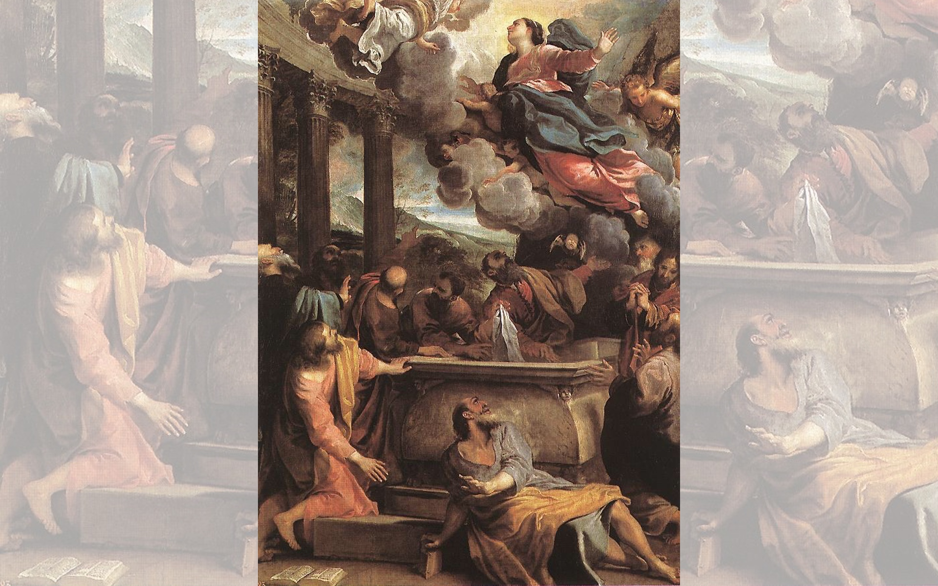
Title: Assumption of the Virgin
Artist: Annibale Carracci
Year: 1590

Slide 25
Title: Coronation of the Virgin,
Artist: Cima da Conegliano
Year: Date Unknown

